Slide 1
Electrical machines
3. Efficiency and motor selection

Slide 2
Practitioner guide
3. Efficiency and motor selection
2

Slide 3
Introduction and overview
3. Efficiency and motor selection | Practitioner guide
These resources help practitioners to deliver the electrical machines components of engineering and manufacturing-related qualifications at levels 2 and 3. They introduce the topic and stimulate learners to explore and reflect on key concepts, and are designed to complement and enhance practitioners’ own lesson materials and schemes of work.
Resources summary
Prerequisites – it is recommended that learners complete 1. Introducing electric motors and 2. Investigating torque, speed and current before starting this resource
Resource name | Level | PPT slides + notes - practitioner | PPT slides - learner | Activity sheets | Film | Interactive
3. Efficiency and motor selection | 3 |  |  | 2
Delivery
Delivery suggestions for practitioners, and suggested answers where appropriate, are in the presenter’s notes for each slide. The core activities in each resource provide around 60 mins of learning time, though additional suggestions, including independent learning, can extend this time significantly.
Overarching theme/big questions
How do we choose the right motor for the work we need to do?
Overview
The Level 2 resource introduces some basic classifications of DC and AC motors before exploring in simple terms what differences lead to their various characteristics and applications.
Level 3 resources introduce characteristic curves for DC series, shunt and compound motors, including for torque, current, speed and power. They continue with an exploration of power output and efficiency, and how this affects real-world performance. The importance of electric motor efficiency is considered in the wider context of sustainability.
3

Slide 4
Learning outcomes and resource links
3. Efficiency and motor selection | Practitioner guide
Level 3 resource 2
Efficiency and motor selection
Calculate the input power to an electric motor.
Interpret a motor data sheet graph, showing how power and efficiency vary with torque.
Select the most efficient motor for an engineering application.
List four engineering approaches that will help to reduce the global energy demand from electric motor-driven systems.
Full resource list available for the topic of Electrical machines:
1. Introducing electric motors (Level 2)
2. Investigating torque, speed and current (Level 3)
3. Efficiency and motor selection (Level 3)
Links to other supported topics
Renewable energy, Sustainability.
4

Slide 5
Subject coverage
3. Efficiency and motor selection | Practitioner guide
Electrical machines/Electric motors
Power consumption
Efficiency and energy losses
Efficiency v power characteristics
Interpreting DC motor data sheets
Selecting motors to suit the application
Maths
Making measurements
Working with formulas
Interpreting charts and tables
Including careers
Careers that use electric motor knowledge and understanding
5

Slide 6
Electrical machines
3. Efficiency and motor selection
6

Slide 7
Learning outcomes
3. Efficiency and motor selection
You will be able to:
Calculate the input power to an electric motor.
Interpret a motor data sheet graph, showing how power and efficiency vary with torque.
Select the most efficient motor for an engineering application.
List four engineering approaches that will help to reduce the global energy demand from electric motor-driven systems.
Image © This Is Engineering
7

Slide 8
Voltage, current and power in
3. Efficiency and motor selection
The total power consumed by an electrical device equals the voltage multiplied by the current:
P = VI
Electrical power in:
P = VI
1. An electric vehicle motor has an input voltage of 132 V and a power input of 112.2 kW. What input current should the connecting cables be able to safely deliver?
2. A cordless impact driver motor running at maximum power draws 42.39 A and has an input power of 763.02 W. What is the voltage of the impact driver’s battery pack?
3. The spindle motor on a bench-top CNC mill draws 2.8 A at 230 V DC. What power does it draw?
I
Mechanical
power out:
P = 𝞽2πN
60
V
8
Notes:
Practitioner delivery notes
This resource reviews P = VI before helping learners to consider the efficiency of DC electric motors and how this varies with torque. Learners briefly consider the sources of losses in an electric motor before investigating how motor data sheets help engineers to make informed choices when selecting an electric motor for an application. Learners can consider how optimum efficiency provides benefits for employers, employees and the environment.
Learners will optionally need internet access to use the Electrical machines interactive tool.
Activity
Remind learners that a motor converts electrical energy into useful work and help them to recall that power is the amount of energy transferred per second.
This useful work is given by the formula for mechanical power out, which learners explored in the previous Electrical machines resource 2. Investigating torque, speed and current.
Ensure learners remember that the unit of power is the Watt, equal to one Joule of energy per second.
Discuss the three engineering scenarios on the slide.
Learners use P = VI to complete the three calculations on the activity sheet.
Activity sheet
Learners complete their answers on Electrical machines - Activity sheet: section 5a.
Example answers
Please see the next slide.
Assessment
Written work.
Discussion of the three scenarios.

Slide 9
Voltage, current and power in – answers
3. Efficiency and motor selection
= 112,200 W.
1. 112.2 kW
112,200/132 V
2. 763.02 W/42.39 A
3. 230 V x 2.8 A
= 850 A through the cables.
= 18 V battery pack.
= 644 W spindle motor.
Discuss what engineering issues the current demands of each motor might raise.
9
Notes:
Practitioner delivery notes
Activity
Review the calculations on the slide.
Learners consider what other engineering issue the answers might suggest.
Example answers
The current in the first two scenarios raises important safety considerations that would need an engineer to ensure that cables are of a sufficient cross-sectional area to avoid overheating, and are sufficiently insulated and isolated to protect users.
Assessment
Discussion and verbal suggestions.
Extension
Learners could investigate cabling and cooling in electric vehicle (EV) powertrain systems and dismantle an old brushless, cordless drill.

Slide 10
Investigating efficiency
3. Efficiency and motor selection
Efficiency η = Power out
Power in
The Electrical machines interactive tool readings of mechanical and electrical power provide the data needed to plot efficiency against torque:
Efficiency (%) v Torque (Nm)
100%
The interactive tool does not allow you to set the radius, mass, and therefore the torque, to zero.
What does the graph predict about the motor’s efficiency when the torque is zero?
Do you think this makes sense? What do you think happens in reality?
75%
Efficiency (%)
50%
25%
0%
0
0.25
0.50
0.75
1.00
Torque (Nm)
10
Notes:
Practitioner delivery notes
Learners can optionally use the Electrical machines interactive tool for which they will need internet access. If so, learners could optionally record their results in a spreadsheet and generate graphs. However, the slide shows an example chart of efficiency for different values of torque.
Note that the model for the motor in the interactive tool has zero no-load current - it is an ‘ideal’ motor. A small no-load current would have the effect of adding a slight upwards curvature to the slope of the efficiency graph, similar to that which learners will see later in this resource when they interpret real data sheets.
Before presenting this slide you may wish to see if learners can remember the basic efficiency formula from their prior Level 2 science learning.
Activity
Review the efficiency formula. (η, Eta, is pronounced ‘eeta’.) Note to learners that the result of this will be between zero and 1 and is expressed as a percentage.
Review the example efficiency graph produced using the Electrical machines interactive tool.
Ask learners to describe the relationship between efficiency and torque within the range on the graph.
Highlight that the interactive tool sets minimum values for r and m and so is unable to set the torque to zero. Discuss the two questions on the slide to consider how the torque graph might extrapolate below the interactive’s minimum torque value of 0.1 Nm. What do learners expect to happen to efficiency? Do learners think this makes sense?
Example answers
Within the range on the graph the efficiency is inversely proportional to the torque. It is a linear relationship.
Please also see the next slide.
Assessment
Discussion and verbal answers.
Ability to reflect on the implications of efficiency tending to 100% as torque tends to zero.
Extension
Learners can generate a similar graph themselves, choosing values of r and m to provide a range of torque from 0.1 Nm to 1.0 Nm.
Vary the mass and radius to set the torque between 0.1 and 1.0 Nm. Record the electrical power and mechanical power for each value of torque.
Use your results to calculate the efficiency for each value of torque.

Slide 11
Investigating efficiency – answers
3. Efficiency and motor selection
Efficiency (%) v Torque (Nm)
When choosing the right motor for an application, engineers need to consider the load, torque, maximum power output and maximum efficiency.
The best motor will be the compromise that best suits the desired performance of the motor-driven system.
100%
Below limit of interactive
75%
Efficiency (%)
50%
25%
When is maximum efficiency achieved v torque on this graph?
Maximum power is achieved at around 50% of maximum torque. What implications does this have when selecting a motor?
Why might an engineer choose to use a motor running at a higher speed, linked to a gearbox that provides lower speed and more torque?
0%
0
0.25
0.50
0.75
1.00
Torque (Nm)
It does not make sense for efficiency to be a maximum when the torque (mechanical output) of the motor is zero.
Below maximum efficiency the efficiency rapidly drops to zero when the torque is zero.
11
Notes:
Practitioner delivery notes
Learners will need to recall their learning from the previous Level 3 resource in Electrical machines (2. Investigating torque, speed and current), that peak power occurs at around 50% of maximum torque, and hence at about 50% of maximum mechanical output.
Activity
Review the graph on the slide, which shows how efficiency drops off rapidly (red) below the lower limit of torque in the interactive tool.
Ask learners to estimate the torque when the motor is at peak efficiency.
Highlight that this is not universal. While the efficiency curve for any DC motor is a similar shape, the point of peak efficiency will vary, usually between about 0.1 to 0.3 of maximum torque. When torque is higher than at peak efficiency, the relationship is approximately inversely proportional and this part of the graph will be approximately linear as shown. (Learners will explore real-world data charts in a later activity.)
Discuss the questions on the slide.
Activity sheet
Learners write answers to the questions on Electrical machines - Activity sheet: section 5b.
Example answers
The motor’s peak efficiency occurs at a torque of around 0.09 Nm.
Please also see the next slide.
Assessment
Predictions of efficiency below the range of the interactive.
Discussion and verbal answers.
Written answers to the slide questions.
Extension
Learners can investigate DC motor data tables to find the peak efficiency of different motors and express the torque at this point as a percentage of the motor’s maximum torque.

Slide 12
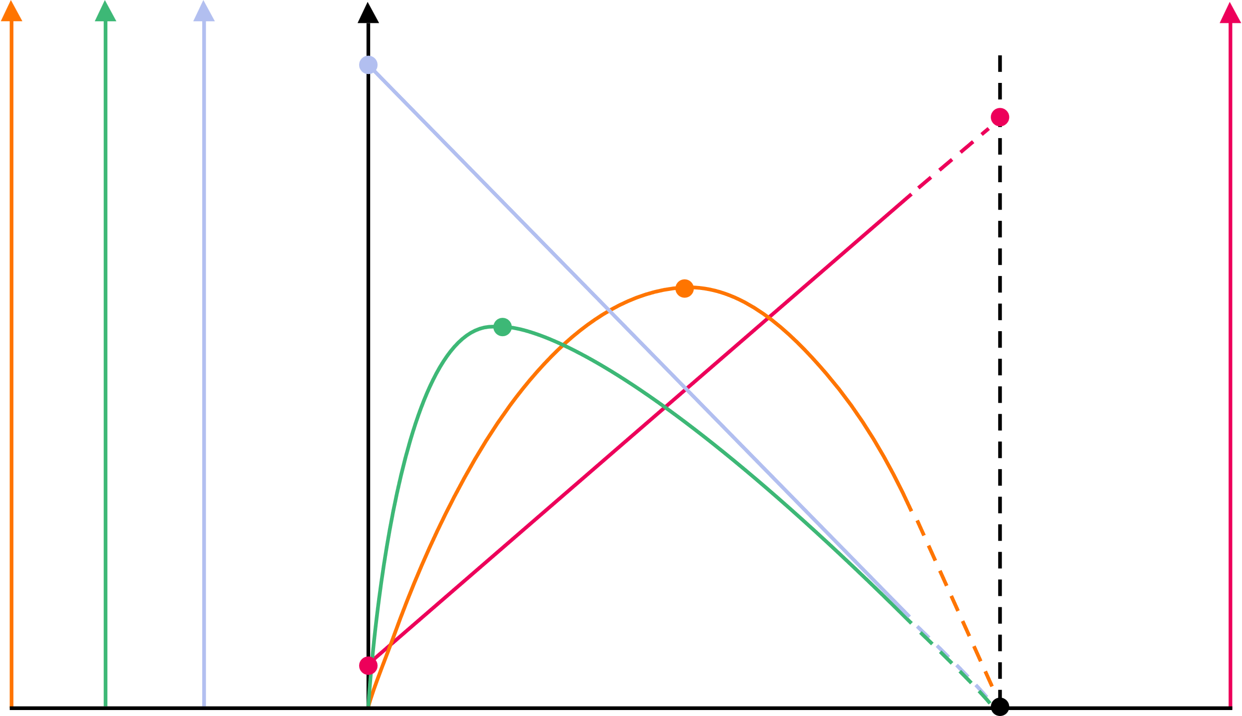
Selecting electric motors
3. Efficiency and motor selection
Maximum power occurs at around 50% of maximum torque. When choosing a motor it is most common to prioritise maximum efficiency.
An engineer might choose a larger motor running at less than maximum power, but at close to maximum efficiency.
The motor’s free-run speed is higher at this point.
This explains why motors will often drive a gearbox to provide lower speed and higher torque.
stall current
Electric motor manufacturers provide a standard data chart showing how current, speed, power and efficiency vary with torque.
Note the different Y-axis scales for each characteristic.
An engineer can use the data chart to identify a motor’s efficiency at different torque, power or speed requirements.
free-run speed
max. efficiency
max. power
Power (W)
Speed (RPM)
Current (A)
Efficiency (%)
Stall torque (theoretical)
free-run current
Torque
12
Notes:
Practitioner delivery notes
Activity
Review the answers at the top of the slide and use the example data chart to illustrate the ideas.
Highlight the use of a separate y-axis scale for each characteristic and note that different manufacturers may organise the scales differently on each side of the chart.
Learners may note a small current at zero torque - this is known as the ‘no-load current’ or ‘free-run current’. This is the current required to overcome friction from the bearings and brushes, along with aerodynamic drag caused by the rotor and any cooling fins moving in the air as the motor spins with no load, resistive losses in the coils and induced currents in the cores (the penultimate slide in this resource illustrates these losses in a Sankey diagram).
Review the task on the next slide.

Slide 13
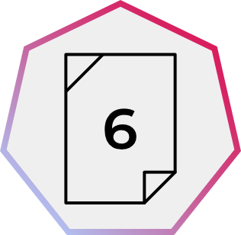
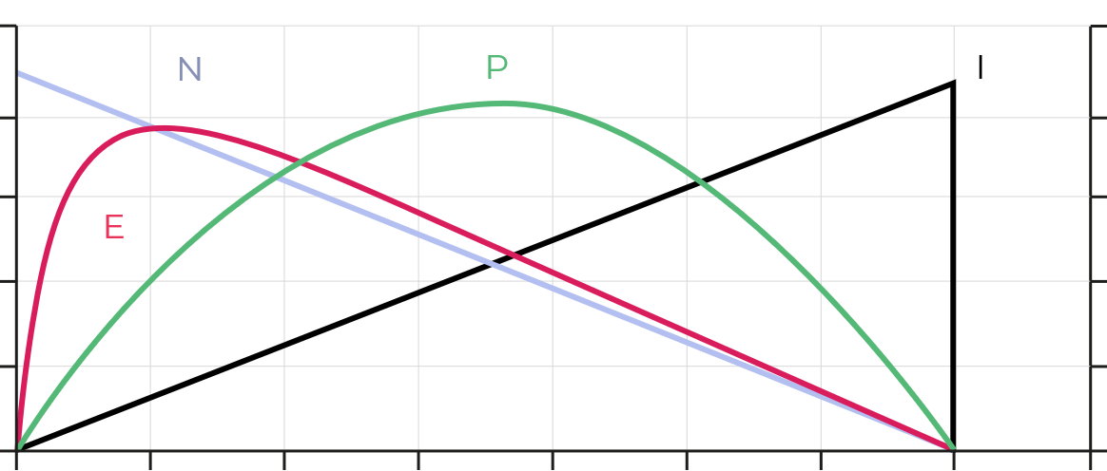
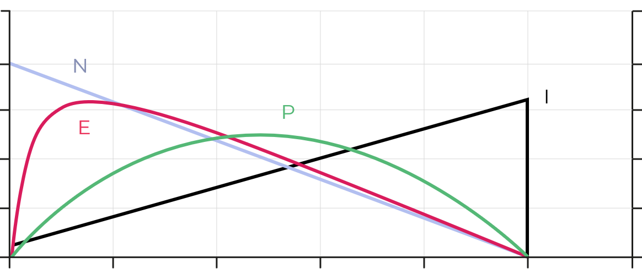
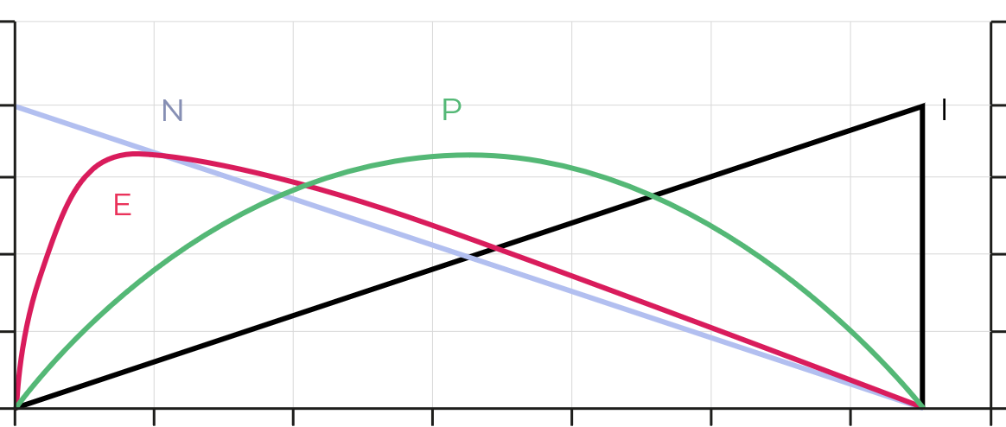
Selecting electric motors
3. Efficiency and motor selection
Motor A
Motor B
Motor C
Torque
Torque
Torque
You are an automation engineer tasked with sourcing efficient motors for a new food production line. Select the appropriate motor to provide:
200 W of power to pump product into jars
0.25 Nm torque to operate a section of conveyor belt
Use the data charts to select the best motor for each scenario. Justify your decisions. The charts on your activity sheet include detailed axis scales.
E Efficiency
N Speed
P Power
I Current
13
Notes:
Practitioner delivery notes
Learners may find it helpful to use a ruler to read values off the x and y axes on the charts. You may wish to model how to do this.
Activity
Review the three DC motor data charts on the slide, which are for three similar motors.
If necessary, help learners to locate the y-axis scale for each characteristic, using their activity sheets.
Ask learners to discuss and share similarities and differences.
Review the two requirements before learners interpret the charts and write their choices and justifications on the activity sheet.
Activity sheet
Learners interpret the charts and write answers on Electrical machines - Activity sheet 6.
Example answers
Please see the next slide.
Assessment
Ability to interpret charts.
Written choices and justifications.
Extension
Use real data sheets to extend with more scenarios of your own.

Slide 14
Selecting electric motors
3. Efficiency and motor selection
Motor A
Motor B
Motor C
200 W
0.25 Nm
Torque
Torque
Torque
Efficiency at 0.25 Nm torque
Efficiency at 200 W power
Maximum efficiency
What problem will occur when using a motor at maximum power rather than maximum efficiency?
Why would this be a concern for healthcare applications such as motorised prosthetics or infusion pumps?
Maximum efficiency
Motor A can provide 0.25 Nm of torque at close to maximum efficiency, so is best to drive the conveyor.
Motor C can provide 200 W of power at close to maximum efficiency, so is best to drive the pump.
E Efficiency
N Speed
P Power
I Current
14
Notes:
Practitioner delivery notes
Activity
Review the graphs on the slide.
Motor A’s peak efficiency is closest to the required torque.
Motor C’s peak efficiency is closed to the required power.
Neither is perfect, but is a ‘best match’ from available choices, a most likely a real-world engineering decision.
Learners discuss the questions on the slide.
Example answers
Lower efficiency implies greater losses, which will be thermal. Therefore a motor operating at low efficiency is more likely to either produce a high heat output or even overheat.
Overheating poses risks of fire or damage to nearby materials (and people).
In healthcare applications safety is paramount and so motors are chosen for high efficiency and minimal thermal losses, to minimise or remove the risk of burn damage to patients or prosthetic users.
Assessment
Written answers.
Discussion and verbal answers.
Ability to link low efficiency to high thermal losses and possible safety concerns.

Slide 15
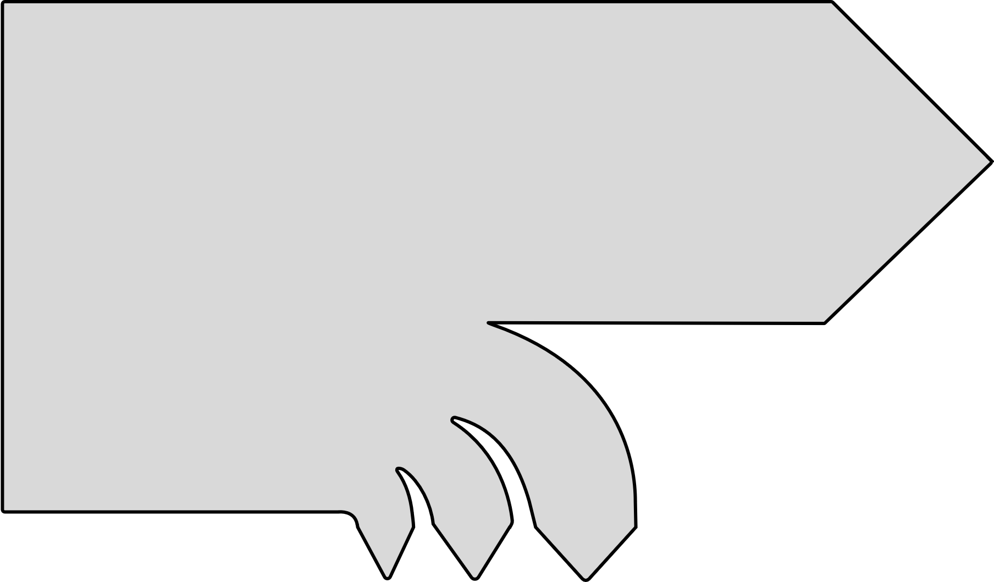
Where are the losses in a motor?
3. Efficiency and motor selection
Electric motors experience inefficiencies due to heat loss, though these are small.
These losses have three main sources:
Copper losses arise from the resistance in the copper windings.
Iron losses arise from eddy currents in the laminated iron cores used to increase the field strength in stators and rotors.
Mechanical losses arise from friction and air resistance.
P_{out} = 𝞽2πN
60
P_{in}= VI
Discuss how you would expect a motor’s copper losses to vary as the torque increases.
Mechanical
losses
Iron
losses
Copper losses
15
Notes:
Practitioner delivery notes
You may wish to first discuss or recall the use of laminated steel cores in rotor and stator construction.
Activity
Review the concept of a Sankey diagram to show inputs, outputs and efficiency. On the left, the electrical input power enters the diagram. On the right, the useful mechanical output power exits. At the bottom, losses exit. Emphasise to learners that this is a qualitative diagram, (ie the size of the arrows does not accurately reflect the scale of the factors at exit).
Help learners to identify that all losses are in the form of heat: from heating effects in copper wires, in steel laminates or from mechanical friction including air resistance.
Ask learners to consider the ‘copper losses’ due to resistance in coil windings. How does the formula suggest that these losses increase as the current increases? (Recall that in a shunt-wound motor the current draw is proportional to the torque, whereas in a series-wound motor it is proportional to the square of the torque.)
Example answers
In a shunt-wound motor, copper losses increase in proportion to the square of the current so a doubling in current will result in four times the heat loss from copper windings. The current range in the interactive tool is approximately 0.12 A to 1.2 A - 10 times the current will produce 100 times the heat losses.
In a series-wound motor, the losses would increase even more rapidly as torque increases - the current is proportional to the square of the torque, and then the power loss is proportional to the square of the current itself.
Assessment
Discussion and verbal answers.

Slide 16
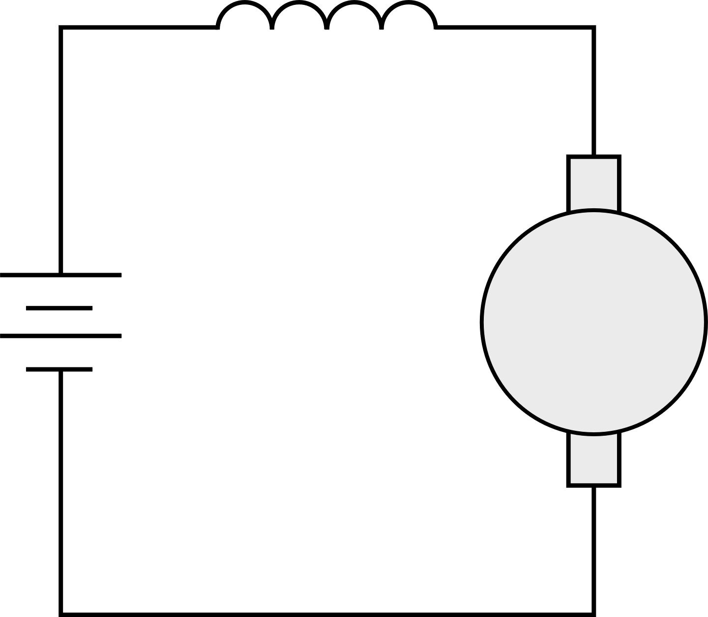
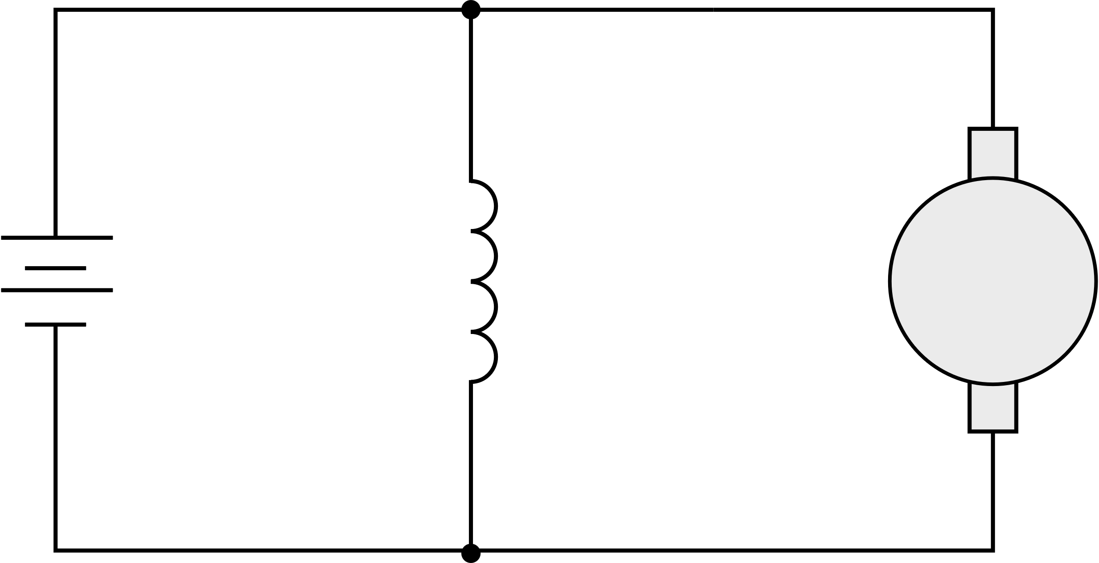
Copper losses in series and shunt-wound DC motors
3. Efficiency and motor selection
Since P = VI and V = IR we can write that P = I²R. This lets us quantify the power losses in the copper windings:
In a series-wound motor, the copper losses are given by:
P = I_{a}² (R_{a} + R_{f})
In a shunt-wound motor, the copper losses are given by:
P = I_{a}²R_{a} + I_{f}²R_{f}
(Remember that the total current I = I_{a} + I_{f})
Series-wound:
V = E + IR_{a} + IR_{f}
Shunt-wound:
V = E + I_{a}R_{a}
V = I_{f}R_{f}
R_{f}
I
I_{f}
I_{a}
+
+
R_{a}
E
Shunt field
R_{f}
R_{a}
E
-
-
16
Notes:
Practitioner delivery notes
Activity
Recall that a back emf E is induced across the rotor’s spinning coils, which acts in the opposite direction to the input voltage V. This reduces the current flowing through the armature coils to just what is needed to overcome mechanical and electrical losses and power the mechanical output. Help learners to recall the basic formulas for input voltage, back emf, current and resistance in series and shunt-wound DC motors.
Review that P = VI and V = IR and so by substituting for V we can write that power P = I²R.
Trace the current flow through each motor to help learners verify the copper power loss formulas above each diagram box.
Assessment
Discussion and ability to verify power loss formulas.

Slide 17
Motors, global energy and climate change
3. Efficiency and motor selection
Industrial electric-motor driven systems around the world account for nearly 50% of the global total of 22.9 TWh electrical consumption and 13.2 Gt carbon emissions from electricity (IEA, 2011).
Four engineering approaches make a 25% reduction in this demand possible:
Efficiency
Improving the ratio of power out to power in.
Matching
Choosing the right motor for every application.
Variable speed drives
Electronic controls match speed to load requirements.
System optimisation
Mechanical systems improved for fewer losses.
Discuss how you might contribute to one or more of these vital areas of improvement in your engineering or manufacturing career.
17
Notes:
Practitioner delivery notes
This activity links to the questions on efficiency within the Renewable energy module’s resource 3. Delivering renewable energy.
Data sources:
Industrial electric-motor driven systems around the world account for 53% of energy/Four approaches make a 25% reduction possible: iea.blob.core.windows.net/assets/d69b2a76-feb9-4a74-a921-2490a8fefcdf/EE_for_ElectricSystems.pdf
Global electrical consumption 22.9 TWh: www.iea.org/reports/electricity-information-overview/electricity-consumption
Global carbon emissions from electricity estimated as 40%: www.world-nuclear.org/information-library/energy-and-the-environment/carbon-dioxide-emissions-from-electricity.aspx
...of 33 Gt emissions www.iea.org/reports/global-energy-review-2021/co2-emissions
Activity
Review the statistics on global electrical consumption by industrial electric-motor driven systems (learners may also wish to consider and estimate the number of smaller single-phase AC motors in households in the UK (there are 30 million households) and globally).
Review the four approaches that can reduce energy consumption (note that matching means using a motor with the right power rating for the application as well as the right characteristics).
Learners identify some engineering and manufacturing careers that might be able to contribute to greater electric motor efficiency.
Assessment
Wider discussion around efficiency.
Career suggestions.
Extension
This discussion can link to innovations in electrical machines, including variable speed drives and pulse width modulation systems.

Slide 18
Motors, global energy and climate change
3. Efficiency and motor selection
Efficiency
Matching
Variable speed drives
System optimisation
Whether designing, specifying, building or maintaining motor-driven systems, you are likely to work with motors in your career.
How could you contribute to greater efficiency in one or more of these areas?
Image © This Is Engineering
18
Notes:
Practitioner delivery notes
This slide supports an open-ended discussion about possible engineering careers and can also link to learners’ planned industry placements.
Activity
Learners discuss how a range of engineering or manufacturing careers might use motor-driven systems and how learners might contribute to one or more of the areas of efficiency.
Assessment
Discussion and verbal answers.
Career interest.
Extension
Learners can develop their career ideas when on industry placement.

Slide 19
Learning outcomes
3. Efficiency and motor selection
You will be able to:
Calculate the input power to an electric motor.
Interpret a motor data sheet graph, showing how power and efficiency vary with torque.
Select the most efficient motor for an engineering application.
List four engineering approaches that will help to reduce the global energy demand from electric motor-driven systems.
Image © This Is Engineering
19

