Slide 1
Engineering materials 1. Materials in engineering

Slide 2
1. Materials in engineering
2

Slide 3
Learning outcomes
1. Materials in engineering
You will be able to:
Define an engineering material.
Suggest some materials that could help to solve an engineering problem.
Identify some materials that allow personal protective equipment (PPE) to keep you safe.
Make calculations of battery capacity in Watt-hours (Wh).
3
Image © This Is Engineering

Slide 4
Engineers and the materials they use
1. Materials in engineering
Concrete for buildings
UPVC for guttering
High speed steel
(HSS) for drill bits
PLA plastic for 3D printing
Discuss why each material is a good choice for its application.
What is an engineering material? Discuss your ideas and think of a definition.
Suggest what knowledge and understanding an engineer might need to work with materials.
4

Slide 5
Purposes, properties, materials and sustainability
1. Materials in engineering
An engineering material is any material used in the construction or production of artificial structures and objects.
The urgent need for greater sustainability is the wider context in which all engineering material choices need to be made.
Engineers first understand the purpose of the materials they will use…
…which helps them identify what properties these materials need to have…
…which helps them choose the right materials for each application.
Materials contribute to how a structure, component or mechanism functions under expected conditions.
A property describes a specific aspect of how a material behaves.
Material choices will affect performance, safety, cost and design/aesthetic decisions.
Discuss how engineers might determine or estimate the expected conditions that a structure, component or mechanism might operate in.
Discuss why each of these aspects of a project (purpose, properties, materials) is important for engineers to consider.
Suggest what will make an engineering material a more sustainable choice.
5

Slide 6
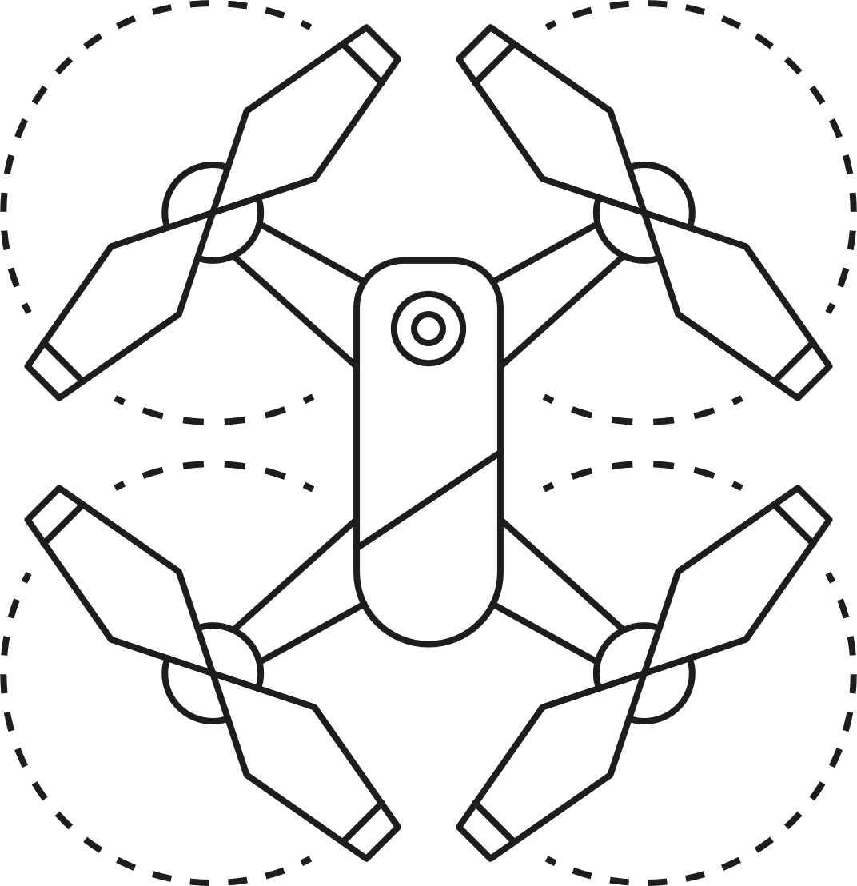
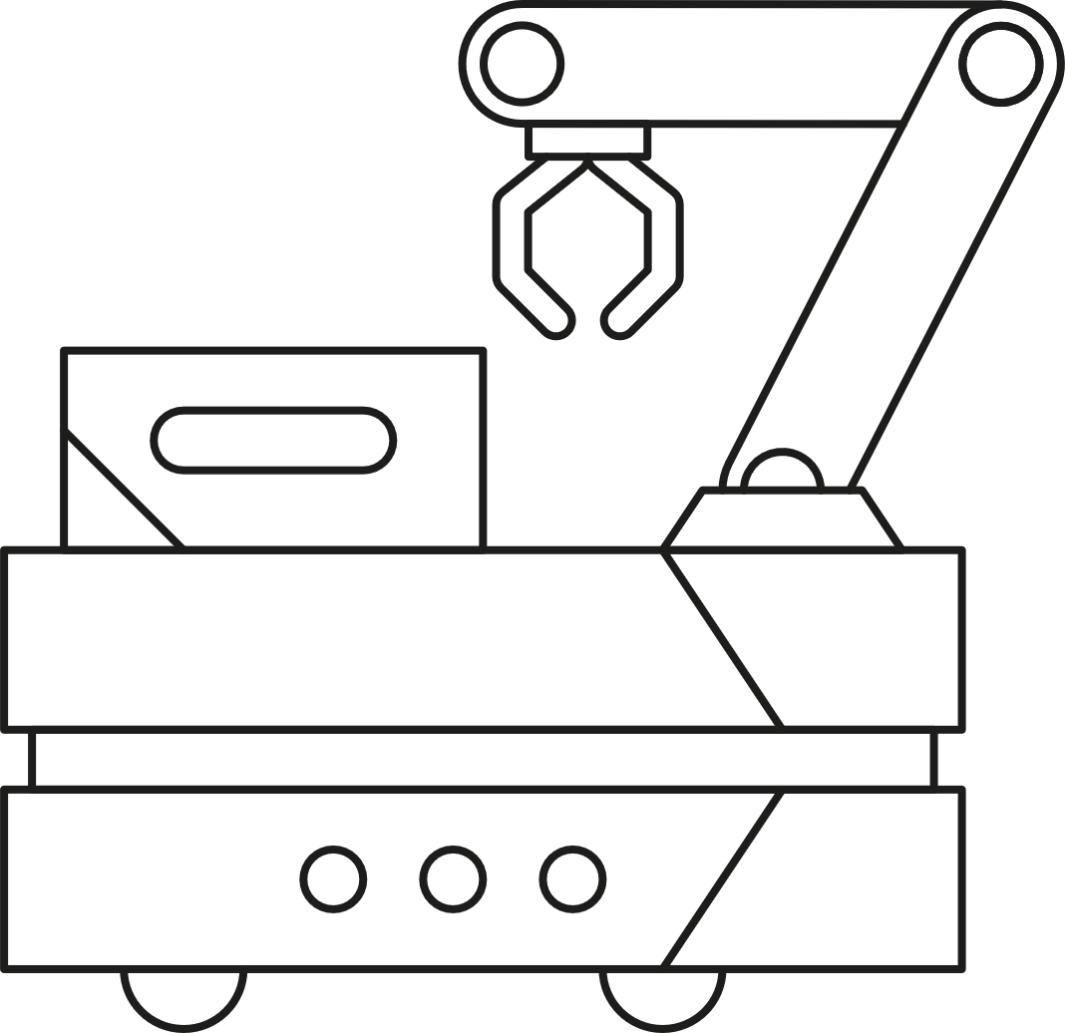
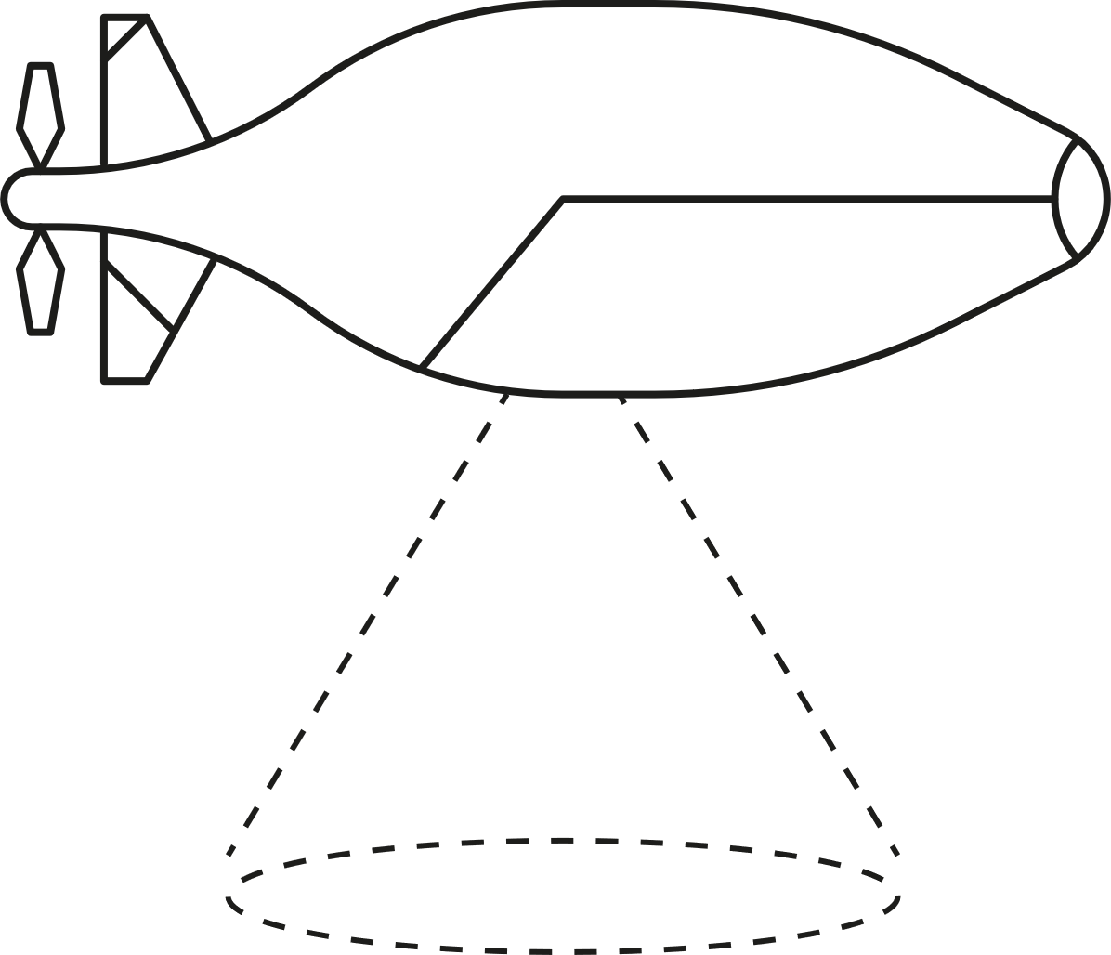
Materials and unmanned vehicles
1. Materials in engineering
Unmanned vehicles are transforming how engineers can access and inspect hard-to-reach places, or how they are able to plan the movement of materials, parts and products within a factory or warehouse.
What are the most important considerations about the purpose and properties of the materials used for each unmanned vehicle?
What materials might an engineer select for the frame and cover of each unmanned vehicle?
Air
Ground
Underwater
Think:
Purpose
Properties
Materials
6

Slide 7
Materials and unmanned vehicles - answers
1. Materials in engineering
 | Air | Ground | Underwater
Purpose and properties | Needs to fly. Needs materials that are very light and rigid. | May carry a heavy load. Needs materials that are strong and wear-resistant to carry out the same task many times. | Operates at depth. Needs materials that resist corrosion and high pressure.
Materials | Frame: Carbon fibre Magnesium alloy Cover: Plastics like ABS | Frame: Steel or alloy Cover: Fibreglass composite or steel | Frame: Steel Cover: Polycarbonate Stainless steel
The need for sustainability might drive material choices that are as light as possible for the application (to reduce energy use during operation), have been recycled (to reduce virgin material use) and can be replaced, repaired or recycled again at the end of the vehicle’s useful life (to support circular lifecycles).
7

Slide 8
Materials and safety
1. Materials in engineering
Engineers choose materials that help machines and constructions to be safe. The right materials also help PPE to perform well.
Think:
Purpose
Properties
What materials do you think make this machine safe to operate and how are they used?
What materials do you think help PPE to keep a machine operator or engineer safe?
Materials
Image © This Is Engineering
8

Slide 9
Materials and safety - answers
1. Materials in engineering
All of these materials are strong or resistant to forces, noise, flying particles or chemicals.
Respirator
or mask
Polyester protective clothing
Plastic and rubber insulation protects from electricity
Coloured plastic safety buttons
Rubber, suede or leather gloves
Hard plastic safety hat
Steel panels protect from internal machinery
Steel, leather and rubber boots or shoes
Plexiglass allows safe viewing of operations
Foam ear protection
Plastic eye protection
Face shield
Think:
Purpose
Properties
Materials
Image © This Is Engineering
9

Slide 10
What materials will keep you safe?
1. Materials in engineering
The Personal Protective Equipment at Work (Amendment) Regulations 2022 (PPER 2022) define the legal obligations of employers and employees regarding PPE. This places a duty on every employer in Great Britain to ensure that suitable PPE is provided to employees who may be exposed to a risk to their health or safety while at work.
PPE should be regarded as the last resort to protect against risks to health and safety. Engineering controls and safe systems of work should be considered first.
You are required to use PPE properly following training and instruction from your employer. If the PPE you are given is lost or becomes defective, you should report that to your employer.
Research what PPE you may need to use, or did use, as part of your industry placement or first job.
Find out what materials each item of PPE is made from and what the item protects you from.
Find out how to care for each item and how to identify when it is worn or defective.
10

Slide 11
Learning outcomes
1. Materials in engineering
You will be able to:
Define an engineering material.
Suggest some materials that could help to solve an engineering problem.
Identify some materials that allow personal protective equipment (PPE) to keep you safe.
Make calculations of battery capacity in Watt-hours (Wh).
Image © This Is Engineering
11

