Slide 1
Electrical machines
1. Introducing electric motors

Slide 2
Practitioner guide
1. Introducing electric motors
2

Slide 3
Introduction and overview
1. Introducing electric motors | Practitioner guide
These resources help practitioners to deliver the electrical machines components of engineering and manufacturing-related qualifications at levels 2 and 3. They introduce the topic and stimulate learners to explore and reflect on key concepts, and are designed to complement and enhance practitioners’ own lesson materials and schemes of work.
Resources summary
Resource name | Level | PPT slides + notes - practitioner | PPT slides - learner | Activity sheets | Film | Interactive
1. Introducing electric motors | 2 |  |  | 2
Delivery
Delivery suggestions for practitioners, and suggested answers where appropriate, are in the presenter’s notes for each slide. The core activities in each resource provide around 60 mins of learning time, though additional suggestions, including independent learning, can extend this time significantly.
Overarching theme/big questions
How do we choose the right motor for the work we need to do?
Overview
The Level 2 resource introduces some basic classifications of DC and AC motors before exploring in simple terms what differences lead to their various characteristics and applications.
Level 3 resources introduce characteristic curves for DC series, shunt and compound motors, including for torque, current, speed and power. They continue with an exploration of power output and efficiency, and how this affects real-world performance. The importance of electric motor efficiency is considered in the wider context of sustainability.
3

Slide 4
Learning outcomes and resource links
1. Introducing electric motors | Practitioner guide
Level 2 resource
Introducing electric motors
Name some different types of direct current (DC) and alternating current (AC) motors.
Describe the differences between the field and armature windings in series and shunt-wound DC motors.
Suggest an appropriate motor to use for a range of applications based on its qualitative characteristics.
Full resource list available for the topic of Electrical machines:
1. Introducing electric motors (Level 2)
2. Investigating torque, speed and current (Level 3)
3. Efficiency and motor selection (Level 3)
Links to other supported topics
Renewable energy, Sustainability.
4

Slide 5
Subject coverage
1. Introducing electric motors | Practitioner guide
Electrical machines/Electric motors
DC and AC motors
Series, shunt and compound-wound motors
Field windings
Commutators and slip rings
Applications of electric motors
Including careers
Careers that use electric motor knowledge and understanding
Contributing to greater sustainability
5

Slide 6
Electrical machines
1. Introducing electric motors
6

Slide 7
Learning outcomes
1. Introducing electric motors
You will be able to:
Name some different types of direct current (DC) and alternating current (AC) motors.
Describe the differences between the field and armature windings in series and shunt-wound DC motors.
Suggest an appropriate motor to use for a range of applications based on its qualitative characteristics.
Image © This Is Engineering
7

Slide 8
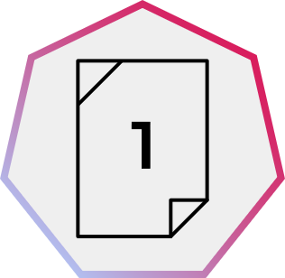
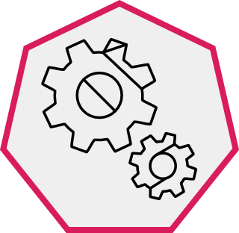
Electric motors around you
1. Introducing electric motors
Think about where you might find electric motors at home and in an engineering workplace.
List some examples of what equipment or appliances these motors might power, or arrange your ideas as two concept maps (one for the home and one for an engineering workplace).
What type of electrical power supply are these motors most likely to be connected to?
Image © This Is Engineering
8
Notes:
Practitioner delivery notes
This resource introduces some key types of electric motor and helps learners to consider the widespread application of electrical motors in all aspects of engineering or manufacturing. Use it to help learners consider motors in the context of their occupational specialism or industry placement.
Film
Before starting this activity, learners could watch the Electrical machines film.
Activity
Learners identify example applications for electric motors in domestic and workplace scenarios.
Learners can personalise their thinking by considering a workplace they might like to work in or that they will visit/have visited for an industrial placement.
Activity sheet
Learners can use Electrical machines - Activity sheet 1 to write or draw lists or concept maps of their ideas.
Example answers
Please see the next slide.
Most motors will be connected to an AC power supply, while motors in portable devices will be connected to the DC supply from the battery pack.
Assessment
Suggestions and lists or concept maps.
Discussion and verbal answers.
Extension
Learners could complete a tour of your workshop to identify the electric motors that power and control each machine and tool. They could examine a range of motors or motor data sheets.

Slide 9
Electric motors around you – example answers
1. Introducing electric motors
Each motor is connected to lower-voltage DC, mains AC or, in the workplace, a higher-voltage 3 phase AC supply:
Electric bike
26 V DC battery
Cordless drill
18 V DC battery
Electric toothbrush
1.2 V DC battery
CNC spindle
230 V AC
Game console fan
12 V DC
Forklift
48 V DC battery
In the workplace
At home
Microwave oven 230 V AC
Water pump 230 V AC
Washing machine
230 V AC
2 tonne hoist
3-phase 415 V AC
How else could you classify the different motors above?
Can you think of any other types of electric motor that you could add to your classification?
9
Notes:
Practitioner delivery notes
Activity
Review the example answers on the slide. (Note that these are generalisations.)
Note the importance of how each motor will have been matched to its application. Learners could discuss how different applications place different requirements on a motor, such as how much torque (rotating force) it can generate, whether this torque is the same at all times (and especially on startup) and whether the speed of the motor needs to be varied. (Learners will begin to explore this later in this resource.)
Example answers
The motors could be classified as AC (alternating current) or DC (direct current) motors.
Other classifications that learners might suggest could include low voltage (eg 5 or 12 V), mains voltage and high voltage motors. Some learners may mention other forms of motor they will explore later in this resource, such as induction, brushed, brushless, synchronous or 3 phase. Other types might include stepper or servo motors.
Assessment
Discussion and verbal answers.
Extension
Learners could research classification tables for industrial motors.

Slide 10
Classifying electric motors – DC and AC motors
1. Introducing electric motors
Permanent magnet
Coiled wire
Electrical connection
Axle
Every electric motor uses electromagnetism to create torque (rotating force). Electric motors operate on a DC or AC supply. The way in which this current is supplied to the motor and how the current is used to create torque is different in different motors.
Direct current (DC)
Alternating current (AC)
Brushed
Brushless
Induction
Synchronous
DC
AC
- Coils on rotor
- Magnets or coils around outside create a fixed magnetic field
- Brushes touching commutator rings supply current to rotor coils
- Magnets on rotor
- Coils on outside create a fixed magnetic field
- Coils on outside create a changing magnetic field
- The changing field induces a current in the rotor
- AC coils on outside create a changing magnetic field
- Slip rings connect a separate DC current to the rotor
Describe how the differences in each type of motor’s connection(s) can help you to distinguish between them.
10
Notes:
Practitioner delivery notes
This activity introduces the two main types of both DC and AC motor (the next slides add more detail on types of brushed DC motor).
You could begin this activity by asking learners to recall what they can remember about electric motors from their prior Level 2 science study.
If possible, have a physical example of a commutator and slip rings to show learners. The next slide briefly explains commutators and slip rings.
Activity
Review that every electric motor relies on electromagnetism (hence the connection to an electrical supply). When a wire carries a current it will experience a force when it is placed into a magnetic field. Electric motors are arranged so that this force is a rotating force which we call torque. Torque is easily experienced elsewhere such as when using a spanner or screwdriver.
Some learners may recall learning about moments in physics: these are static turning forces about a point. When a moment is able to rotate, it becomes torque.
Review how the slide divides electric motors into DC and AC motors, which can each then be classified as brushed or brushless, induction or synchronous motors. These form the four major groups of electric motors. (Learners don’t need to understand the differences between induction and synchronous motors for the purposes of this resource and activity, but may need to do so for their qualification.)
An induced current is one that is produced by a changing magnetic field and not because of a direct electrical connection.
Example answers
Learners should identify from the diagrams that:
The small centre circle represents the axle. (Note that the outer coils, which do not move, are sometimes called the stator.)
Brushed motors always have coils at the centre. Brushes and a commutator connect current to the rotating coils. Some brushed motors have outer coils to create the magnetic field (learners will explore this on a later slide) and these will need their own connections.
Brushless motors always have a permanent magnet on the rotor and coils on the outside, to which current is connected. (An electronic controller creates a rotating magnetic field in brushless motors.)
Induction motors have coils on the rotor and on the outside stator. But only the stator has connections. This is because the field created by the stator induces a current in the rotor.
Synchronous motors have two connections, but are different to a brushed DC motor with a stator coil. In a synchronous motor the rotor is not supplied by brushes and a commutator, but via a separate DC current applied to slip rings.
Assessment
Discussion and verbal answers.
Ability to discern differences between the basic construction of each type of motor.
Extension
Learners research and explain the operation of commutators and slip rings, identifying that commutators reverse the current flow every half turn (or more), while slip rings maintain a constant connection.
Learners can investigate universal motors that can run on both DC and AC: en.wikipedia.org/wiki/Universal_motor

Slide 11
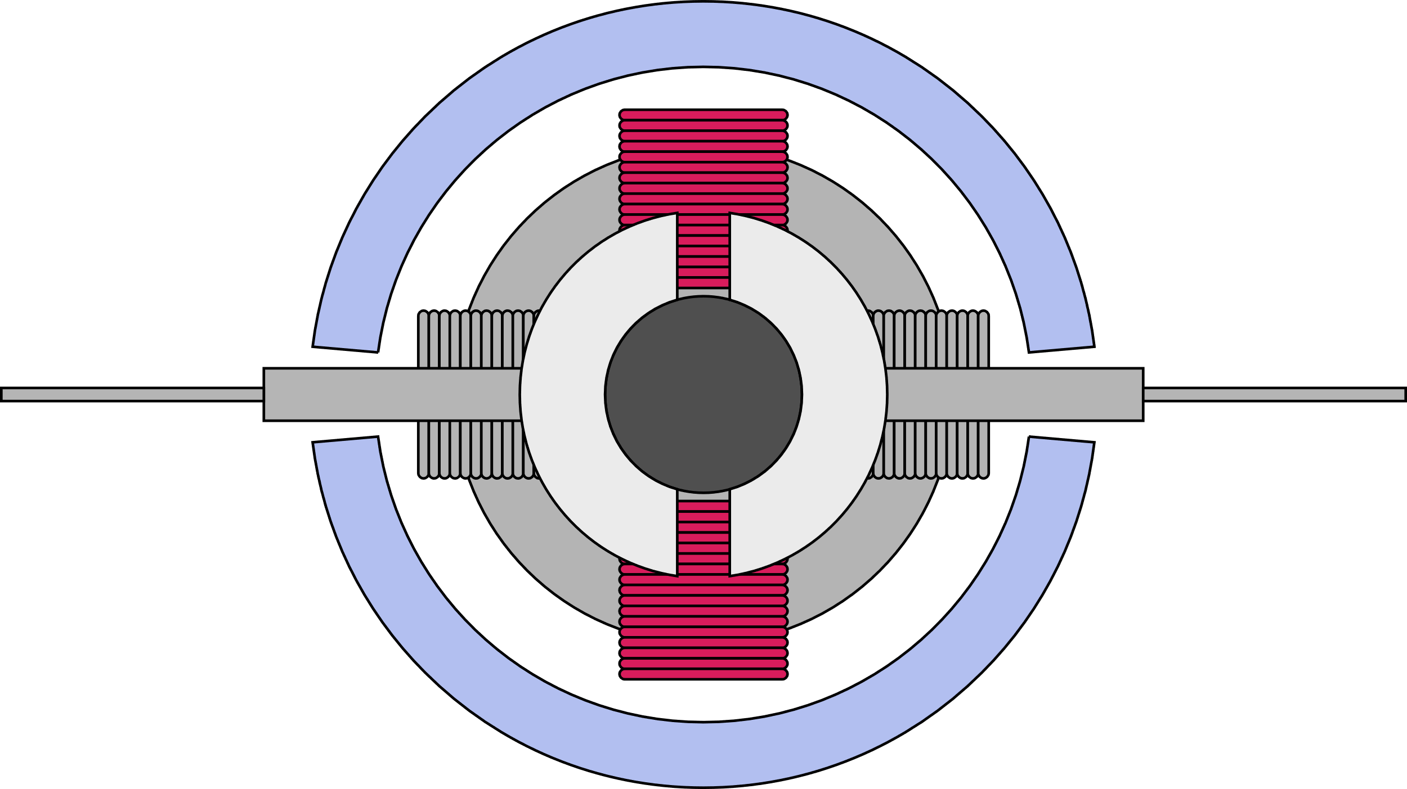
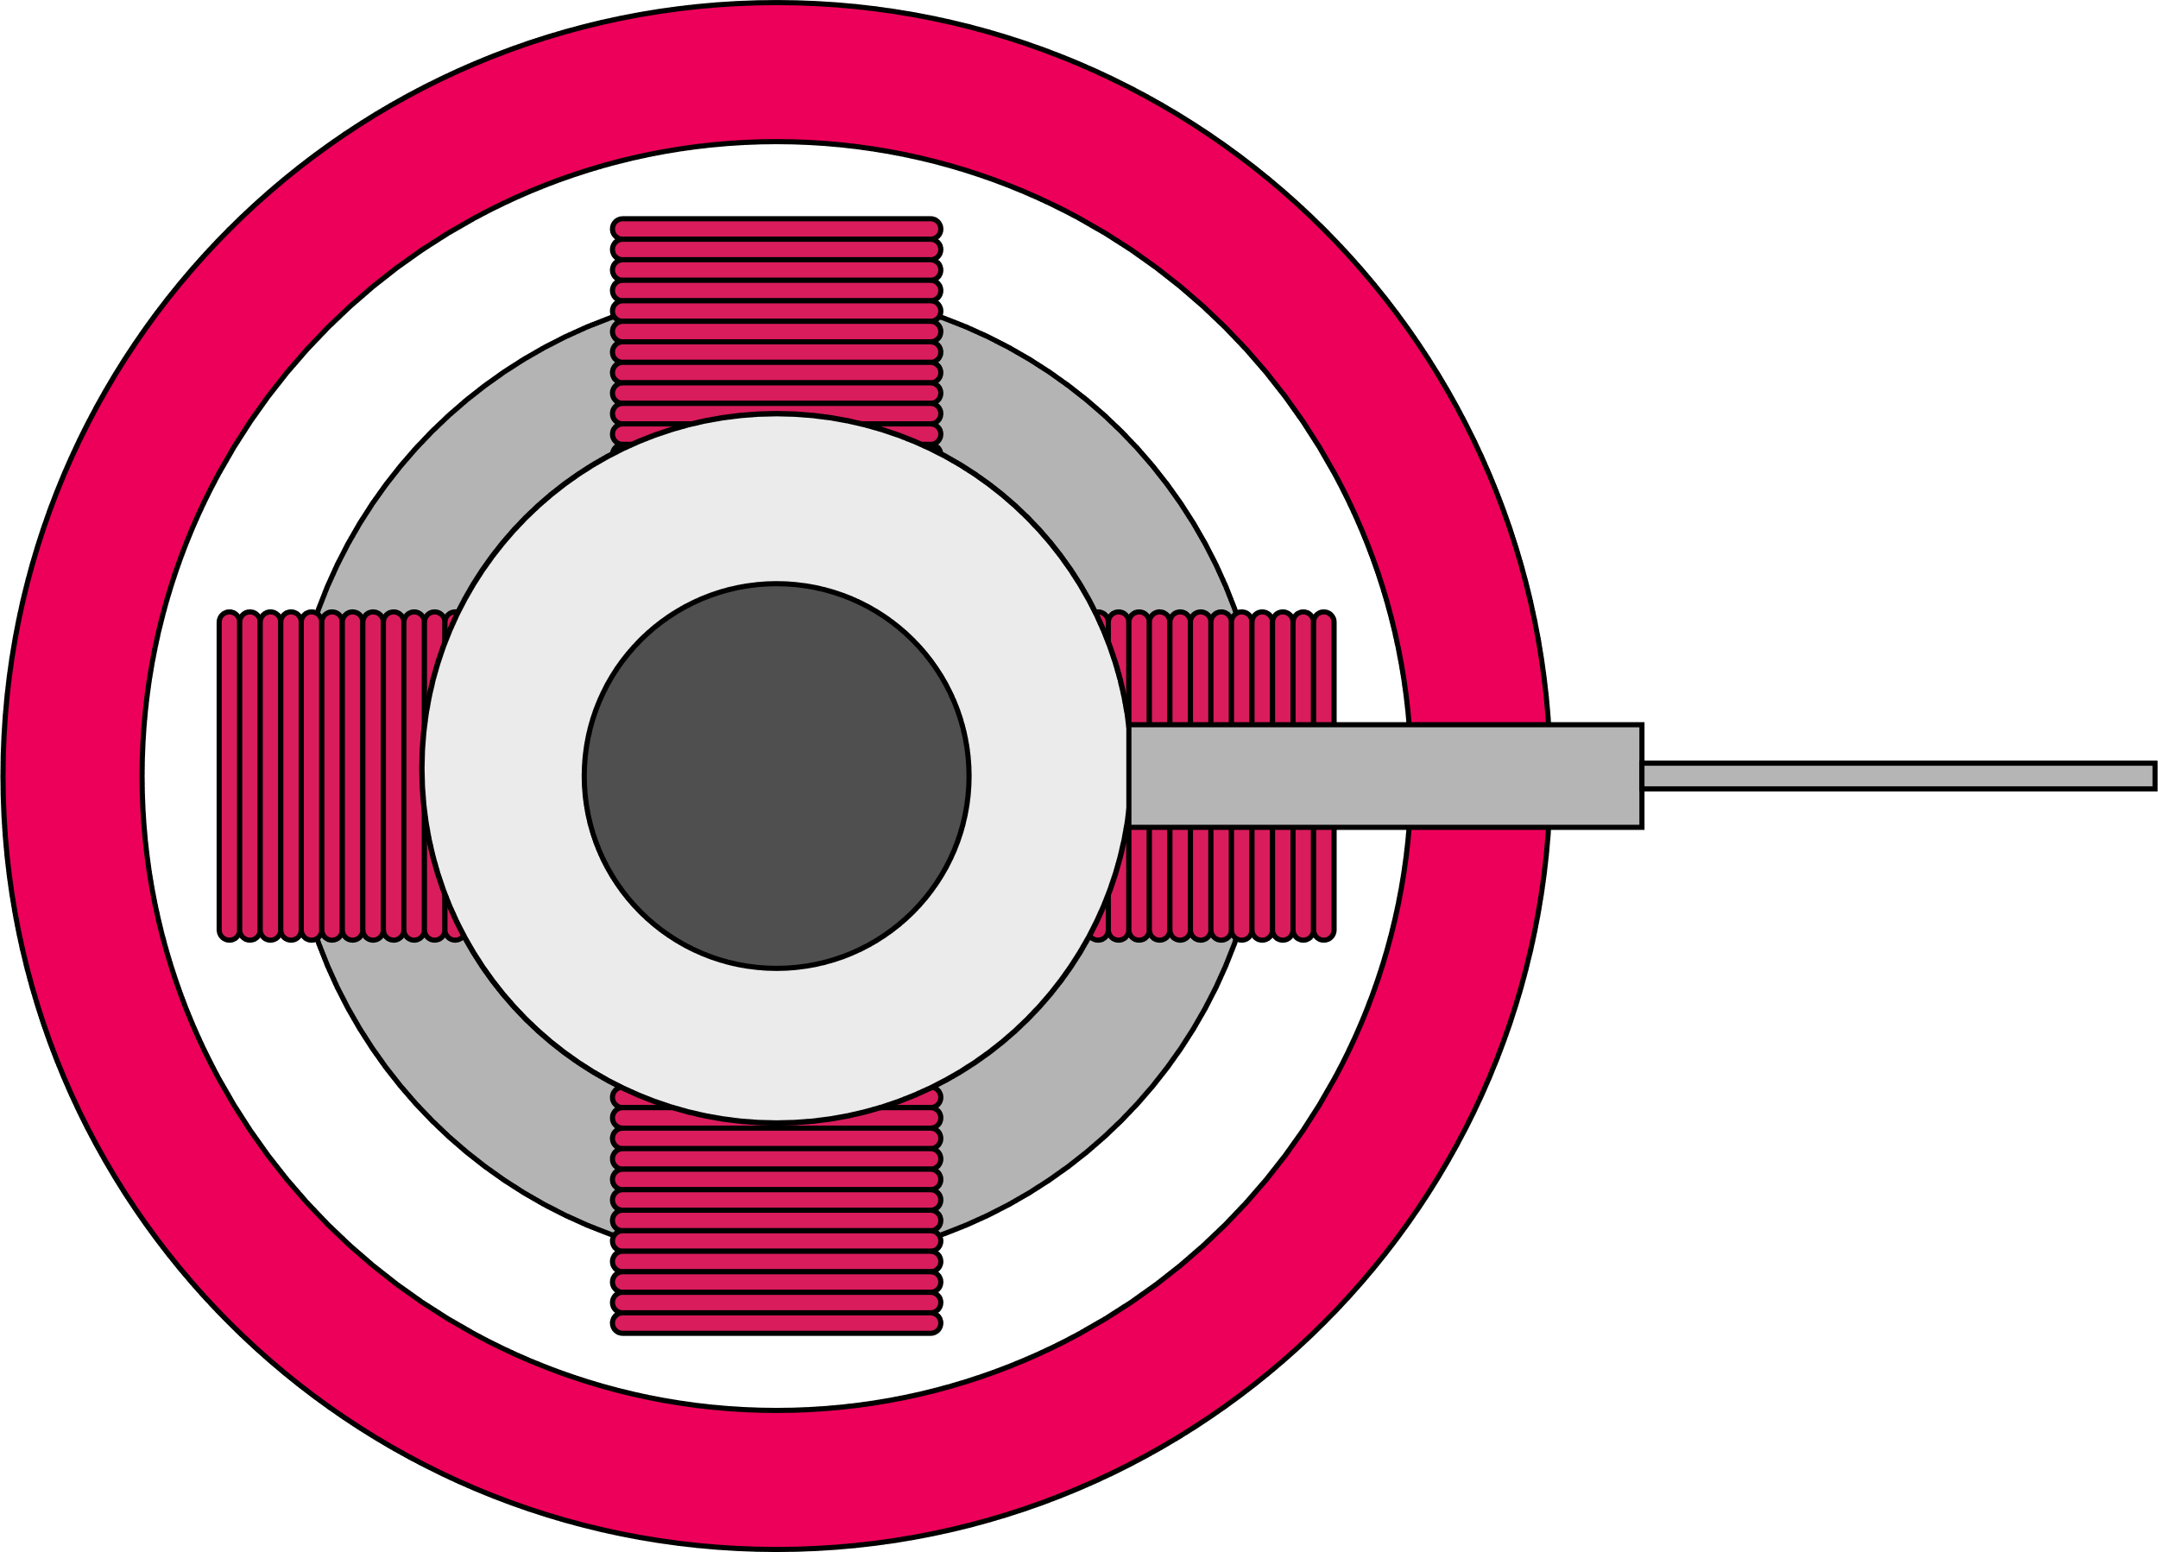
Commutators v slip rings – visual differences
1. Introducing electric motors
The rotor coils in a brushed DC motor need to always experience a turning force in the same direction.
Commutators are split connectors on either side of the axle that reverse the current every half turn, to allow this.
Conductive brushes press on each commutator during each half of a rotation. A gap briefly interrupts the current to stop the rotor ‘sticking’ when the coils align with the magnetic field.
In a synchronous AC motor the magnetic field changes direction with the AC current through the field coils. The rotor coils need a constant DC current that always flows in the same direction.
Two slip rings (one is hidden behind the other in the diagram below) provide this constant connection, again with conductive brushes pressing against them. There is no gap in slip rings.
Magnets
Field coils
Rotor coils
Rotor coils
Brush
Brush
(another is hidden behind)
Commutator
Axle
Axle
Gap
Slip ring
(another is hidden behind)
11
Notes:
Practitioner delivery notes
Activity
Use this slide to briefly discuss the difference between how slip rings and commutators can each deliver current to rotor (armature) coils.
Learners can discuss brush wear and the need to inspect and replace brushes.
Extension
Learners can inspect disassembled brushed DC and AC synchronous motors to observe the difference between commutators and slip rings.
Learners can use Fleming’s left-hand rule to consider the forces acting on a simple rotor coil in a fixed magnetic field, to deduce the need for commutators.
Learners can research replacement brushes on the internet and identify why their materials (eg carbon/graphite) are chosen.

Slide 12
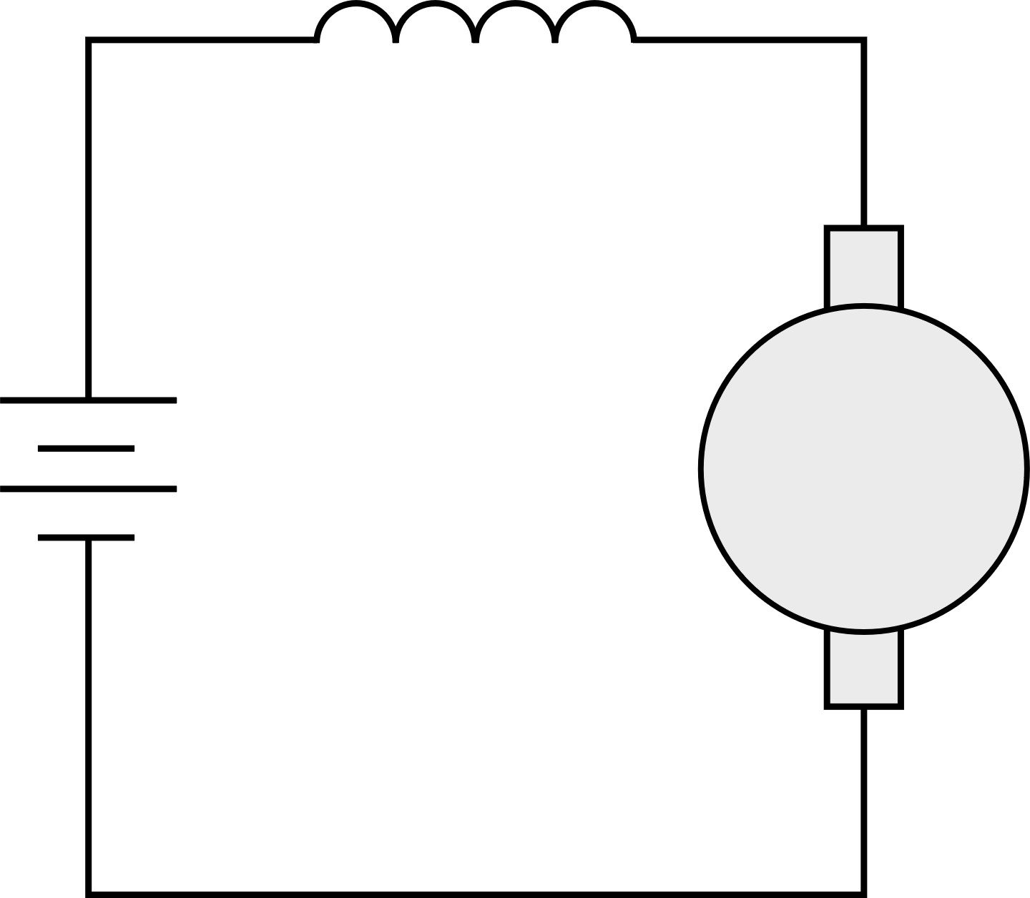
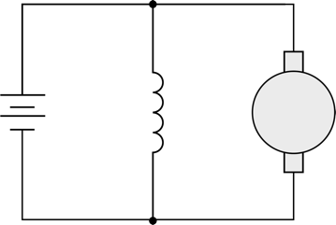
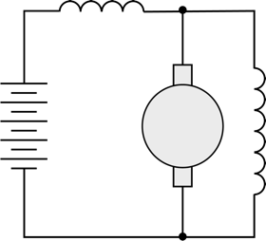
Brushed DC motors – series, shunt and compound
1. Introducing electric motors
Brushed DC motors can have stationary field coils around the outside instead of permanent magnets, to create the magnetic field (‘excitation’).
The coils wound around the rotor create the torque (rotating force). These are also called the armature coils.
The field coils can be wound in series with the armature coils, in parallel, or a combination:
Use your understanding of voltage and current in series and parallel circuits to suggest why series and shunt field coils need to use different types of coil winding.
Series
Shunt
Compound
Series field
Series field
+
+
+
Shunt
field
Shunt field
-
Armature
-
Armature
-
Armature
- Field coils are in series with the armature coil
- Few, thick coils
- The same current flows through the field and armature coils
- Field coils are in parallel with the armature coil
- Many, thin coils
- The current from the supply is split between the field and armature coils
- Many, thin parallel coils with few, thick series coils on top
- All of the current from the supply flows through the series field coils and then is split between the shunt field and armature coils
12
Notes:
Practitioner delivery notes
While electronic controllers now make speed and torque control possible, it is still important for learners to understand the distinction between traditional series, shunt and compound-wound motors that were devised before electronic control became available.
Prior learning: You may first wish to review with learners their Level 2 learning about series and parallel circuits. Highlight that components in series share the voltage across them and the current remains the same, while components in parallel share the current between them and the voltage across each component is the same full voltage.
Link this brief theory to practical investigations of the speed and torque characteristics of series, shunt and compound brushed DC motors.
Activity
Recall that when brushed DC motors were introduced on an earlier slide, some brushed DC motors will have permanent field magnets around the outside, while others (usually industrial versions of these motors) will have field or stator windings that create the magnetic field.
Review the three motor circuits on the slide. Highlight that each diagram shows the circuit within the motor - the field coil and armature are all within the motor, rather than the field coil being a separate, external component.
Ask learners to describe the voltage and current in the series motor diagram. Next, discuss what is happening with the supply voltage and current in the shunt motor diagram. Finally, consider the compound motor diagram, which includes two field coils: one in series and one in parallel.
Then, discuss the nature of the field coils in each type of brushed DC motor. Series motors have a small number of thick coils. Shunt motors have many coils made of fine wire. Compound motors include both types of coil.
Challenge learners to use their understanding of the voltage and current in each circuit to explain why the number and type of coils differs (highlight that in each design the total power produced is exactly the same), remembering that it is important to maximise the current flowing through the rotor coils.
Example answers
In the series motor the field coils must carry the full load current. These need to be thick so that the coils don’t heat up due to resistance in the wire. (This resistance would reduce the current through the rotor coils.)
In the shunt motor the field coils carry part of the load current. These need to keep this current low so that most current flows through the rotor coils. Hence the wire is thin. To create a strong field, many coils are used.
The compound motor will have both types of coil and an inspection will reveal many thin turns with a few thick turns on top.
Assessment
Discussion and verbal answers.
Extension
Explore how it is the armature current that does the ‘work’ within the motor, (ie where electrical energy is converted into kinetic energy).
Use ampere-turns to explore quantitatively how the turns might differ between series and shunt, for example using V = 230 V and I = 13 A.

Slide 13
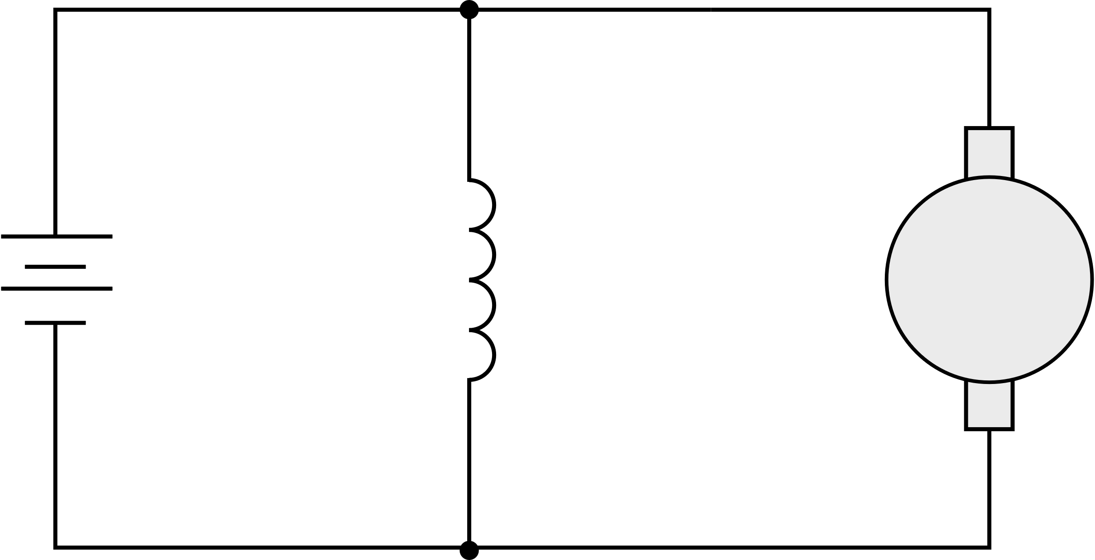
Voltage, current and resistance in DC motors
1. Introducing electric motors
The current through the armature coils makes them turn in the magnetic field. This turning induces a voltage across the coils, called the back emf E. (emf = electromotive force.)
The back emf acts in the opposite direction to the input voltage V. This reduces the current flowing through the armature coils.
At the motor’s operating speed, enough current flows to overcome mechanical and electrical losses, and to power the mechanical output. This is a lower current than was needed to start the motor.
Engineers need to understand how the input voltage creates a current through the field and armature coils, and how this differs in series and shunt-wound DC motors:
Examine the circuit diagrams again. Remember that the field (f) and armature (a) coils each have resistance R and a current I flowing through them.
Use V=IR to help you verify the formulas by discussing the formulas linking voltage, current and resistance.
Series-wound:
V = E + IR_{a} + IR_{f}
Shunt-wound:
V = E + I_{a}R_{a}
V = I_{f}R_{f}
R_{f}
I
I_{f}
I_{a}
+
+
R_{a}
E
Shunt field
R_{f}
R_{a}
E
-
-
13
Notes:
Practitioner delivery notes
This slide introduces the concept of back emf and supports a brief discussion of the basic formulas linking input voltage, back emf, current and resistance, to extend learners’ initial observations of the reasons for thick or thin field windings in series and shunt-wound DC motors.
Your discussion of back emf may first require a brief discussion of DC generators if you have not already covered this content.
Activity
Introduce the concept of a back emf. This can be hard for learners to understand, but a demonstration of measuring current into a DC motor on startup and in operation can help to illustrate that the operating current is low. Highlight that two opposing processes are taking place at once: the input voltage causes the rotor to spin but in turn, the spinning rotor induces its own voltage, in the opposite direction to the input.
Highlight that the presence of back emf makes the DC motor a self-regulating machine. The motor draws just enough armature current to create the torque required by the load. When the motor is running on no load, a small torque is still needed to overcome the friction and windage losses. This is the ‘no-load current’ of the motor.
Review the circuit diagrams again with learners.
Remind learners that in a circuit, or across any component, V=IR.
Make sure learners understand how a and f denote the current I or resistance R in the field (f) and armature (a) windings.
Trace the flow of current through each one to identify that I_{f} = I_{a} in the series-wound motor (denoted just as I) but I_{f} and I_{a} will differ in the shunt-wound motor.
Learners should be able to generate each of the formulas to verify them.
Example answers
In the series motor by verifying that I_{f} = I_{a} learners will see why the field windings are a few thick coils that carry the full current.
In the shunt motor learners will verify that the current splits through the field and armature windings but the voltage V will be the same across both, hence since V = E + I_{a}R_{a} and V = I_{f}R_{f} it follows that E + I_{a}R_{a} = I_{f}R_{f} To keep the field current low and ensure sufficient armature current, the windings must create a large resistance compared with the armature windings, hence many thin coils.
Assessment
Discussion.
Ability to verify formulas by identifying field and armature current and resistance.
Extension
Learners can measure current on startup and operation of DC motors.

Slide 14
Key characteristics of AC and DC motors
1. Introducing electric motors
The unique construction of each type of motor gives them different characteristics.
DC |  |  |  | AC
Brushless | Series wound | Shunt wound | Compound wound | Synchronous | Induction 230 V Single phase | Induction 400 V 3 phase
High speed High torque Wide range of speed control | High starting torque Good for traction (motive force) applications | Lower starting torque Good for constant speed applications | Reasonable starting torque and speed regulation - midway between series and shunt | Constant speed as load varies Best for low speed applications | Simple, rugged Limited speed control | Simple, rugged Limited speed control High power capacity
Discuss your ideas for applications when speed control might be more important than torque characteristics, and vice versa.
14
Notes:
Practitioner delivery notes
The Level 3 resources in the rest of the Electrical machines module will build on this introduction to operating characteristics in order to interpret speed and torque graphs and select the right motor.
Activity
Highlight that while a series, shunt or compound brushed DC motor might be the same size and contain the same mass of copper wire, the different wiring configurations deliver different operating characteristics.
Review the qualitative differences between DC motors and then AC motors.
Learners discuss and share examples of when speed or torque might be more important.
Highlight that learners need to understand and remember these distinctive characteristics.
Example answers
Torque matters when the motor needs to drive a heavy load - any application that might include lifting or moving heavy objects or vehicles, accelerating or starting from a standstill.
Speed matters when the motor needs to vary the rate at which it does work, for example to vary the flow of moving air or fluids.
Sometimes both speed and torque matter, for example to control a cordless drill.
Assessment
Discussion and verbal answers.
Ability to match characteristic to an example application.
Extension
Learners could research the types of motor used in a real factory environment, for example when on industry placement.

Slide 15
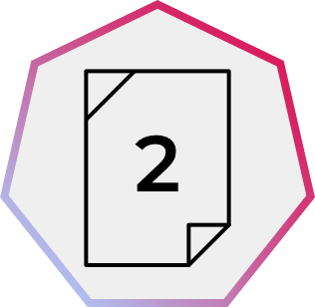
Choose the right type of motor
1. Introducing electric motors
Power tool
A cordless power tool motor needs to provide a wide range of speed and torque.
Forklift
A warehouse forklift truck needs very high starting torque for moving and lifting loads. It runs on a 48 V DC battery.
HVAC fan (heating, ventilation, air conditioning)
The extraction fans in a workshop will operate in a narrow speed range.
Clock
A factory wall clock needs a low-speed motor that runs off mains electricity.
Hoist
A high-load hoist needs a motor with very high power output.
Conveyor
A conveyor in a food processing plant must move at a consistent speed.
Apply what you have learned about the characteristics of DC and AC motors to choose the best type of motor for each application.
Give a reason for your choice.
15
Notes:
Practitioner delivery notes
This activity provides an opportunity for learners to make qualitative matches between motors and applications.
Activity
Learners apply the information from the previous slide to suggest an appropriate type of motor for each application.
Activity sheet
Learners complete Electrical machines - Activity sheet 2.
Example answers
Please see the next slide.
Assessment
Written answers.

Slide 16
Choose the right type of motor – example answers
1. Introducing electric motors
Power tool
Brushless DC
The motor will run from a DC battery and provide a wide range of speeds and torques.
Forklift
Series-wound brushed DC
The motor provides high torque and can run off the truck’s 48 V battery.
HVAC fan
230 V single phase AC
Simple and rugged.
Clock
230 V AC synchronous
Performs well at low speed.
Hoist
400 V 3 phase AC induction
Can provide very high output power.
Conveyor
Shunt-wound brushed DC
This maintains speed under varying loads.
Discuss what other considerations could help to minimise the energy needed to power electrical motor-driven systems.
16
Notes:
Practitioner delivery notes
Activity
Review the example answers on the slide.
Highlight that since motors are everywhere, they account for a large proportion of global energy consumption.
Learners have begun to explore the importance of matching motors with the right characteristics for their application. Discuss what other considerations would help engineers to minimise their energy use.
Example answers
Please see the next slide.
Assessment
Discussion and verbal answers.

Slide 17
When might you need to select or use the right motor?
1. Introducing electric motors
Machine tools
Powered hand tools
Ventilation or extraction
Heating or cooling
Automation
Vehicles
What engineering or manufacturing environments might you visit for an industry placement or job?
Identify what motor applications make the activities in this environment possible.
17
Notes:
Practitioner delivery notes
This is an open-ended discussion to support learners who may progress into a wide range of industrial or engineering settings.
Activity
Learners use the discussion questions and prompts to consider more specifically what motor-driven equipment, tools and applications they might encounter.
Use the discussion to emphasise the importance of electric motor-driven systems in modern engineering and manufacturing, and in turn, to highlight that importance of understanding electric motor selection, maintenance and safe, correct use.
Assessment
Discussion and verbal answers.
Link to industry placements or employment.

Slide 18
Learning outcomes
1. Introducing electric motors
You will be able to:
Name some different types of direct current (DC) and alternating current (AC) motors.
Describe the differences between the field and armature windings in series and shunt-wound DC motors.
Suggest an appropriate motor to use for a range of applications based on its qualitative characteristics.
Image © This Is Engineering
18

