Slide 1
Microcontroller systems
1. Mechatronic systems and control

Slide 2
1. Mechatronic systems and control
2

Slide 3
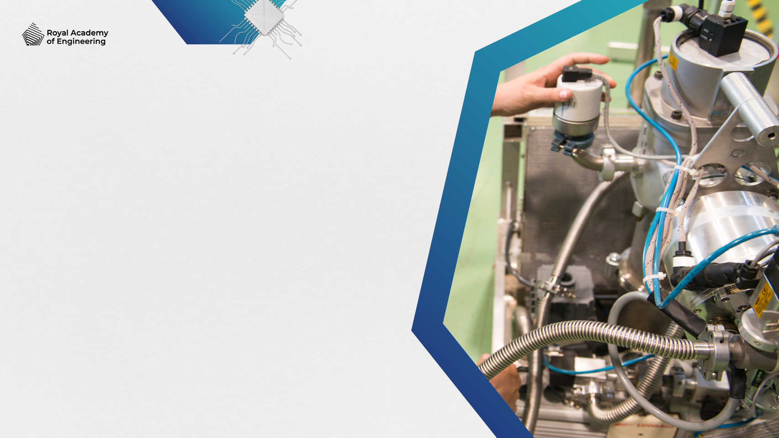

Learning outcomes
1. Mechatronic systems and control
You will be able to:
Explain some
differences between
a microcontroller,
a programmable logic controller (PLC) and a microcomputer.
Name some examples
of mechatronic systems
in domestic and
industrial settings.
List the main parts
of a control system
and describe how
they work together.
Image © This Is Engineering
3

Slide 4


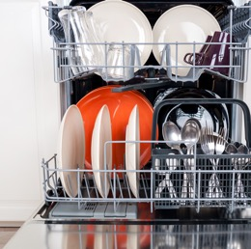
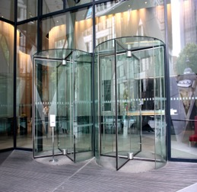
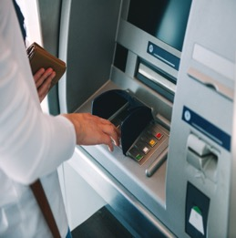
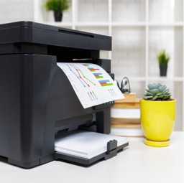
1. Mechatronic systems and control
What is a mechatronic system?
In mechatronics, mechanical, electronic and control systems are combined to create a complete system. Mechatronic systems typically perform fast and precise motions and therefore require sophisticated electronic devices and control algorithms.
Dishwasher
Automatic doors
How does each example combine
mechanical and electronic systems?
Use these examples to define
a mechatronic system.
ATM
Printer
4

Slide 5

Mechatronic systems and control
1. Mechatronic systems and control
Identify the role of each
part of a control system.
Arrange these parts and join them with arrows to show how
an electronic system can control a mechanical system.
Add labels to show input, output and feedback.
A mechatronic system combines electronics, mechanics and computer control to automate a process or response.
Electronic controller
Output
device
Input
device
Sensor
5

Slide 6



Mechatronic systems and control
1. Mechatronic systems and control
What do the
arrows in the diagram represent?
What is the importance
of feedback in a control system?
Provides the system
with a goal
Compares the current state of
the system with the goal to make decisions that reach the goal
Controls the
mechanical system
Input
device
Input
Electronic controller
Output
Output
device
Provides information about the state of the mechanical system
or its environment
Feedback
Sensor
6

Slide 7
Sensors and actuators
1. Mechatronic systems and control
Sensors are input devices that provide information about the system’s goal or current state.
Actuators are output devices that change the state of the mechanical system.
Pneumatic piston
Sort these examples
into sensors and actuators.
Organise the sensors into their five categories as shown on the activity sheet.
Tilt switch
Microswitch
Rotary encoder
Linear encoder
Flow rate
Variable resistor
Lead screw
Stepper motor
Gear train
DC motor
Switch
Thermistor
Hydraulic piston
AC motor
Light beam
Proximity switch
7

Slide 8
Sensors
1. Mechatronic systems and control
Actuators
User input
Light
Switch
Light beam
AC motor
What output devices
might a control system also include for the user?
What two types of information might a control system use to communicate with sensors and actuators?
Which of these types of information does the controller use to operate?
Variable resistor
Movement/
orientation
DC motor
Presence
Linear encoder
Stepper motor
Proximity switch
Tilt switch
Pneumatic piston
Microswitch
Flow rate
Lead screw
Temperature
Rotary encoder
Gear train
Thermistor
Hydraulic piston
8

Slide 9
Microcontrollers, PLCs and microcomputers
1. Mechatronic systems and control
Mechatronic systems use algorithms (rules or instructions) to process the inputs from setting controls and sensors
and decide the outputs controlled by actuators. These algorithms are programmed into a microcontroller, programmable
logic controller (PLC) or microcomputer.
Microcontroller
Dedicated computer on a chip
Embedded in a machine
Pre-programmed in factory
Multipurpose or single purpose
Usually low power
Dedicated input and output devices
Example:
Speed control on a brushless,
cordless drill
Programmable Logic
Controller (PLC)
Rugged, stand-alone device
Attached to a machine
Multipurpose, programmable
Usually higher power
Accepts a range of input and output devices that can be connected directly with no buffer or interface
Can be unitary (one) or modular (many)
Example:
Flow control in food manufacturing
Microcomputer
A general-purpose computer
Separate to a machine
Multipurpose, programmable using software
Accepts a range of input and output devices through an interface
Example:
Multi-axis robot control
9

Slide 10
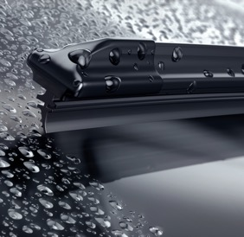
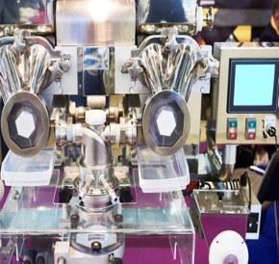

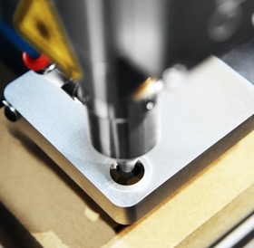
Inputs, outputs and control
1. Mechatronic systems and control
These systems all use dedicated microcontroller chips or PLCs.
Car automatic windscreen wipers
List at least one input
and one output device that
each system might contain.
What form of controller do they include?
What are the advantages of using this type of controller?
Pie filling machine
CNC milling machine
Smartphone
10

Slide 11




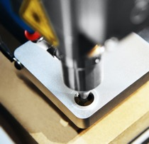
Inputs, outputs and control
1. Mechatronic systems and control
These systems all use dedicated microcontroller chips or PLCs.
Car automatic windscreen wipers
Smartphone
Input:
Rain sensor
Output:
Wiper blade motor
Control:
Microcontroller
Advantages:
Small
Cheap
Input:
Screen (touch)
Voice
Motion
Output:
Audio
Haptic
Screen (visual)
Control:
Microcomputer
Advantages:
Small
Low power consumption
Powerful processor
Pie filling machine
CNC milling machine
Input:
Weight sensor
Output:
Flow control valve
Control:
PLC
Advantages:
Rugged
Programmable
Input:
Software program
Output:
Motion control motors
Tool motor
Control:
Microcomputer
Advantages:
Versatile
Easy to load new program
11

Slide 12
Where might we find control systems?
1. Mechatronic systems and control
Identify one example
of a control system in each environment.
Suggest what inputs and outputs they might include.
List some benefits your examples of control systems deliver for their users.
Food production
Manufacturing
Renewable energy
Healthcare and hospitals
Transport
Buildings
12

Slide 13
Learning outcomes
1. Mechatronic systems and control
You will be able to:
Explain some
differences between
a microcontroller,
a programmable logic controller (PLC) and a microcomputer.
Name some examples
of mechatronic systems
in domestic and
industrial settings.
List the main parts
of a control system
and describe how
they work together.
Image © This Is Engineering
13

