Slide 1
Innovation
and emerging technologies
1. What is innovation?

Slide 2
1. What is innovation?
2

Slide 3

Learning outcomes
1. What is innovation?
You will be able to:
Explain the difference between market
pull and technology
push influences
on innovation.
Use your own
examples to
develop a definition
of innovation.
Apply your
understanding of innovation to other
topic areas and highlight reasons for/when innovation takes
place in a product
or system.
Explain the different
types of innovation
and the elements
needed for innovation
to happen.
3

Slide 4

What is innovation?
1. What is innovation?
Humanity has
innovated
throughout
our history.
Our modern
world is the
result of these
innovations.
Today’s
innovations
will shape
our future.
Identify five modern innovations you think
will shape your future.
Use your examples to write a definition of innovation.
4

Slide 5
What is innovation?
1. What is innovation?
Innovation turns ideas into improved products and services
that help a business to differentiate itself from and advance
ahead of competitors. It creates new value.
Innovation is both a process and an outcome.
Do all innovations have the
same impact or can we classify innovations into different types?
5

Slide 6
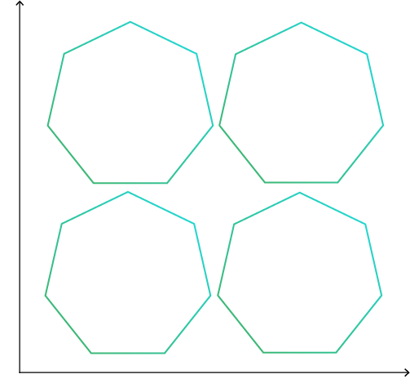
Types of innovation
1. What is innovation?
High
New
technologies
that displace established
businesses or
products to create
new value and
a new market.
We can classify innovations according to how different the innovation is from current technology and how much this changes the business or the market it operates in.
The chart shows four types of innovation:
disruptive
incremental
radical
sustaining.
Significant improvements that retain the business’s position in an
existing market.
Impact on the market
Gradual improvements to a business’s existing products and services.
Technical breakthroughs that transform industries, sometimes creating
a new market.
Label each type of innovation with the correct name.
Suggest one example of each type. Give reasons for your choices.
Low
Low
Newness of technology
High
6

Slide 7
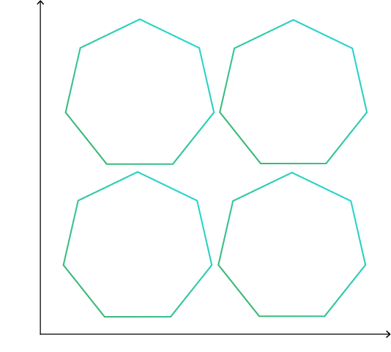
Types of innovation
1. What is innovation?
High
Disruptive
Netflix introduced streaming,
transforming how people consume
film and
TV content.
Over time one type of innovation may evolve into another.
Sustaining
Apple A15 phone chip: sustains
Apple’s dominant position.
Draw arrows on your diagram to show
how some innovations my evolve over time
into another type.
Use your answer to explain why one form of innovation could be considered most important for a company.
Innovation should form part of a company’s working culture. What processes do you think need to take place for innovation to happen?
Impact on the market
Incremental
OLED TVs improve
an existing product
but don’t grow the market for TVs.
Radical
Personal computers:
a new technology
but at first had a
limited uptake.
Low
Low
Newness of technology
High
7

Slide 8




Elements of innovation
1. What is innovation?
These four elements are essential for innovation to happen. They are a critical part of a business’s
innovation strategy: its roadmap for how it will turn ideas into new products and new value for its customers.
Work well together
Teamwork
Cross-disciplinary work
Shared vision
Generate lots of good ideas
Creativity
Prototyping
Testing
Collaboration
Ideation
Deliver great products
Design
Quality and consistency
Price
Deliver real benefits and improvements
For customers
For the company (including profit)
Implementation
Value creation
Do you think these elements happen sequentially,
simultaneously or a combination?
How might different engineering careers contribute to innovation?
8

Slide 9
Elements of innovation
1. What is innovation?
Sales
Design
Production
Sales
Design
Production design
Production management
Quality control
Customers
Company
Collaboration
Ideation
Implementation
Value creation
Customer feedback is essential
Ideation relies on strong collaboration both within the business and with its
external customers or partners.
How might a company’s R&D staff influence innovation in a different way to
how customers might influence the process, playing different roles in how new technology makes it to the market?
9

Slide 10
Market pull versus technology push
1. What is innovation?
Innovation is a dynamic process.
It can be driven by opportunities or existing capabilities.
Market pull
Innovations happen due
to customer demand.
Customer opportunities drive innovation.
Technology push
Innovations happen when applications are found for existing technologies.
R&D capabilities
drive innovation.
Identify two advantages and two disadvantages
of market-pull and technology-push innovation.
10

Slide 11
Market pull versus technology push
1. What is innovation?
Advantages
Disadvantages
Market pull
Customer opportunities drive innovation.
Known demand, making a successful product more likely.
Development may be cheaper.
Open to competitors
who will have the same market information.
Risk of ‘me too’ products.
Technology push
R&D capabilities
drive innovation.
More likely to lead to radical
or disruptive innovation.
IP protection can stop competitors entering the market.
Higher risk as success is harder to predict.
Development may be more expensive.
11

Slide 12



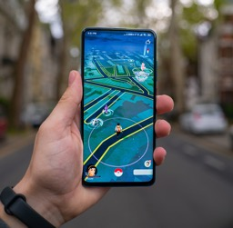

Innovations that will shape your future
1. What is innovation?
At the start you were asked to name five examples of modern innovations that may shape your future. How many of these did you mention?
Generate ideas for
how each example may shape your personal life and your future as an engineer.
Which are the most innovative companies today, and why? Discuss and justify your ideas.
Artificial intelligence (AI)
Virtual reality (VR)
Internet of things (IoT)
Augmented reality (AR)
Robotics
12

