Slide 1
Sustainability
2. Sustainability and my career

Slide 2
Practitioner guide
2. Sustainability and my career

Slide 3
Introduction and overview
These resources help practitioners to deliver the sustainability component of engineering and manufacturing-related qualifications at levels 2 and 3. They introduce the topic and stimulate learners to explore and reflect on key concepts and are designed to complement and enhance practitioners’ own lesson materials and schemes of work.
Resources summary
Resource name | Level | PPT slides + notes - practitioner | PPT slides - learner | Activity sheets | Film | Interactive
2. Sustainability and my career | 3 |  |  | 2 | * | *
*uses the film and interactive from the 1. Circular lifecycles and sustainability resource as recap tools.
Delivery
Delivery suggestions for practitioners, and suggested answers where appropriate, are in the presenter’s notes for each slide. Example answers can also be found at the end of this practitioner guide. The core activities in each resource provide around 60 mins of learning time, though additional suggestions, including independent learning, can extend this time significantly.
Overarching theme/big questions
What is sustainability?
How can engineering and manufacturing contribute to a more sustainable future, including zero waste and net zero carbon emissions?
Overview
These Level 3 resources help learners to develop a more complex understanding of sustainability and reflect on examples of sustainable practice. The resources then help learners to identify opportunities for how engineering and manufacturing can contribute to greater sustainability including their own personal contribution, and to consider how health and safety are at the heart of sustainable practice.
3

Slide 4
Learning outcomes and resource links
Level 3 resource
Sustainability and my career
Analyse a real-world example of applying the 6Rs and identify how this supports social, economic or environmental sustainability.
Give reasons why health and safety need to be at the heart of any approach to sustainability.
Formulate career ideas that emphasise sustainability within engineering or manufacturing.
Full resource list available for the topic of Sustainability:
1. Circular lifecycles and sustainability (Level 2)
2. Sustainability and my career (Level 3)
Links to other supported topics
Sustainability is included in all other topics in this series: Battery technologies, CNC machinery, Electrical machines, Engineering materials, Innovation and emerging technologies, Microcontroller systems, Renewable energy, Robotics.
4

Slide 5
Subject coverage
Sustainability
Sustainability
Sustainable design
The 6Rs of sustainability
Product lifecycles
Circular economies
Waste and disposal
Emerging trends
Including careers
How different engineering roles contribute to sustainability
Career opportunities and sustainability
5

Slide 6
2. Sustainability and my career
6

Slide 7
Learning outcomes
2. Sustainability and my career
You will be able to:
Analyse a real-world example of applying the 6Rs and identify how this supports social, economic or environmental sustainability.
Give reasons why health and safety need to be at the heart of any approach to sustainability.
Formulate career ideas that emphasise sustainability within engineering or manufacturing.
Image © This Is Engineering
7

Slide 8
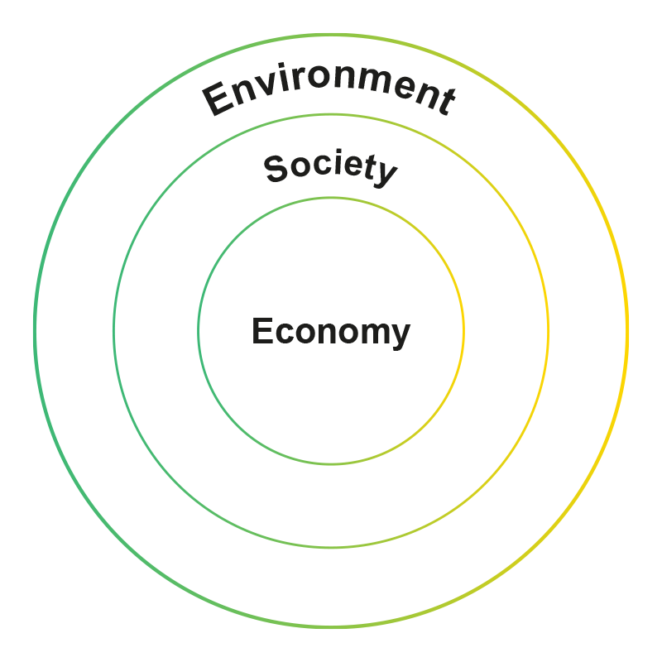
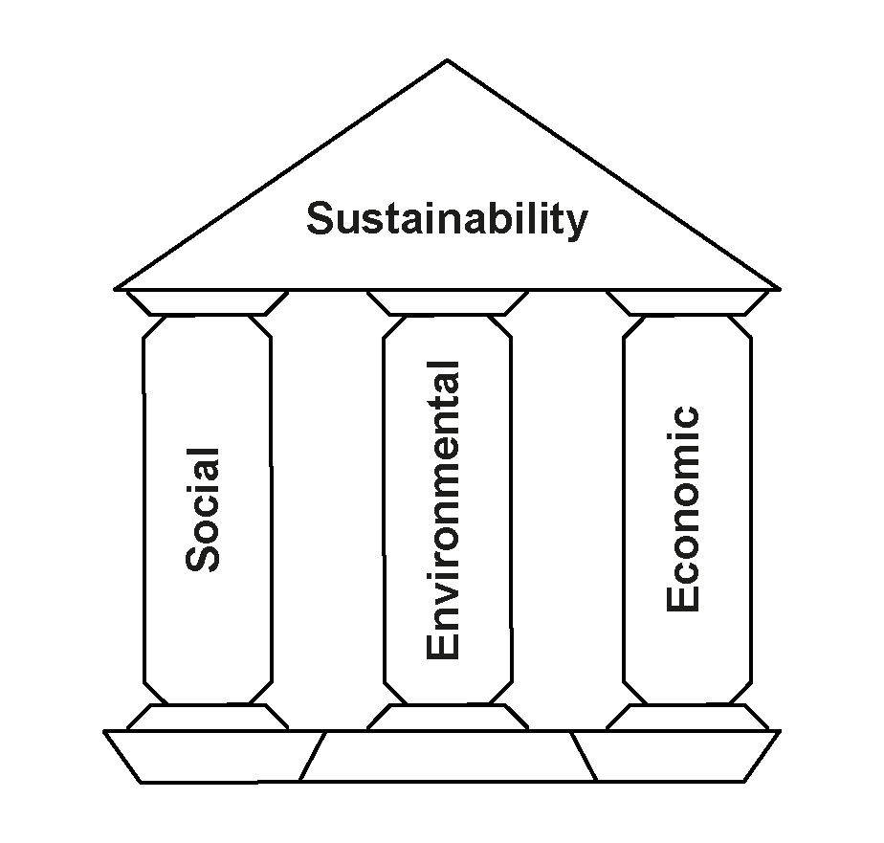
Engineering, manufacturing and sustainability
How can the 6Rs and circular lifecycles change how engineering and manufacturing impacts the three pillars of sustainability?
8
Notes:
Practitioner delivery suggestions
The Level 3 resources help learners to develop a more complex understanding of sustainability and reflect on examples of sustainable practice they identified in case studies and research in other topic areas, practised during workshop activities or observed during their work experience placement. It’s therefore helpful to deliver these resources after Level 3 learners have completed other topic areas and have had opportunities for practical work and work experience.
The resources then help learners to identify opportunities for how engineering and manufacturing can contribute to greater sustainability including their own personal contribution, and to consider how health and safety are at the heart of sustainable practice.
Starter activity
In groups or pairs, learners recall and discuss their own definitions of sustainability. Then, they identify three actions someone in their occupational specialism could take to make their practice more sustainable.
Learners could create concept maps of the 6Rs and recall and sketch the diagram for a circular lifecycle.
Interactive tool and film
Learners can rewatch the Sustainability film and use the Sustainability interactive tool to refresh their memory of linear lifecycles, the 6Rs of sustainability and circular lifecycles.
Activity
Explain that sustainability rests on or is made up of three elements: social sustainability, environmental sustainability and economic sustainability. In groups, learners choose one element and suggest what this might include.
To extend their learning, ask learners to explain why on the right, the three pillars are instead nested. How does this version of the diagram help them to understand how each pillar is interrelated with the others?
Example answers
Social sustainability includes health, equality/equity, education and standard of living.
Environmental sustainability includes biodiversity, resource use, pollution, regeneration, net zero carbon emissions and zero end-of-life waste.
Economic sustainability includes innovation, corporate ethics and profitability.
Assessment
Recall of Level 2 learning
Explanation of how social, environmental and economic sustainability interrelate.
Case study
Learners can explore the six principles at:
Engineering Council guidance on sustainability: www.engc.org.uk/sustainability/

Slide 9
Recap: rethink, refuse, reduce
Rethink:
What real need does this product satisfy?
What benefits do we need to deliver?
How could the product do the same thing, differently?
How can we reduce our resource use and waste and contribute to zero end-of-life waste and net zero carbon emissions?
Refuse:
What materials are usually used in products like this?
What materials are used in parts we don’t really need?
Do any materials harm the environment?
What less harmful materials can we use instead?
Reduce:
How can the design be simpler than existing products?
How can it use less materials, while still being safe and fit for purpose?
What features don’t people need?
Think about: Use, Design, Recovery, Production
9
Notes:
Practitioner delivery suggestions
Activity
Practitioners can use this slide and the one that follows to review real-world applications of the 6Rs and circular lifecycles. Learners could use the stimulus questions to:
Analyse real-world examples from case studies in other topics, practical work and work experience, and share with the group.
Where possible, identify quantifiable differences (for example a percentage reduction in material use, water use, waste or carbon emissions) and consider the effect of production at scale - what does a small percentage change add up to in terms of mass or volume when multiplied over hundreds, thousands or millions of products?
Build on their Level 2 work by reimagining a product or process, inspired by the examples they have explored, and identify how their ability to apply the 6Rs has progressed.
Alternatively, print each R’s stimulus questions on a large sheet of paper and spread around the room or stick to the walls. Learners rotate between Rs and write examples for each one. Then, assign one sheet to a group and ask groups to collate, organise and present learners’ ideas.
Embed health and safety
Practitioners may wish to use the slide on health, safety and sustainability (slide 12) to include health and safety in class discussions.
Activity sheet
Learners complete Sustainability - Activity sheet 3 to capture their ideas, which they could develop into a report or presentation.
Example answers
Please see the slide that follows.
Assessment
Recall of examples from case studies, practical work and work experience.
Discussions.
Written work using Sustainability - Activity sheet 3.

Slide 10
Recap: reuse, repair, recycle
Reuse:
Can the whole product be used for something else at the end of its life?
Which parts could be reused at the end of the product’s life?
How will the product be taken apart?
How might someone reuse each part?
Repair:
What parts of our design might break or wear out?
How could these parts be repaired or replaced?
How can the design make it easier to disassemble and repair?
Who might do this, and where?
Recycle:
Which parts or materials can be recycled at the end of the product’s life?
How would these products be recovered?
How might they be remanufactured into the same product again?
How might they be reprocessed into new things?
Think about: Use, Design, Recovery, Production
10
Notes:
Practitioner delivery suggestions
Please refer to the previous slide’s practitioner delivery suggestions.

Slide 11
Engineering, manufacturing and sustainability example answers
Company and product: Ocado Technology - 600 Series Bots
Situation: Ocado Technology designs and builds robotic warehouse systems for picking and packing online grocery orders. They wanted to make their main robot design lighter and more efficient to operate.
R(s) used in solution: Rethink and Reduce
Action: Ocado engineers used ideas from aerospace manufacturing to redesign the robot frame so it could be made using additive manufacturing and 3D printing so the frame is smaller and uses much less material. This used computer simulations of the stress on the frame.
Environmental, social, economic impact: The 600 Series Bot is the world’s lightest and most efficient warehouse robot, takes less material to make and smaller motors to operate, uses less energy to run – so has a lower impact on climate change. The lighter robot imparts lower inertial forces on the storage grid that it runs upon, allowing future grid structures to be designed with lower density materials.
11
Notes:
Practitioner delivery suggestions
Activity
Review the example answers on the slide.
Extension
Watch a video about the 600 series bot development at www.youtube.com/watch?v=fy4vpjw_nNw

Slide 12
Health, safety and sustainability
2. Sustainability and my career
How can the 6Rs include health and safety within sustainability?
Rethink
Design for safer products and safer production.
Refuse
Social impacts Safer employees and communities.
Economic impacts Reduced costs from fewer accidents.
Environmental impacts Cleaner ecosystems.
Design out unsafe materials and features.
Hazards
Reduce
Limit the use of environmentally unfriendly substances.
Reuse
Make sure reused items are safe and fit for purpose.
Repair
Keep machinery in good working order.
Recycle
Recycle polluting substances to keep them out of landfill and ecosystems.
Notes:
Practitioner delivery suggestions
This slide supports an exploration of how sustainability includes health and safety.
Activity
Introduce a scenario: On 4 August 2020, a large amount of ammonium nitrate stored at the Port of Beirut, the capital city of Lebanon, exploded, causing at least 218 deaths, 7,000 injuries, and US$15 billion in property damage, and leaving an estimated 300,000 people homeless. A cargo of 2,750 tonnes of the substance (equivalent to around 1.1 kilotons of TNT) had been stored in a warehouse without proper safety measures for the previous six years.
(Source: en.wikipedia.org/wiki/2020_Beirut_explosion
Use this example to discuss how health and safety issues are linked to social, environmental and economic sustainability. How might students apply some of the 6Rs to prevent a similar accident?
Learners suggest which of the 6Rs comes first, to place health and safety at the heart of sustainability - Rethink.
Use the stimulus on the slide to consider aspects of health and safety. Learners can link to their occupational specialism and (perhaps using an existing risk assessment), identify possible social, economic and environmental impacts of an accident in that occupational context. Learners can report verbally or create a brief report.
Example answers
From the scenario:
The physical damage caused links to environmental and economic sustainability due to pollution and loss of employment and productivity.
The human effects, which took away family members and breadwinners, link to both social and economic sustainability due to illness, injury, death and loss of employment.
Until the environment is repaired, economic and social losses cannot be remedied.
Rethinking helps to place safety at the heart of design and production - safer products and safer production reduces accidents, injuries and pollution.
Assessment
Discussions.
Ability to relate to occupational specialism (verbal or written report).

Slide 13
Sustainability careers: what might your role be?
Aisha identified a recyclable alternative to existing plastics in a product, helping to minimise material requirements while maintaining strength.
Jade redesigned a product to make it easy to disassemble and make parts that wear out easy to replace.
Materials engineer
Repair
Design engineer
Goals:
Net zero new resource use
Net zero carbon emissions
Zero end-of-life waste
Hannah explored how customers use a product to find ways to ‘design out’ unnecessary parts and make it easier for them to repair and recycle, for zero end-of-life waste.
Kevin redesigned a production process to use less energy, reduce material waste and recover waste materials for remanufacture.
Recycle
Reuse
Manufacturing systems engineer
Product designer
Rahim helped to design a factory building to reduce energy use, include solar generation, and create a wildlife habitat.
Noah ensured the factory’s solar panels are efficient, to maximise contribution towards net zero carbon emissions and helps the factory schedule some processes for when energy is cheapest.
Sustainability consultant
Consumption
Production
Energy engineer
13
Notes:
Practitioner delivery suggestions
Practitioners may find it helpful for learners to have access to the Prospects website or other preferred careers directory.
Activity
Explain that the brief career case studies on the slide illustrate how a wide range of roles contribute to greater sustainability - in fact any role. (Note that only one role includes ‘sustainability’ in its title.)
In groups, learners could identify what they know about one or all roles, capturing their ideas as lists or concept maps (divide roles between groups or learners rotate between tables for a carousel approach).
Learners could then use the links below to research more about one career, identifying opportunities for that role to contribute to sustainability, and report back (learners can also search for more roles in engineering or manufacturing).
Share reports and invite each learner to suggest one career of interest.
www.prospects.ac.uk/job-profiles/materials-engineer
www.prospects.ac.uk/job-profiles/manufacturing-systems-engineer
www.prospects.ac.uk/job-profiles/sustainability-consultant
www.prospects.ac.uk/job-profiles/energy-engineer
www.prospects.ac.uk/job-profiles/product-designer
www.prospects.ac.uk/job-profiles/design-engineer
Highlight that according to government data, across the UK there are already more than 410,000 jobs in low carbon businesses and their supply chains. Ask learners to suggest what ‘low carbon’ business might describe (industries that directly or indirectly support the UK’s transition to creating zero net carbon emissions from energy use).
Learners could visit assets.publishing.service.gov.uk/government/uploads/system/uploads/attachment_data/file/1003570/gjtf-report.pdf
and review pages 17-25 (learners could do this in groups and read one section each). They could identify job opportunities in these sectors and report back, noting any sectors of interest to research further.
Highlights:
Offshore wind: By 2026, the sector could employ around 70,000 workers (40,000 direct jobs and 30,000 jobs in the supply chain).
Upgrading the grid: National Grid estimates a need to recruit for 400,000 energy jobs between now and 2050 to get to net zero, including 260,000 new roles.
Smart systems: (smart grid, Internet of Things etc.) could support around 10,000 jobs.
Buildings retrofit: 12,000 workers need to be trained every year for about the next four years before ramping up to 30,000 workers per year by 2030.
Automotive: New gigafactories could create up to 78,000 new jobs. An additional 7,500-10,000 workers will also be needed in battery cell manufacturing by 2030
Domestic heating and cooling: 60,000 workers will be needed by 2030 for heat pump installation in domestic and non-domestic buildings.
Assessment
Discussion of the engineering roles on the slide.
Reporting back after internet career research.
Ability to identify opportunities in low or zero carbon industries.

Slide 14
Sustainability: over to you
How can you apply the 6Rs as you develop your occupational skills?
How could you contribute to greater sustainability in your future career?
Image © This Is Engineering
14
Notes:
Practitioner delivery suggestions
Link this activity to the occupational skill element of the qualification of the learners - learners’ practical skill development and work experience.
Activity
Highlight that the need for sustainability, including getting to zero waste and net zero carbon emissions, is everyone’s responsibility - and everyone’s opportunity, including professional.
Explain that ethics is the branch of learning that deals with moral principles - the ideas that govern a person's behaviour.
Learners could reflect on the ethics of sustainability and consider the ethics of:
Is it OK to use finite resources now that might not be available to future generations?
Is it OK to act now (for example burning fossil fuels) in ways that will make the world a worse place for future generations (for example due to sea level rise and extreme weather caused by climate change).
Is it OK to create problems that future generations will have to solve (for example resources trapped in landfill waste, or the effects of long-term pollutants)?
Is it OK that some parts of the world have much less access to the benefits of modern life than others, even though giving everyone equal access will make environmental and climate problems even worse?
What is the correct ethical response to these challenges for today’s global population?
Learners could summarise their learning by linking it to their current learning and future career aspirations and complete Sustainability - Activity sheet 4, which uses the 6Rs as a framework for considering opportunities for sustainable practice. Share ideas.
Assessment
Written work - Sustainability - Activity sheet 4.

Slide 15
Sustainability: over to you - example answers
Here’s one example of how an engineer could apply the 6Rs and contribute to greater sustainability: Occupational specialism: CNC machine operator
Career aspiration: Production engineer
Rethink: Find ways to build using 3D printing etc. rather than mill from blocks or sheets.
Refuse: Work with CAD team to simplify designs.
Reduce: Improve layouts to get more parts from one block or sheet. Use efficient tool paths for less energy use.
Reuse: Find ways to machine small parts from sheet skeletons or waste blocks.
Repair: Redesign parts so they can be removed and replaced.
Recycle: Create a closed loop with material suppliers to return waste raw materials for reprocessing.
15
Notes:
Practitioner delivery suggestions
Activity
Review the example answers on the slide.

Slide 16
Learning outcomes
2. Sustainability and my career
You will be able to:
Analyse a real-world example of applying the 6Rs and identify how this supports social, economic or environmental sustainability.
Give reasons why health and safety need to be at the heart of any approach to sustainability.
Formulate career ideas that emphasise sustainability within engineering or manufacturing.
Image © This Is Engineering
16

