Slide 1
Robotics
4. Planning for safety
and performance

Slide 2
4. Planning for safety and performance
2

Slide 3


Learning outcomes
4. Planning for safety and performance
You will be able to:
Apply your
understanding of robotics design principles to plan a simple robot work cell, suggesting effective safety features and practices.
Identify safety considerations and human dangers when working alongside robots.
Review the application and effectiveness of safety systems.
3

Slide 4

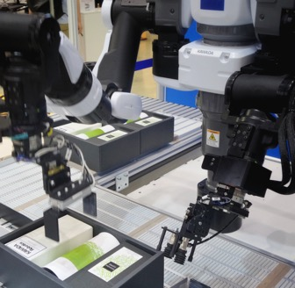

Hazards around industrial robots
4. Planning for safety and performance
Hazards
Impacts
Crushing
Electrical
End effector or tool
Environmental (eg paint spray, swarf)
Mechanical fault
Control fault
Causes
Entry into work envelope or tool area
Mechanical breakdown
Electronic breakdown
Incorrect programming
Incorrect installation
Incorrect operation or change to programmed operation
What safety steps can be taken to mitigate or
remove these hazards?
Discuss which of these steps takes place before operation and which might take place once operation begins.
4

Slide 5
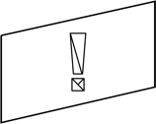
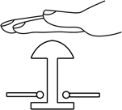



Safety devices and procedures
4. Planning for safety and performance
Safety devices can be designed into the robot work cell (operating area):
Fences and guards
Hold and emergency
stop buttons
Presence
sensors
Pressure
mats
Enabling device/
Dead man’s switch mats
Interlocks
Safety procedures include programming, training and safe standard operating procedures (SOPs) for operation, planned and unplanned maintenance.
Discuss how each device contributes to maximum safety around an industrial robot.
Identify any factors that might influence the effectiveness of each device.
5

Slide 6
Safety devices and procedures
4. Planning for safety and performance
Fences and guards are physical barriers to prevent entry and protect from flying material. | BUT: They need to be closed. Interlocks and microswitches can prevent operation if they are open.
Hold buttons pause or slow operation but don’t provide operator safety. Emergency stop buttons cease operation immediately and completely. | BUT: Buttons need to be correctly wired into the control circuit and used after operator training.
Presence sensors and pressure mats detect when a human is within a certain area or distance and can be mounted on the work cell or on the robot itself. | BUT: To work well they must be located and calibrated to protect the working area.
An enabling switch must be pressed at the same time as the start button. A dead man’s switch must be held at all times to enable operation. | BUT: Both need to be correctly wired into the control circuit and used after operator training.
Interlocks connect two systems to prevent something from happening, for example to detect an open safety fence and prevent operation until closed. | BUT: Interlocks need to be placed to prevent each possible unwanted event and must be included in the safety programming for the robot and work cell.
6

Slide 7
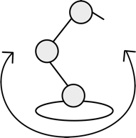
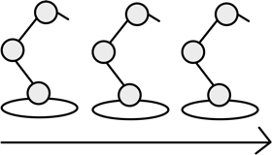
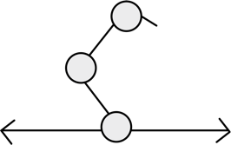
Robotic work cells
4. Planning for safety and performance
Work cells are where robotic systems perform their tasks. The work cell contains the robot(s), control system(s), tool areas and other necessary components. Work cells are optimised to maximise productivity and safety and minimise waste.
A work cell can be:
Discuss some advantages and
suitable applications for each type of robotic work cell.
How might material flow from one cell to another and within
a cell?
Robot-centred
Designed around
a single robot.
In-line
Several robots work
in a line.
Mobile
One robot moves along
a rail.
7

Slide 8
Material flows
4. Planning for safety and performance
Material flow is an important aspect of work cell design and contributes to the overall efficiency of a design.
Synchronised
Material stops at each robot, at the same time.
Continuous movement
Material always moves, robots must track and follow.
Non-synchronised
Some material moves, while some is processed.
What is the desired outcome when planning material flow within a work cell?
What factors might influence whether material flow is intermittent, continuous or non-synchronised?
8

Slide 9
Plan a robotic work cell
4. Planning for safety and performance
An autonomous guided vehicle (AGV) will deposit a bin of stacked metal components to a robotic work cell. Each component needs to be:
Lifted from the bin.
Processed in a CNC mill to shape the top surface.
Processed in a CNC drill to make holes in the top surface
(both processes take about the same time).
Stacked in a finished component bin to be collected by
another AGV and moved to another work cell.
9

Slide 10
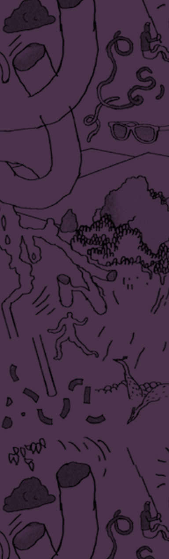

Plan your work cell and material flow
4. Planning for safety and performance
Your cell plan shows how work will enter and leave the cell.
Choose whether your work cell
will be robot-centred, in-line
or mobile.
Select what type(s) of robot you will include in your work cell:
Articulated
SCARA
Delta
Spherical
Polar/Cylindrical
Cartesian/Gantry
Identify where you will locate
the CNC mill and CNC drill.
Sketch the position and size of each robot on the cell plan. Label them to describe the key operational steps.
Sketch a plan view of each robot’s work envelope.
Choose how material will flow through the work cell:
Synchronised
Continuous
Non-synchronised
10

Slide 11

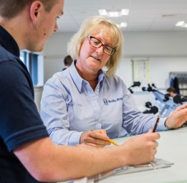
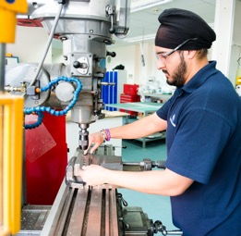
Add safety features and define safe working practices
1. Introducing robotics
On activity sheet 9, add
and label safety features that will make your cell a safe working space:
Fences and guards
Hold and emergency stop buttons
Presence sensors
Pressure mats
Enabling device/ dead man’s switch
Interlocks
On activity sheet 10,
list some safe working practices
that should take place:
when the work cell is in design (being planned and programmed)
when the work cell is in operation.
Image © This Is Engineering
11

Slide 12
Example solution: activity sheet 9
4. Planning for safety and performance
Fence
Enabler
6-axis
arm
Hold/Stop
Hold/Stop
Unprocessed
components
Processed
components
Interlock
Interlock
Pressure mat
in work envelope
Presence sensor
Presence sensor
CNC mill
CNC drill
12

Slide 13
Example solution: activity sheet 10
4. Planning for safety and performance
Safe working practices during design:
Follow manufacturer’s guidance
Follow health and safety legislation and codes of practice
Identify all hazards and ways to mitigate or remove them
Design safe operating procedures
Design safety training
Include safety signage
Safe working practices during operation:
Follow manufacturer’s guidance
Follow health and safety legislation and codes of practice
Only authorised employees operate the cell
Only authorised employees maintain the cell
Train all employees to follow safe operating procedures for use and maintenance.
Keep to maintenance schedule to ensure optimum performance.
13

