Slide 1
Engineering materials 1. Materials in engineering

Slide 2
Practitioner guide 1. Materials in engineering
2

Slide 3
Introduction and overview
1. Materials in engineering | Practitioner guide
These resources help practitioners to deliver the materials components of engineering and manufacturing-related qualifications at levels 2 and 3. They introduce the topic and stimulate learners to explore and reflect on key concepts, and are designed to complement and enhance practitioners’ own lesson materials and schemes of work.
Resources summary
Prerequisites – it is essential that learners complete the Sustainability module and helpful if they complete Innovation and emerging technologies module before starting this resource.
Resource name | Level | PPT slides + notes - practitioner | PPT slides - learner | Activity sheets | Film | Interactive
1. Engineering materials | 2 |  |  | 2
Delivery
Delivery suggestions for practitioners, and suggested answers where appropriate, are in the presenter’s notes for each slide. The core activities in each resource provide around 60 mins of learning time, though additional suggestions, including independent learning, can extend this time significantly.
Overarching theme/big questions
How can engineers choose the right materials for the job?
How are innovations in materials changing what engineers can do?
Overview
The Level 2 resource defines engineering materials and explores how engineers relate the properties of materials to their purpose. The resource introduces some key areas that later resources develop and, importantly, gauges any prior understanding.
The Level 3 resources introduce physical and material properties, and material classifications. They help learners to understand the definitions of key properties and explore innovations in materials, including the potential applications of smart materials. Learners will also consider how engineering controls, administrative controls and PPE help to mitigate hazards from materials and material processing.
3

Slide 4
Learning outcomes and resource links
1. Materials in engineering | Practitioner guide
Level 2 resource
Materials in engineering
Define an engineering material.
Suggest some materials that could help to solve an engineering problem.
Identify some materials that allow personal protective equipment (PPE) to keep you safe.
Full resource list available for the topic of Engineering materials:
1. Materials in engineering (Level 2)
2. Physical and mechanical properties of materials (Level 3)
3. Innovations and modern materials (Level 3)
4. Smart materials (Level 3)
Links to other supported topics
Battery technologies, Electrical machines, Innovation and emerging technologies, Renewable energy, Sustainability
4

Slide 5
Subject coverage
1. Materials in engineering | Practitioner guide
Materials
Definition of an engineering material
Material properties and applications
Health and safety (PPE)
Including careers
Use of materials and health and safety in the workplace
5

Slide 6
1. Materials in engineering
6

Slide 7
Learning outcomes
1. Materials in engineering
You will be able to:
Define an engineering material.
Suggest some materials that could help to solve an engineering problem.
Identify some materials that allow personal protective equipment (PPE) to keep you safe.
Make calculations of battery capacity in Watt-hours (Wh).
7
Image © This Is Engineering

Slide 8
Engineers and the materials they use
1. Materials in engineering
Concrete for buildings
UPVC for guttering
High speed steel
(HSS) for drill bits
PLA plastic for 3D printing
Discuss why each material is a good choice for its application.
What is an engineering material? Discuss your ideas and think of a definition.
Suggest what knowledge and understanding an engineer might need to work with materials.
8
Notes:
Practitioner delivery notes
This Level 2 resource introduces the concept of engineering materials, and how engineers in a range of sectors need to understand the properties of the materials they will work with and relate these to the purpose of the material. Learners don’t need to know any specific material properties, which are introduced in the Level 3 resources - this resource introduces some key concepts that later resources develop and, importantly, gauges any prior understanding.
Activity
Introduce the topic of materials. Suggest some common materials and ask learners why each one might be used for the named application.
Concrete for buildings: strong, durable and weather-resistant
UPVC for guttering: light, rigid and does not break down in sunlight
High-speed steel (HSS) for drill bits: hard, and stays hard when heated
PLA plastic for 3D printing: low melting point, easy to surface finish, good mechanical properties
Learners could generate additional ideas for materials in pairs or small groups, including at least one they think is unusual or interesting.
Learners discuss the questions at the bottom of the slide.
Example answers
An engineering material is any material that is used in the construction or production of artificial structures and objects. This means that engineering materials can include natural materials like wood and stone as well as modern materials like metal alloys, plastics and composite materials, such as carbon fibre.
An engineer needs to understand the properties of the materials they might use in order to select materials with the right properties for each application. Put simply, a material that will work as intended and not, for example, be too soft or brittle.
Assessment
Discussion and verbal suggestions, including a definition of an engineering material.
Film
Learners can watch the Engineering materials film.

Slide 9
Purposes, properties, materials and sustainability
1. Materials in engineering
An engineering material is any material used in the construction or production of artificial structures and objects.
The urgent need for greater sustainability is the wider context in which all engineering material choices need to be made.
Engineers first understand the purpose of the materials they will use…
…which helps them identify what properties these materials need to have…
…which helps them choose the right materials for each application.
Materials contribute to how a structure, component or mechanism functions under expected conditions.
A property describes a specific aspect of how a material behaves.
Material choices will affect performance, safety, cost and design/aesthetic decisions.
Discuss how engineers might determine or estimate the expected conditions that a structure, component or mechanism might operate in.
Discuss why each of these aspects of a project (purpose, properties, materials) is important for engineers to consider.
Suggest what will make an engineering material a more sustainable choice.
9
Notes:
Practitioner delivery notes
Learners can consider how applying the 6Rs of sustainability can help to guide more sustainable material choices (Rethink, Refuse, Reduce, Reuse, Repair, Recycle).
Activity
Review the definition of engineering materials at the top of the slide.
Work through the flowchart discussing how material selection follows from a clear understanding of the engineering problem to be solved: materials are part of the engineering solution to obtaining the desired performance from a structure, component or mechanism.
Materials contribute to how a structure, component or mechanism functions under expected conditions.
A property describes a specific aspect of how a material behaves.
Material choices will affect performance, safety, cost and design/aesthetic decisions.
Sustainability is always the broader context for any engineering material choice.
Example answers
Engineers will have access to a range of existing data about operating conditions, which may come from established formulas or primary data, or they will need to generate this data through simulations or testing.
Engineers need to consider all aspects of a project to deliver both a successful solution for their clients and a successful project for their employer. Materials need to deliver at least the minimum required performance so while ‘better’ material choices may exist, it may not make sense to use these and ‘overengineer’ a solution beyond what is needed for safety. Overspecifying materials can have a significant cost implication and engineering projects are often won through competitive tender. Where several possible materials are available that meet performance and cost criteria, a final choice may be made based on how each material can be processed and finished (a cheaper material may require more expensive processing, for example) or because a certain ‘look’ is preferable and is of value to the end client or customers.
A material might be a more sustainable choice if, for example:
It is recycled or can be recycled at the end of the project’s lifecycle.
Less of the material can be used for the same safety and performance.
The material contains less embodied carbon (the carbon emissions caused by its extraction, processing and manufacture).
The material is easy to replace or repair.
The material or its processing and manufacture has a low toxicity.
Assessment
Discussion.
Verbal suggestions.
Prior knowledge of materials and properties.

Slide 10
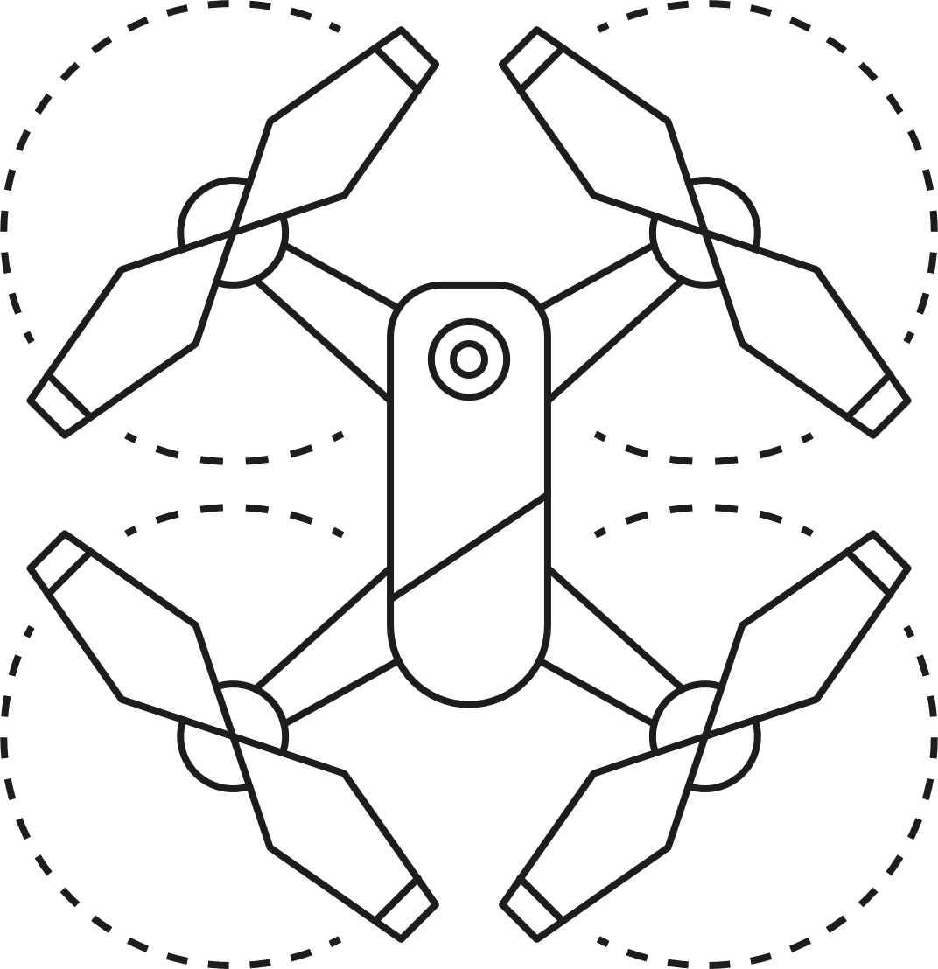
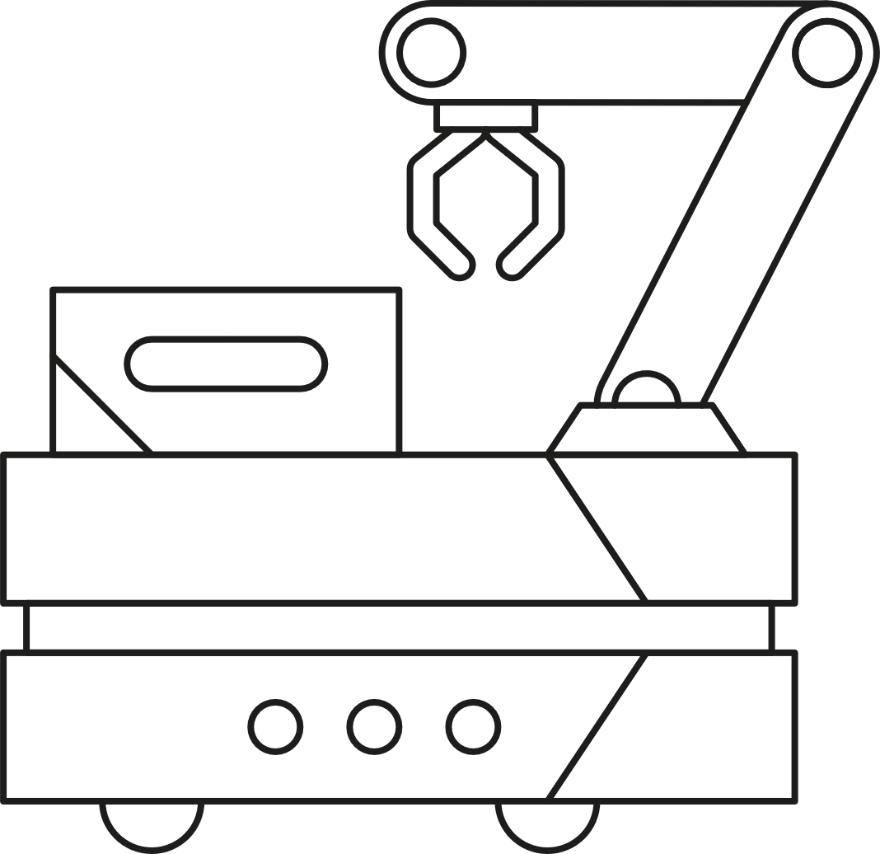
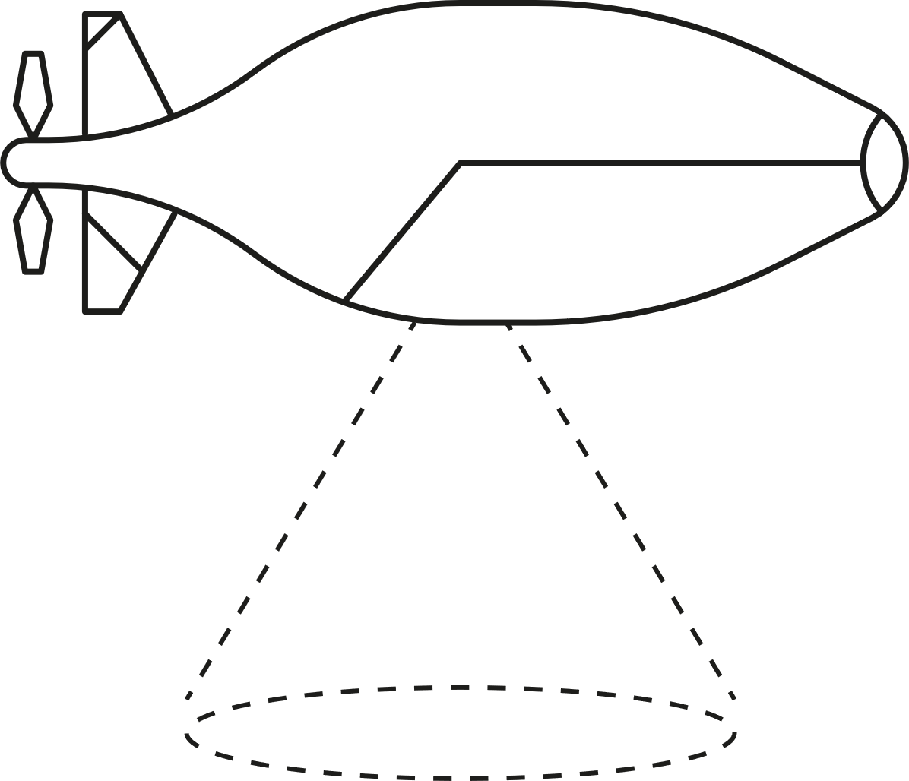
Materials and unmanned vehicles
1. Materials in engineering
Unmanned vehicles are transforming how engineers can access and inspect hard-to-reach places, or how they are able to plan the movement of materials, parts and products within a factory or warehouse.
What are the most important considerations about the purpose and properties of the materials used for each unmanned vehicle?
What materials might an engineer select for the frame and cover of each unmanned vehicle?
Air
Ground
Underwater
Think:
Purpose
Properties
Materials
10
Notes:
Practitioner delivery notes
Activity
Discuss how engineers might use unmanned vehicles for inspection or as part of factory or warehouse designs.
Learners consider suitable material choices for the frame and cover/case of each example vehicle.
Activity sheet
Learners complete Engineering materials - Activity sheet 1.
Example answers
Please see the next slide.
Extension
Learners could research examples of each type of vehicle to find out what materials they are made of.

Slide 11
Materials and unmanned vehicles - answers
1. Materials in engineering
 | Air | Ground | Underwater
Purpose and properties | Needs to fly. Needs materials that are very light and rigid. | May carry a heavy load. Needs materials that are strong and wear-resistant to carry out the same task many times. | Operates at depth. Needs materials that resist corrosion and high pressure.
Materials | Frame: Carbon fibre Magnesium alloy Cover: Plastics like ABS | Frame: Steel or alloy Cover: Fibreglass composite or steel | Frame: Steel Cover: Polycarbonate Stainless steel
The need for sustainability might drive material choices that are as light as possible for the application (to reduce energy use during operation), have been recycled (to reduce virgin material use) and can be replaced, repaired or recycled again at the end of the vehicle’s useful life (to support circular lifecycles).
11
Notes:
Practitioner delivery notes
Activity
Discuss the example answers on the slide.

Slide 12
Materials and safety
1. Materials in engineering
Engineers choose materials that help machines and constructions to be safe. The right materials also help PPE to perform well.
Think:
Purpose
Properties
What materials do you think make this machine safe to operate and how are they used?
What materials do you think help PPE to keep a machine operator or engineer safe?
Materials
Image © This Is Engineering
12
Notes:
Practitioner delivery notes
This can link to the safe use of CNC machines, covered in the CNC machinery module.
Activity
Discuss when or where engineers might need to wear PPE, for example in a factory or outside on site. List some suggestions for the hazards they might encounter (heat, flying particles, noise, chemicals, etc.)
Learners consider suitable material choices for a CNC machine’s safety features and typical PPE.
Activity sheet
Learners complete Engineering materials - Activity sheet 2.
Example answers
Please see the next slide.
Extension
This can link to the safe use of CNC machines, covered in the CNC machinery module.

Slide 13
Materials and safety - answers
1. Materials in engineering
All of these materials are strong or resistant to forces, noise, flying particles or chemicals.
Respirator
or mask
Polyester protective clothing
Plastic and rubber insulation protects from electricity
Coloured plastic safety buttons
Rubber, suede or leather gloves
Hard plastic safety hat
Steel panels protect from internal machinery
Steel, leather and rubber boots or shoes
Plexiglass allows safe viewing of operations
Foam ear protection
Plastic eye protection
Face shield
Think:
Purpose
Properties
Materials
Image © This Is Engineering
13
Notes:
Practitioner delivery notes
Activity
Discuss the example answers on the slide.
Optionally, learners could discuss what might help PPE to be more sustainable.
Example answers
More sustainable PPE could:
Be cleaned for reuse.
Be repairable or have replaceable parts.
Use recyclable plastics or other materials.
Be reused for other purposes at the end of its useful life as PPE.

Slide 14
What materials will keep you safe?
1. Materials in engineering
The Personal Protective Equipment at Work (Amendment) Regulations 2022 (PPER 2022) define the legal obligations of employers and employees regarding PPE. This places a duty on every employer in Great Britain to ensure that suitable PPE is provided to employees who may be exposed to a risk to their health or safety while at work.
PPE should be regarded as the last resort to protect against risks to health and safety. Engineering controls and safe systems of work should be considered first.
You are required to use PPE properly following training and instruction from your employer. If the PPE you are given is lost or becomes defective, you should report that to your employer.
Research what PPE you may need to use, or did use, as part of your industry placement or first job.
Find out what materials each item of PPE is made from and what the item protects you from.
Find out how to care for each item and how to identify when it is worn or defective.
14
Notes:
Practitioner delivery notes
This open-ended activity helps to prime learners to become safe engineers by understanding and carrying out their responsibilities regarding PPE. Amend to suit how you plan with learners for their industry placement or follow up on a previous placement.
Activity
Review the information on the slide.
Discuss how learners can complete the suggested research on the slide and make this a part of their everyday practice as safe engineers.
Assessment
Discussion and verbal answers.
Understanding the importance of complying with their legal obligations under PPER 2022.
Willingness to find out about their PPE responsibilities.
Extension
Learners can find out more about employer and employee obligations under PPER 2022 at:
www.hse.gov.uk/ppe/ppe-regulations-2022.htm

Slide 15
Learning outcomes
1. Materials in engineering
You will be able to:
Define an engineering material.
Suggest some materials that could help to solve an engineering problem.
Identify some materials that allow personal protective equipment (PPE) to keep you safe.
Make calculations of battery capacity in Watt-hours (Wh).
Image © This Is Engineering
15

