Slide 1
Electrical
machines
2. Investigating torque,
speed and current

Slide 2
Electrical
machines
2. Investigating torque,
speed and current
2

Slide 3
Learning outcomes
2. Investigating torque, speed and current
You will be able to:
Describe how torque and speed vary with current in
a series-wound and shunt-wound DC motor.
State the formula for calculating the output power of an electric motor.
Calculate the mechanical power of a motor based
on its rotational speed
and torque.
Image © This Is Engineering
3

Slide 4


Torque, speed and current in DC motors
2. Investigating torque, speed and current
Torque and speed vary with current in different ways in series, shunt and compound DC motors:
In a series-wound motor:
Torque is proportional to the square of the current. Speed is inversely proportional to the square of current.
In a shunt-wound motor:
Torque is proportional to current. Speed is inversely proportional to current.
In the sketch
graphs, identify which of motors A and B is series-wound and which is shunt-wound.
Motor C is compound-wound. Its torque and speed characteristics are a compromise between series and shunt. Describe how motor C’s characteristics might look on each graph.
B
Torque (Nm)
Speed (RPM)
A
B
A
Current (A)
Current (A)
4

Slide 5
Torque, speed and current in DC motors
2. Investigating torque, speed and current
A compound-wound motor’s torque and speed characteristics
are midway between those of series and shunt-wound motors.
These speed and torque characteristics can be combined to identify how speed varies with torque:
C Compound
B Series
B Series
A Shunt
Torque (Nm)
A Shunt
A Shunt
Speed (RPM)
Speed (RPM)
B Series
C Compound
C Compound
Current (A)
Current (A)
Torque (Nm)
The current draw through a motor is dependent on the load.
Use the speed v current graph to explain why it might
be dangerous to start a series-wound motor with no load.
Use this graph to explain why a series-wound motor is a
better choice for when a heavy load must be moved from rest.
5

Slide 6


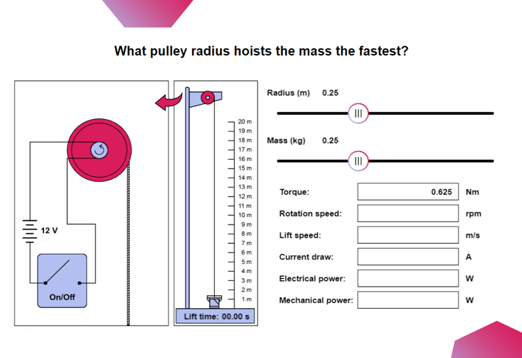
Investigating torque and current
2. Investigating torque, speed and current
The Electrical machines interactive tool supports a range of investigations
into the relationships between load, torque, speed, power and efficiency.
1. Use the sliders to
set the radius and mass
2. Click on the switch
to run the motor every time you set the radius and mass.
3. Observe how the values change.
Set r = 0.1 m
and, for the range of values for mass, plot a chart of torque (y axis) against current draw (x axis).
Use your chart to identify whether this is a series or shunt-wound motor.
6

Slide 7
Investigating torque and current – answer
2. Investigating torque, speed and current
The motor demonstrates a linear relationship between torque and current.
This is a shunt-wound DC motor.
Torque (Nm) v Current (A)
0.5
0.4
0.3
Torque (Nm)
0.2
0.1
0.0
0.0
0.2
0.3
0.4
0.5
0.6
Current (A)
7

Slide 8

Investigating lift speed
2. Investigating torque, speed and current
The motor is used to power a hoist. The operator wants to know how to lift different masses most efficiently. They can vary the radius of the pulley connected to the axle.
20 m
19 m
18 m
17 m
16 m
15 m
Discuss whether this is an appropriate application for a shunt-wound DC motor.
Use the interactive tool to find what pulley radius hoists the mass at the fastest speed.
What do you predict about how lift speed will
vary with radius?
Start with r = 0.1 m and m = 0.2 kg. Time the hoist. Change the radius and repeat your measurement to find r for the fastest lift speed
at m = 0.2 kg.
14 m
13 m
12 m
1
1 m
10 m
12 V
9 m
8 m
7 m
6 m
5 m
4 m
3 m
On/Off
2 m
1 m
Lift time: 00.00 s
8

Slide 9
Investigating lift speed – answers
2. Investigating torque, speed and current
The motor must do work to raise the load. As the load gains height, it gains potential energy.
The faster the load rises, the faster the energy used in the motor is converted into this potential energy.
Torque (Nm) v Current (A)
What characteristic
of the motor do you
think is at its maximum
when the lifting speed is
at its maximum value?
2.0
1.5
Lift Speed (m/f)
1.0
0.5
0.0
0.1
0.2
0.3
0.4
0.5
Radius (m)
The lifting speed increases with radius to a maximum before decreasing.
9

Slide 10
Angular velocity, torque and power output
2. Investigating torque, speed and current
This force F moves a distance d at velocity v, in time t:
d
F
F
When a force F moves, work is done where W = Fd
Power is the amount of work done per second: P = W so we can write that P = Fd
Since d is velocity v, we can say that P = Fv
The power is equal to the force multiplied by the velocity at which it is moving.
Can you suggest the equivalent of P = Fv for a force that rotates around a point?
t t
t
10

Slide 11
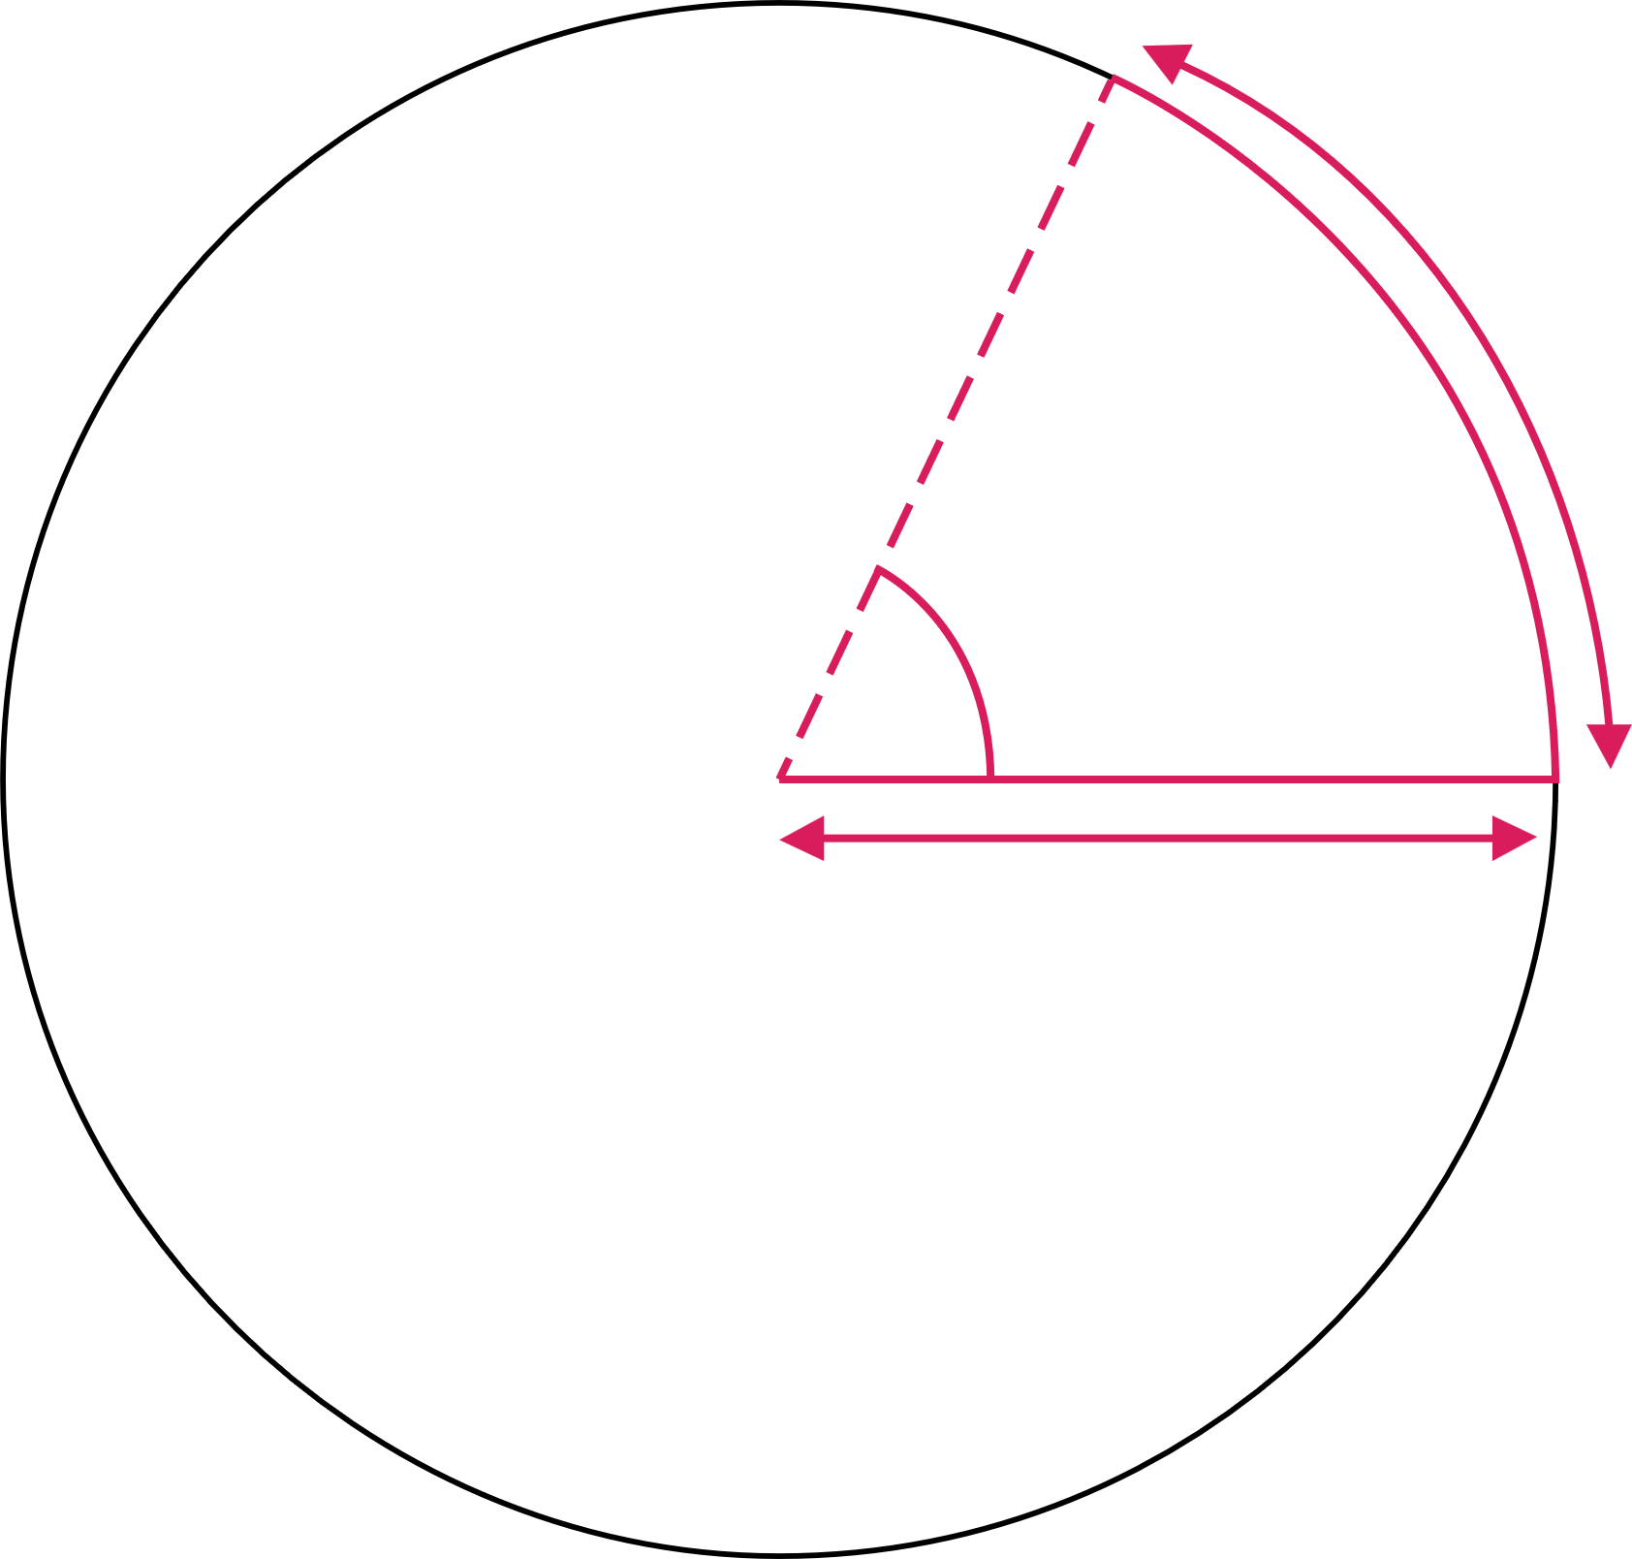
Angular velocity, torque and power out
2. Investigating torque, speed and current
If a force F rotates it becomes a torque 𝞽.
We measure angular velocity ω in radians per second:
There are 2π radians in one complete revolution.
𝞽
.
ω
P = 𝞽ω
radius r
𝞽
1 radian
For angular motion P = Fv becomes P = 𝞽ω
ω = speed N in RPM x 2π radians per second
60
(dividing by 60 converts ‘per minute’ to ‘per second’)
and so by substituting, we can write
P = 𝞽2πN
60
radius r
11

Slide 12
Understanding power, torque and current
2. Investigating torque, speed and current
This knowledge helps to explain why, in a shunt-wound DC motor, torque is proportional to current, as you previously found:
Remember that in a shunt-wound motor
V = E + I_{a}R_{a}
Since P = VI the mechanical power P = EI_{a}
We also know that P = 𝞽ω
Hence 𝞽ω = EI_{a} and so 𝞽 = I_{a} x E
ω
Torque is proportional to current.
Torque (Nm) v Current (A)
0.5
0.4
0.3
Torque (Nm)
0.2
0.1
0.0
0.0
0.2
0.3
0.4
0.5
0.6
Current (A)
12

Slide 13

Investigating mechanical power
2. Investigating torque, speed and current
Radius (m) | Torque (Nm) | Rotation (RPM) | Power (W)
0.1 | 0.2 | 115.2 | 2.413
0.15 | 0.3 | 100.8 | 3.167
0.2 | 0.4 | 86.4 | 3.619
0.25 | 0.5 | 72 | 3.77
0.3 | 0.6 | 57.6 | 3.619
0.35 | 0.7 | 43.2 | 3.167
0.4 | 0.8 | 28.8 | 2.413
0.45 | 0.9 | 14.4 | 1.357
0.5 | 1 | 0 | 0
In the Electrical machines interactive
tool, verify that P_{out} = 𝞽2πN
Choose two combinations of radius and mass. Use
the values for torque, rotational speed and mechanical power to verify the relationship. Use π = 3.14159.
The table on the left shows how torque, rotation speed and power change as the radius increases when lifting a mass of 0.2 kg. (Remember that 1 W = 1 Nm/s). Use the power formula above to help you interpret the table and suggest why power increases to a maximum, but then decreases.
60
13

Slide 14
Investigating mechanical power – answers
2. Investigating torque, speed and current
The mechanical power output is proportional to rotational speed x torque.
For a fixed mass,
increasing the radius increases the load on the motor. Hence the power of the motor first increases with load before decreasing after maximum power is reached.
How else could you verify this using the Electrical machines interactive tool?
What practical considerations do
you think this power output curve raises
for an engineer?
Rotational speed is inversely proportional to the radius:
… while torque is proportional to the radius:
125
1.00
100
0.75
75
Torque (Nm)
Rotation (RPM)
0.50
50
25
0.25
0.0
0.1
0.2
0.3
0.4
0.5
0.0
0.1
0.2
0.3
0.4
0.5
Radius (m)
Radius (m)
4
… and when torque and rotational speed are multiplied within the power formula, this has the result of creating a curve for power output against radius:
3
Power (W)
Fastest lift speed is at maximum power output
2
1
0.0
0.1
0.2
0.3
0.4
0.5
Radius (m)
14

Slide 15
Learning outcomes
2. Investigating torque, speed and current
You will be able to:
Describe how torque and speed vary with current in
a series-wound and shunt-wound DC motor.
State the formula for calculating the output power of an electric motor.
Calculate the mechanical power of a motor based
on its rotational speed
and torque.
Image © This Is Engineering
15

