Slide 1
Electrical machines
3. Efficiency and motor selection

Slide 2
Electrical machines
3. Efficiency and motor selection
2

Slide 3
Learning outcomes
3. Efficiency and motor selection
You will be able to:
Calculate the input power to an electric motor.
Interpret a motor data sheet graph, showing how power and efficiency vary with torque.
Select the most efficient motor for an engineering application.
List four engineering approaches that will help to reduce the global energy demand from electric motor-driven systems.
Image © This Is Engineering
3

Slide 4


Voltage, current and power in
3. Efficiency and motor selection
The total power consumed by an electrical device equals the voltage multiplied by the current:
P = VI
Electrical power in:
P = VI
1. An electric vehicle motor has an input voltage of 132 V and a power input of 112.2 kW. What input current should the connecting cables be able to safely deliver?
2. A cordless impact driver motor running at maximum power draws 42.39 A and has an input power of 763.02 W. What is the voltage of the impact driver’s battery pack?
3. The spindle motor on a bench-top CNC mill draws 2.8 A at 230 V DC. What power does it draw?
I
Mechanical
power out:
P = 𝞽2πN
60
V
4

Slide 5
Voltage, current and power in – answers
3. Efficiency and motor selection
= 112,200 W.
1. 112.2 kW
112,200/132 V
2. 763.02 W/42.39 A
3. 230 V x 2.8 A
= 850 A through the cables.
= 18 V battery pack.
= 644 W spindle motor.
Discuss what engineering issues the current demands of each motor might raise.
5

Slide 6

Investigating efficiency
3. Efficiency and motor selection
Efficiency η = Power out
Power in
The Electrical machines interactive tool readings of mechanical and electrical power provide the data needed to plot efficiency against torque:
Efficiency (%) v Torque (Nm)
100%
The interactive tool does not allow you to set the radius, mass, and therefore the torque, to zero.
What does the graph predict about the motor’s efficiency when the torque is zero?
Do you think this makes sense? What do you think happens in reality?
75%
Efficiency (%)
50%
25%
0%
0
0.25
0.50
0.75
1.00
Torque (Nm)
6

Slide 7

Investigating efficiency – answers
3. Efficiency and motor selection
Efficiency (%) v Torque (Nm)
When choosing the right motor for an application, engineers need to consider the load, torque, maximum power output and maximum efficiency.
The best motor will be the compromise that best suits the desired performance of the motor-driven system.
100%
Below limit of interactive
75%
Efficiency (%)
50%
25%
When is maximum efficiency achieved v torque on this graph?
Maximum power is achieved at around 50% of maximum torque. What implications does this have when selecting a motor?
Why might an engineer choose to use a motor running at a higher speed, linked to a gearbox that provides lower speed and more torque?
0%
0
0.25
0.50
0.75
1.00
Torque (Nm)
It does not make sense for efficiency to be a maximum when the torque (mechanical output) of the motor is zero.
Below maximum efficiency the efficiency rapidly drops to zero when the torque is zero.
7

Slide 8
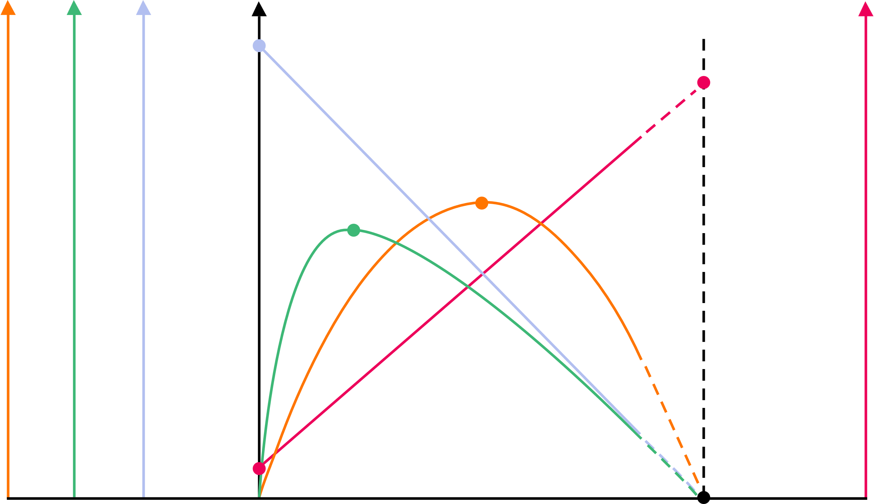
Selecting electric motors
3. Efficiency and motor selection
Maximum power occurs at around 50% of maximum torque. When choosing a motor it is most common to prioritise maximum efficiency.
An engineer might choose a larger motor running at less than maximum power, but at close to maximum efficiency.
The motor’s free-run speed is higher at this point.
This explains why motors will often drive a gearbox to provide lower speed and higher torque.
stall current
Electric motor manufacturers provide a standard data chart showing how current, speed, power and efficiency vary with torque.
Note the different Y-axis scales for each characteristic.
An engineer can use the data chart to identify a motor’s efficiency at different torque, power or speed requirements.
free-run speed
max. efficiency
max. power
Power (W)
Speed (RPM)
Current (A)
Efficiency (%)
Stall torque (theoretical)
free-run current
Torque
8

Slide 9

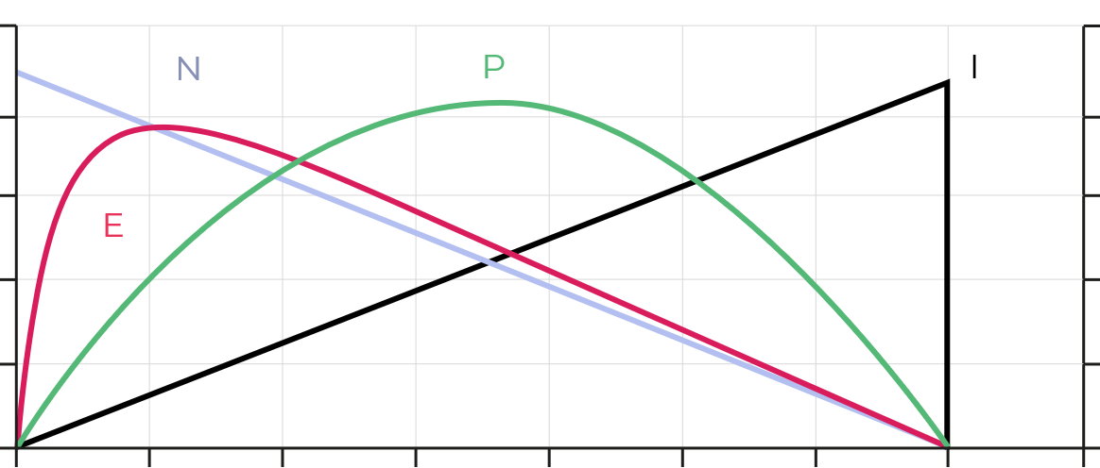
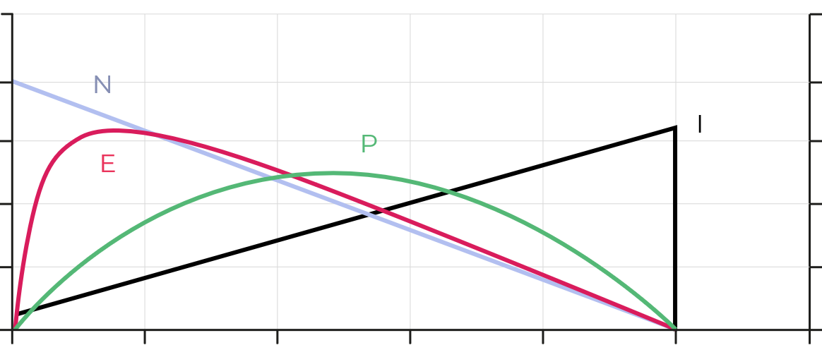
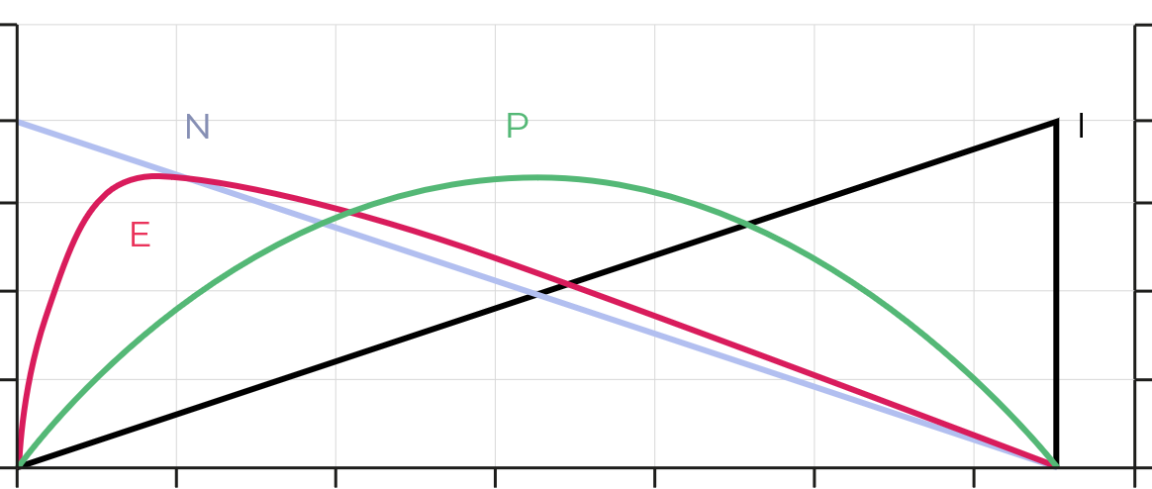
Selecting electric motors
3. Efficiency and motor selection
Motor A
Motor B
Motor C
Torque
Torque
Torque
You are an automation engineer tasked with sourcing efficient motors for a new food production line. Select the appropriate motor to provide:
200 W of power to pump product into jars
0.25 Nm torque to operate a section of conveyor belt
Use the data charts to select the best motor for each scenario. Justify your decisions. The charts on your activity sheet include detailed axis scales.
E Efficiency
N Speed
P Power
I Current
9

Slide 10
Selecting electric motors
3. Efficiency and motor selection
Motor A
Motor B
Motor C
200 W
0.25 Nm
Torque
Torque
Torque
Efficiency at 0.25 Nm torque
Efficiency at 200 W power
Maximum efficiency
What problem will occur when using a motor at maximum power rather than maximum efficiency?
Why would this be a concern for healthcare applications such as motorised prosthetics or infusion pumps?
Maximum efficiency
Motor A can provide 0.25 Nm of torque at close to maximum efficiency, so is best to drive the conveyor.
Motor C can provide 200 W of power at close to maximum efficiency, so is best to drive the pump.
E Efficiency
N Speed
P Power
I Current
10

Slide 11
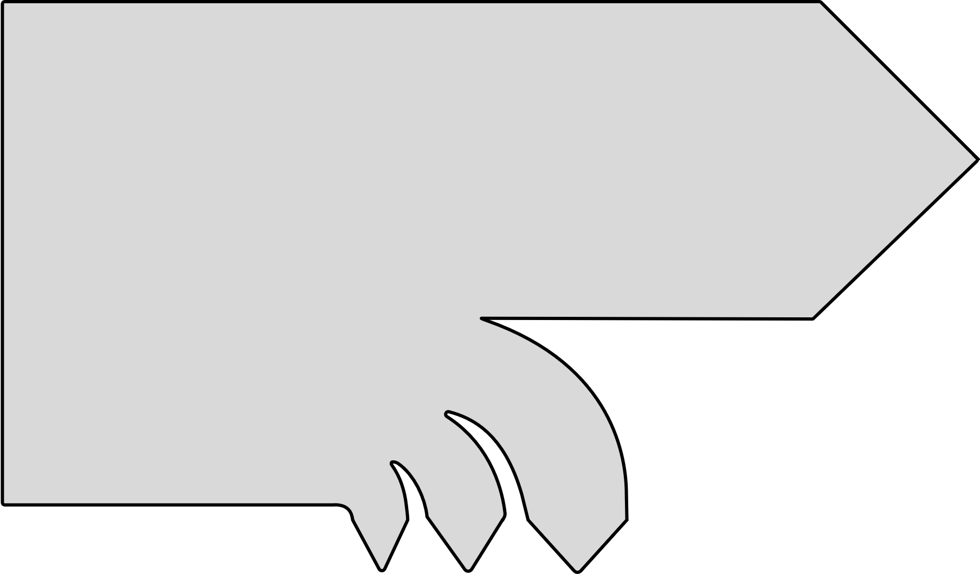
Where are the losses in a motor?
3. Efficiency and motor selection
Electric motors experience inefficiencies due to heat loss, though these are small.
These losses have three main sources:
Copper losses arise from the resistance in the copper windings.
Iron losses arise from eddy currents in the laminated iron cores used to increase the field strength in stators and rotors.
Mechanical losses arise from friction and air resistance.
P_{out} = 𝞽2πN
60
P_{in}= VI
Discuss how you would expect a motor’s copper losses to vary as the torque increases.
Mechanical
losses
Iron
losses
Copper losses
11

Slide 12
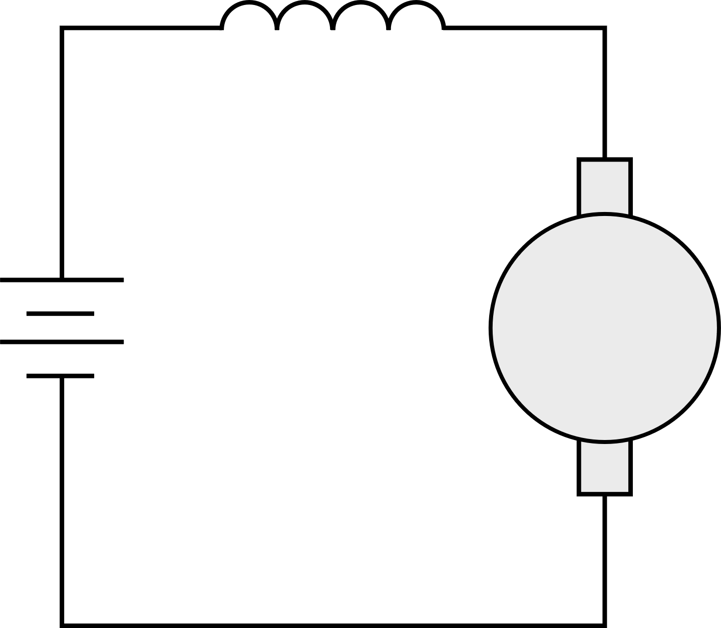
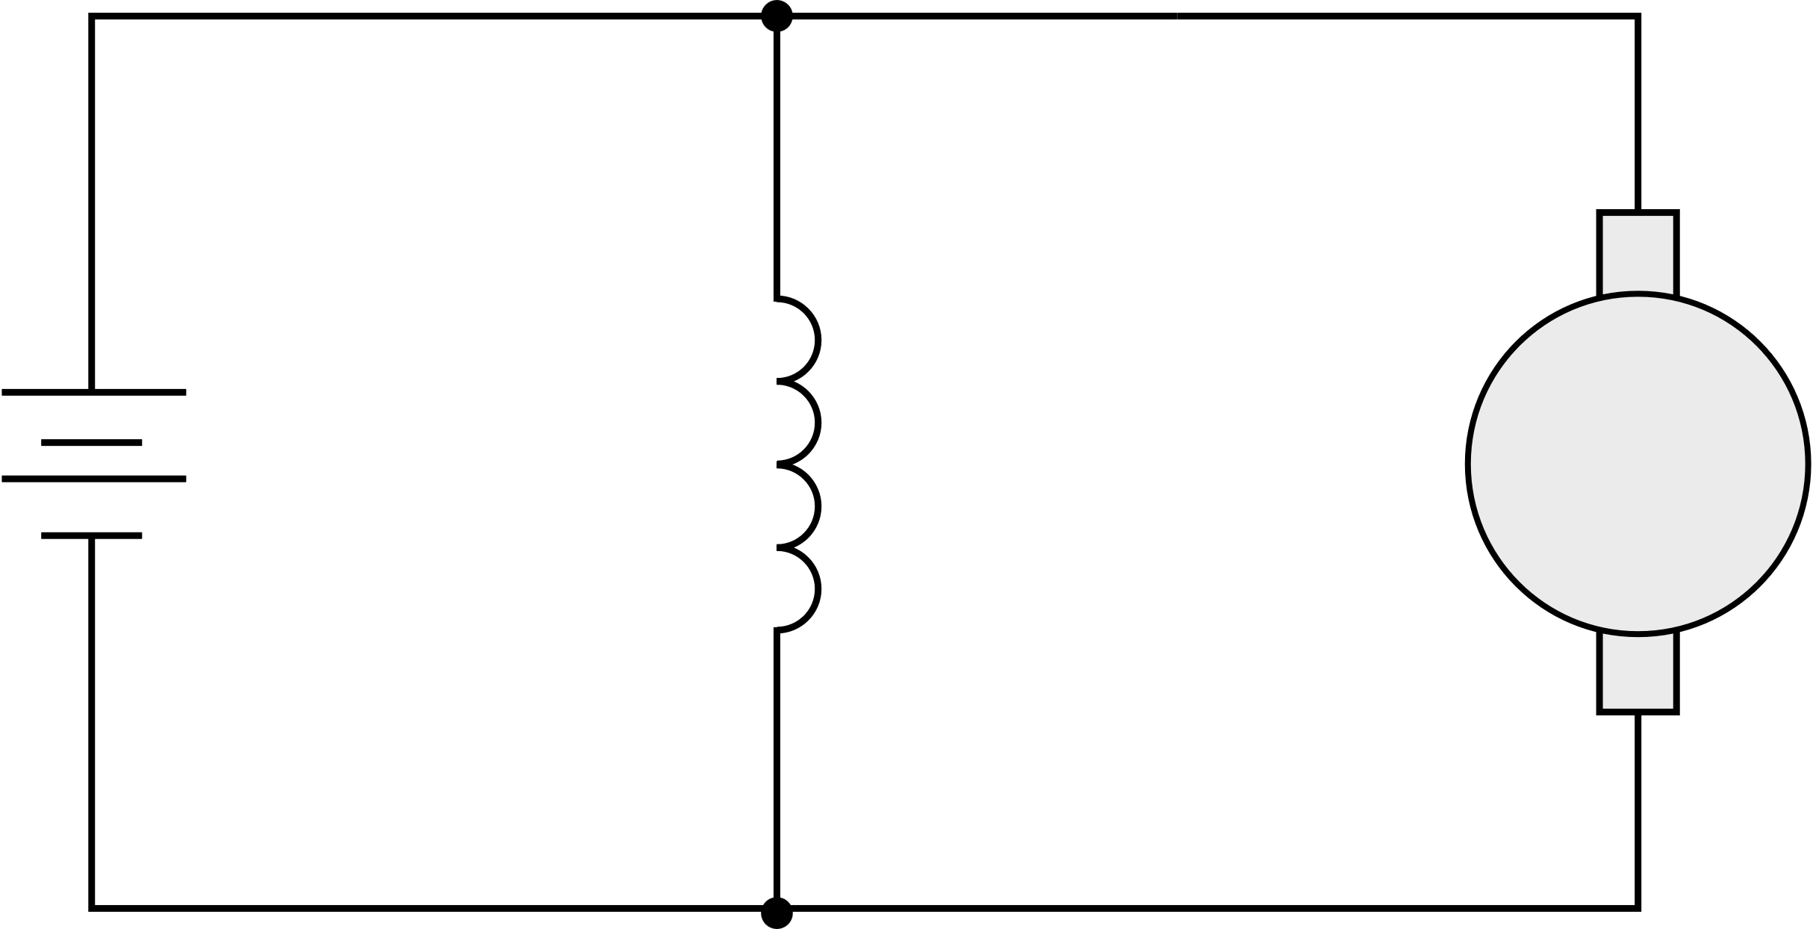

Copper losses in series and shunt-wound DC motors
3. Efficiency and motor selection
Since P = VI and V = IR we can write that P = I²R. This lets us quantify the power losses in the copper windings:
In a series-wound motor, the copper losses are given by:
P = I_{a}² (R_{a} + R_{f})
In a shunt-wound motor, the copper losses are given by:
P = I_{a}²R_{a} + I_{f}²R_{f}
(Remember that the total current I = I_{a} + I_{f})
Series-wound:
V = E + IR_{a} + IR_{f}
Shunt-wound:
V = E + I_{a}R_{a}
V = I_{f}R_{f}
R_{f}
I
I_{f}
I_{a}
+
+
R_{a}
E
Shunt field
R_{f}
R_{a}
E
-
-
12

Slide 13
Motors, global energy and climate change
3. Efficiency and motor selection
Industrial electric-motor driven systems around the world account for nearly 50% of the global total of 22.9 TWh electrical consumption and 13.2 Gt carbon emissions from electricity (IEA, 2011).
Four engineering approaches make a 25% reduction in this demand possible:
Efficiency
Improving the ratio of power out to power in.
Matching
Choosing the right motor for every application.
Variable speed drives
Electronic controls match speed to load requirements.
System optimisation
Mechanical systems improved for fewer losses.
Discuss how you might contribute to one or more of these vital areas of improvement in your engineering or manufacturing career.
13

Slide 14
Motors, global energy and climate change
3. Efficiency and motor selection
Efficiency
Matching
Variable speed drives
System optimisation
Whether designing, specifying, building or maintaining motor-driven systems, you are likely to work with motors in your career.
How could you contribute to greater efficiency in one or more of these areas?
Image © This Is Engineering
14

Slide 15
Learning outcomes
3. Efficiency and motor selection
You will be able to:
Calculate the input power to an electric motor.
Interpret a motor data sheet graph, showing how power and efficiency vary with torque.
Select the most efficient motor for an engineering application.
List four engineering approaches that will help to reduce the global energy demand from electric motor-driven systems.
Image © This Is Engineering
15

