Slide 1
CNC machinery
3. Programming CNC machines

Slide 2
CNC machinery
3. Programming CNC machines
2

Slide 3
Learning outcomes
3. Programming CNC machines
You will be able to:
List the main G-code instructions and explain their functions.
Suggest improvements that help a CNC operation to be more efficient.
Use G-code to define how a CNC machine could cut a shape into a sheet of material.
Identify some advantages of multi-axis CNC machines.
3

Slide 4
G-code tells CNC machines what to do
3. Programming CNC machines
A setup checklist includes asking whether the correct instructions are loaded in the CNC machine. These instructions are written in G-code (or CAD software generates the code).
G-code tells the machine how to move the chosen tool, for example in the X, Y and Z dimensions.
G90 Absolute coordinates
G91 Relative coordinates
G20 Inches
G21 Millimetres
G17 Move in the XY plane
Some G-code defines how the CNC machine should interpret the rest of the code:
M Motor controls, eg on, off
S Spindle speed in RPM
F Feed rate in mm/min
Other codes define other operating parameters:
G00 Fast move to a coordinate
G01 Linear movement
G02 Clockwise circular
G03 Anticlockwise circular
The G-code that then follows instructs the CNC machine how to move the tool:
4

Slide 5


Interpreting G-code
3. Programming CNC machines
G90
G21
M03 S1000 F100
G00 X1 Y4
G01 Z-5
G01 X2 Y2
G01 X7 Y2
G01 X8 Y4
G01 Z5
G00 X2 Y5
G01 Z-5
G01 X2 Y7
G01 X4 Y7
G01 X4 Y5
G01 X2 Y5
G01 Z5
G00 X5 Y5
G01 Z-5
G01 X5 Y7
G01 X7 Y7
G01 X7 Y5
G01 X5 Y5
G01 Z5
M05
Interpret this G-code to draw a shape on your activity sheet.
Inspect the code to identify:
Are you using relative or absolute coordinates?
What units are you working in?
Which codes do you think start and stop the spindle motor?
How fast is the spindle spinning?
How fast will the tool move through the material?
Which G-code sets the depth of the cut and how deep is this?
Which G-code stops the tool from cutting in between parts of the shape?
5

Slide 6
Interpreting G-code – answers
3. Programming CNC machines
The instructions use absolute coordinates (G90) in millimetres (mm) (G21).
M03 starts and M05 stops the spindle motor.
S1000 sets the spindle speed at 1000 RPM.
F100 sets the feed rate at 100 mm/min.
G01 Z-5 sets the cutting depth at 5mm.
G01 Z5 raises the tool again to stop the tool from cutting in between parts of the shape.
8
7
6
5
Y axis
4
Real G-code starts and ends with a % symbol and includes an O program number, e.g. O12345.
Since each line of G-code follows the last, it is important to ensure that G-code is written in the right order. A single instruction in the wrong place will mean the rest of the shape is cut incorrectly.
Discuss what safety or production problems incorrect G-code might cause.
3
2
1
0
0
1
2
3
4
5
6
7
8
9
10
X axis
6

Slide 7

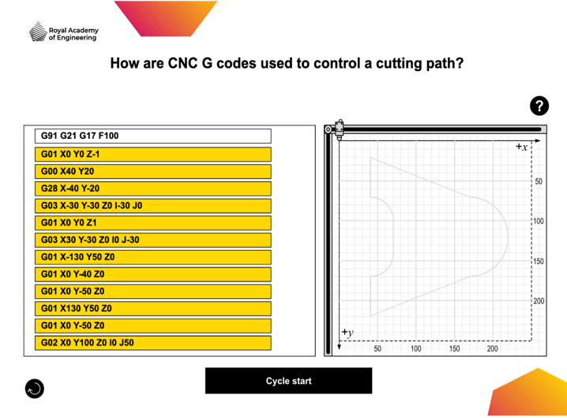
Organise the G-code for correct operation
3. Programming CNC machines
The CNC machinery online interactive tool challenges you to organise the lines of G-code into their correct order. You will see one of three randomised shapes and sets of code.
1. Click to hold and drag the lines of G-code.
As you explore the code:
identify what each part of the G02 or G03 command instructs the machine to do.
what do you think the G28 command means?
2. Use the grey outline to help you reorder the G-code. Look carefully to place the codes for straight lines in the right places. One is shorter than it looks!
3. Press ‘Cycle start’ to test your code. The machine will create a black line as it cuts. When running, this button becomes 'Abort cycle'. Press to stop the run if code is still out of order.
Press to restart with a different shape.
7

Slide 8
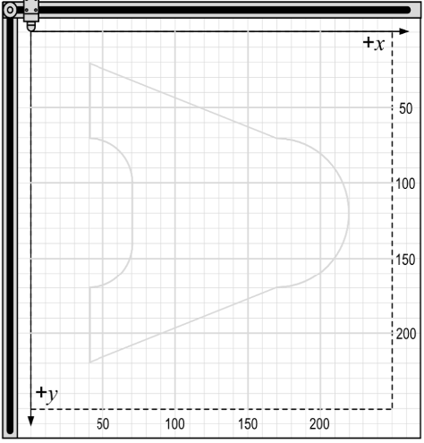
Organise the G-code for correct operation
3. Programming CNC machines
J0
G02
Y0
I50
X100
G02
Like any G-code movement command, a G02 or G03 circular movement starts at the current position of the tool.
G28 instructs the CNC machine to return the tool to its home position.
I50 J0
The command defines the end point of the circular movement. Using G91 this is relative to the starting point but in G90 this would be an absolute coordinate.
X100 Y0
The pivot point is always defined relative to the starting point, using I and J coordinates.
8

Slide 9
Optimising G-code for safety and efficiency
3. Programming CNC machines
A CNC programmer or operator has the responsibility to ensure the process is as safe and efficient as possible.
Sketch out the following G-code for a CNC router.
Discuss how you would correct any mistakes and/or omissions to make the program more efficient.
G90
S1000 F100
G01 X2 Y1
G01 Z-5
G01 X6 Y1
G01 Z 5 G01 X4 Y4 G01 Z-5 G01 X6 Y1 G01 Z5 G01 X4 Y4 G01 X2 Y1
Things to think about:
What information is missing?
What information is repeated?
Can you improve the order?
9

Slide 10
Optimising G-code for safety and efficiency – answer
3. Programming CNC machines
The G-code cuts a simple equilateral triangle.
G21 unit code needed
G90
G21 M03 S100 F100
G00 X2 Y1
G01 Z-5
G01 X6 Y1 G01 X4 Y4 G01 X2 Y1 G01 Z5 M05
Z instruction only needed once to set tool at working depth
M03 turns motor on
G00 takes tool to starting point without cutting
Cleaner, faster instructions
Z5 needed to raise tool
M05 turns motor off
10

Slide 11
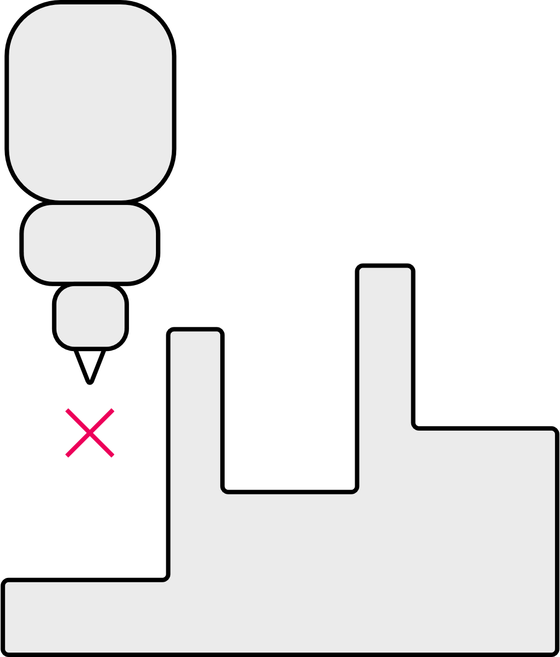
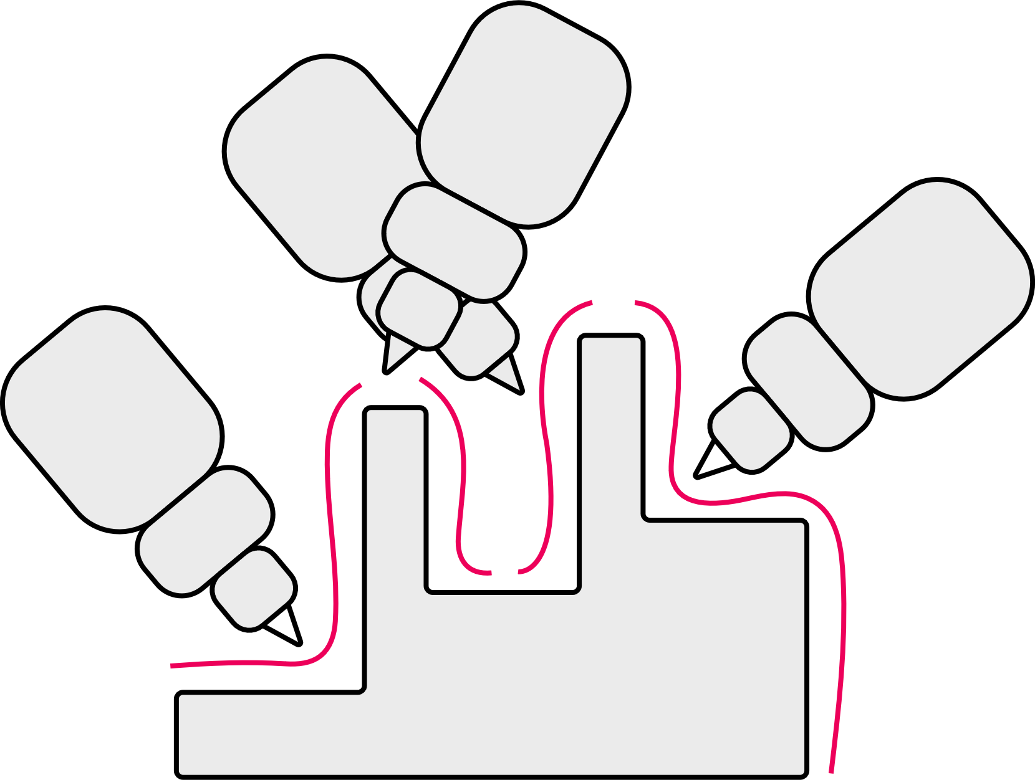

More axes overcome the limitations of three-axis CNC
3. Programming CNC machines
Three-axis CNC machines have limitations:
The tool is unable to form complex parts with deep or narrow cavities, or overhangs.
The part may therefore need to be repositioned to machine other faces, causing long machine times.
More axes of motion let the tool head complete more complex movements from different angles.
Indexed five-axis (three- plus two-axis) machines rotate and tilt the part in between tool motions.
The part is machined in many short movements.
In continuous five-axis machines, all axes can move at the same time.
The part is machined in fewer long movements.
Discuss what movements these two additional axes allow.
What parts of the CNC machine might move to create one or both of these additional axes of motion?
11

Slide 12

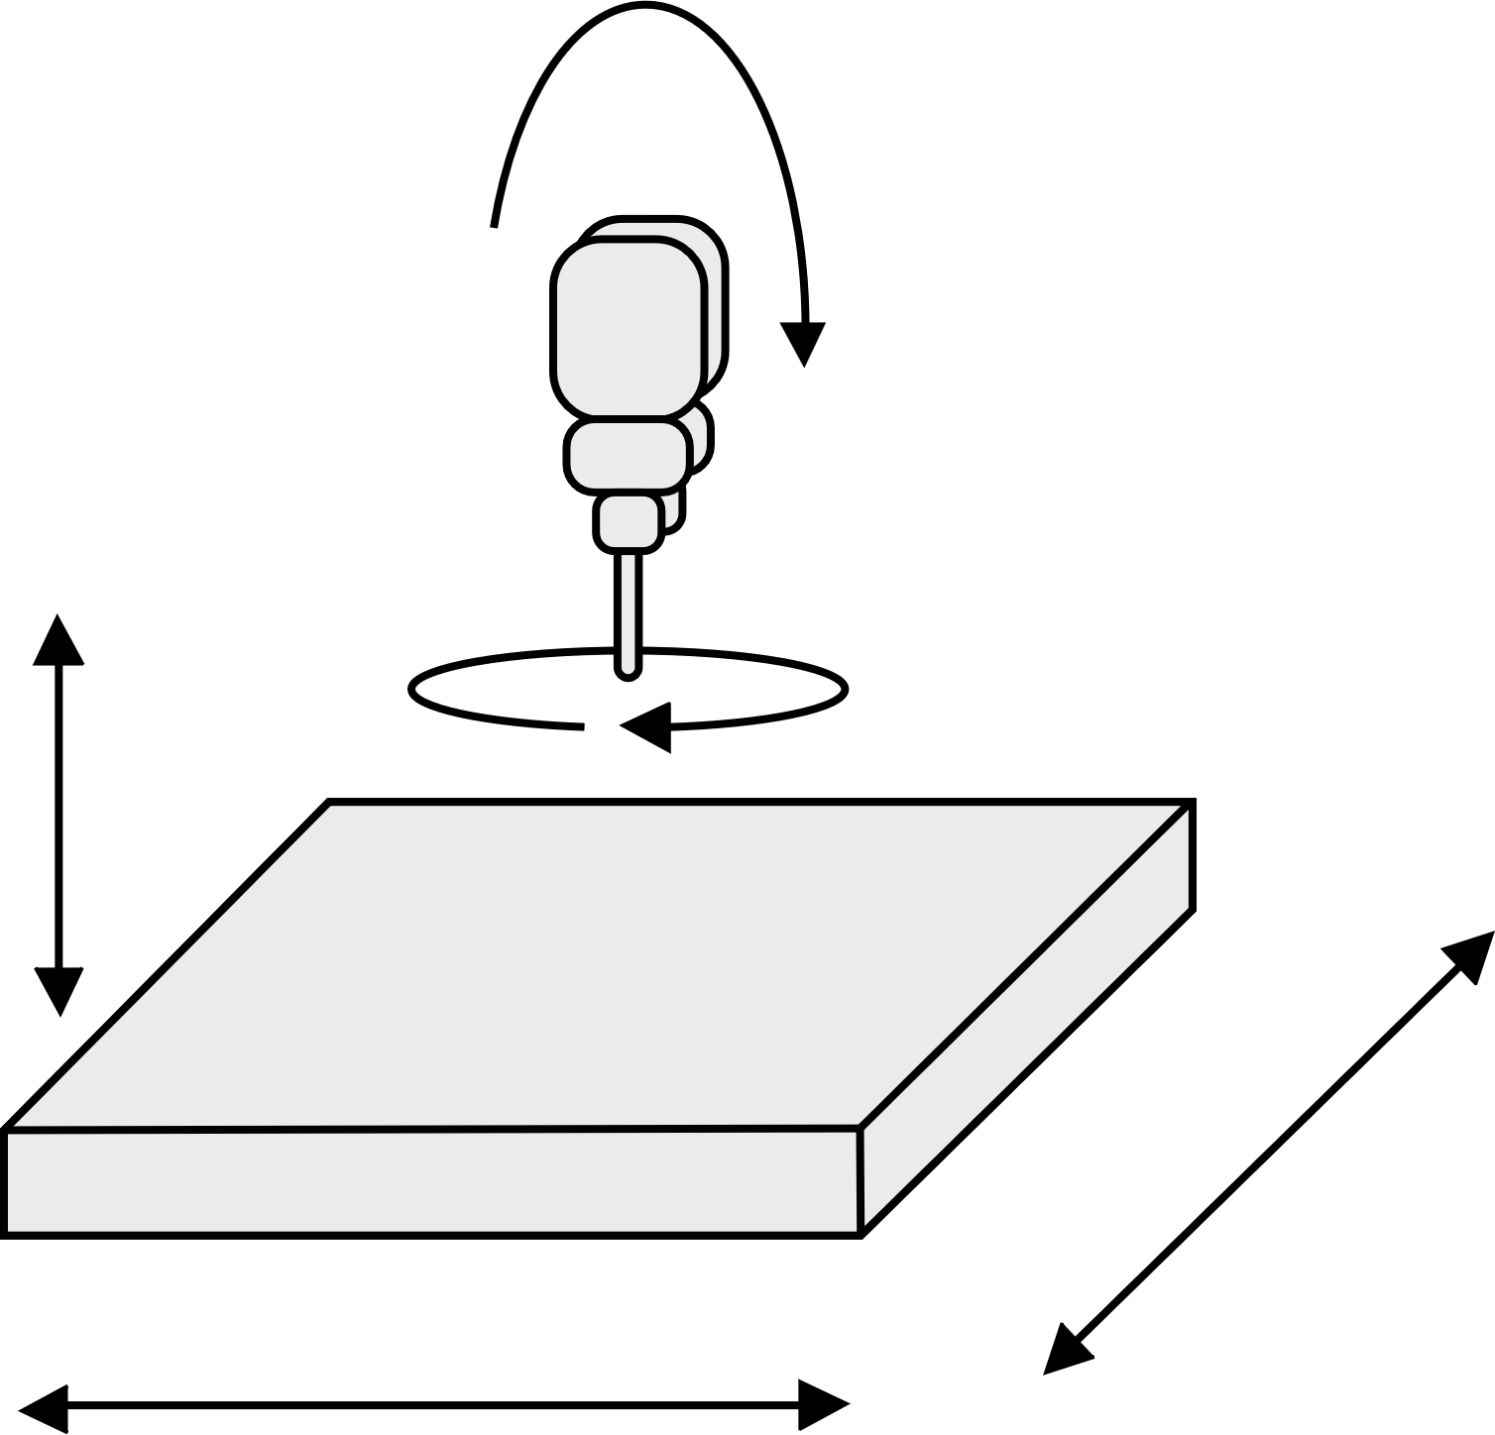
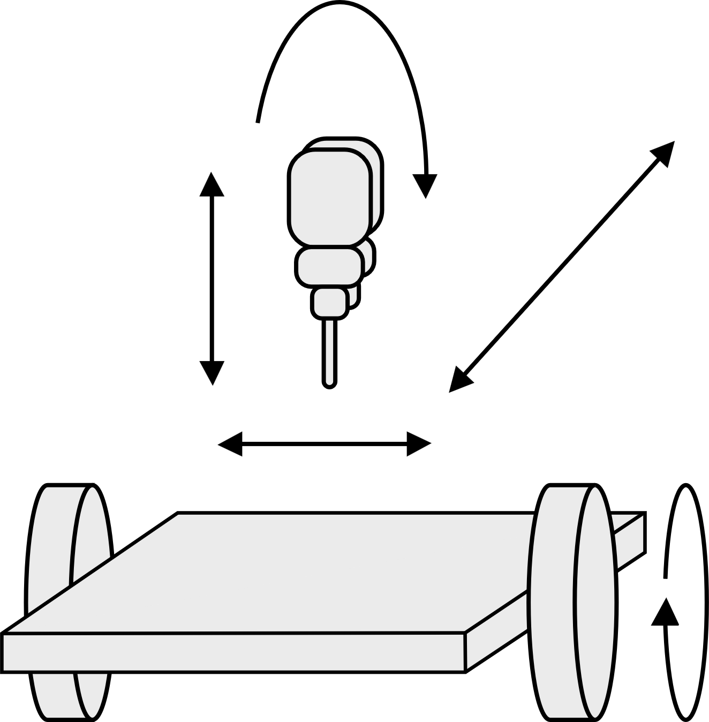
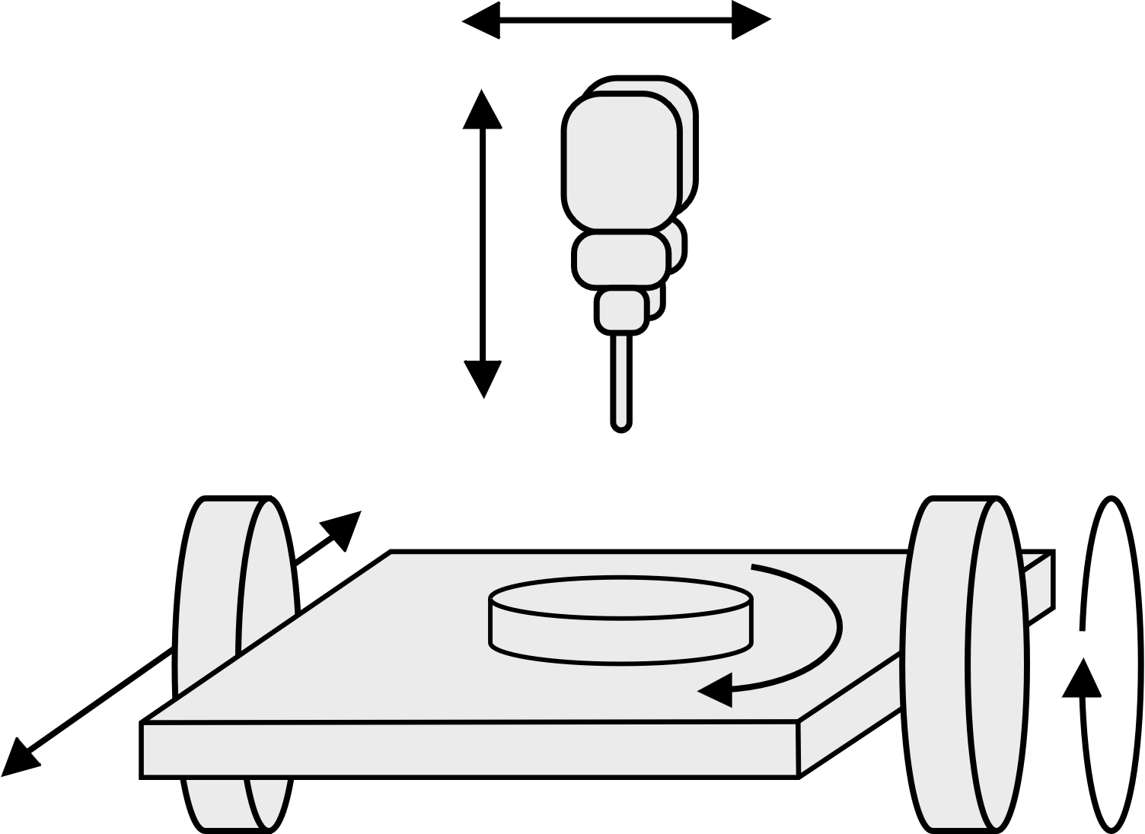
Table and head rotation in multi-axis CNC machines
3. Programming CNC machines
There are many types of multi-axis CNC machine, which may have up to nine axes of motion. They can be broadly grouped by whether the table, head or both provide rotation. One approach is not better than the others. The different configurations support a wide range of machining requirements and part dimensions.
Table/Table (trunnion) Head/Head (swivel head) Table/Head
X
B
B
Z
Y
C
Z
Z
X
Y
A
Y
A
C
X
C
Visualise how each type of five-axis CNC might move to machine a part. Suggest some advantages of using each type of five-axis machine.
Then, list some broad advantages of multi-axis CNC machining.
12

Slide 13
Advantages of multi-axis CNC machines – answers
3. Programming CNC machines
Table/Table | Head/Head and Table/Head | Multi-axis in general
Easy to visualise movements/actions during machining. Allows for heavy material removal. Allows full range of XYZ travel. Table tilts further – good for undercuts. | Can machine heavier parts. Very rigid set up for larger parts. More versatile. Can allow multiple vices so multiple pieces can be worked on. Standard tooling can be used as rotating head allows easier access. | Shorter cycle times. Greater accuracy. Less set-up time. Increased capability.
13

Slide 14
Learning outcomes
3. Programming CNC machines
You will be able to:
List the main G-code instructions and explain their functions.
Suggest improvements that help a CNC operation to be more efficient.
Use G-code to define how a CNC machine could cut a shape into a sheet of material.
Identify some advantages of multi-axis CNC machines.
14

