Slide 1
Microcontroller systems
4. Pulse width modulation

Slide 2
Practitioner guide
4. Pulse width modulation
2

Slide 3

Introduction and overview
4. Pulse width modulation | Practitioner guide
These resources help practitioners to deliver the microcontroller systems components of engineering and manufacturing-related qualifications at levels 2 and 3.. They introduce the topic and stimulate learners to explore and reflect on key concepts and are designed to complement and enhance practitioners’ own lesson materials and schemes of work.
Resources summary
Prerequisites – it is recommended that learners complete 1. Mechatronic systems and control, 2. Sensors and signals and 3. Understanding control processes before starting this resource.
Resource name | Level | PPT slides + notes – practitioner | PPT slides - learner | Activity sheets | Film | Interactive
4. Pulse with modulation | 3 |  |  | 2
Delivery
Delivery suggestions for practitioners, and suggested answers where appropriate, are in the presenter’s notes for each slide. The core activities in each resource provide around 60 mins learning time, though additional suggestions, including independent learning, can extend this time significantly.
Overarching theme/big questions
What is a mechatronics/automated system?
What is the role of programmable logic controllers (PLCs) in mechatronics?
Overview
The Level 2 resource provides a bridge between Level 2 and Level 3. It helps learners to understand the purpose and features of a mechatronic system, identify examples of mechatronic systems in a range of settings, describe in simple terms how the different components in a mechatronic system work together to control a process, and identify some differences between a microcontroller, PLC and microcomputer, suggesting suitable applications for each.
The Level 3 resources develop learners’ understanding of sensors and actuators before using a series of realistic but simple scenarios to provide an introduction to PLCs and PLC programming. We suggest that practitioners adapt the activities to suit the range of sensors, actuators and PLCs available in their place of learning
or which relate to learners’ industrial placements. Practical extension suggestions enable learners to practise PLC programming using your preferred tool, software
or simulator and to build a complete demonstration system.
3

Slide 4
Learning outcomes and resource links
4. Pulse width modulation | Practitioner guide
Level 3 resource 3
Pulse width modulation
Describe pulse width modulation (PWM).
Identify how PWM can control a range of devices including LEDs, DC motors and servo motors.
Make calculations to generate the right PWM signal to obtain
desired results.
Full resource list available for the topic of
Microcontroller systems:
1. Mechatronic systems and control (Level 2)
2. Sensors and actuators (Level 3)
3. Understanding control processes (Level 3)
4. Pulse width modulation (Level 3)
Links to other supported topics
Sustainability, Robotics, CNC machinery, Renewable energy, Electric machines.
4

Slide 5
Subject coverage
4. Pulse with modulation | Practitioner guide
Microcontrollers and PLCs
Mechatronics
Sensors and actuators in automation and control
Programmable Logic Controllers (PLCs)
PLC programming
Applications of PLCs
Control system theory
Pulse width modulation
Maths
Using formulas
Percentages
Averages
Patterns and relationships
Communicating
Mathematical diagrams
Including careers
How different engineering sectors use control and automation.
5

Slide 6

4. Pulse width modulation
6

Slide 7

Learning outcomes
You will be able to:
Describe pulse width modulation (PWM).
Identify how
PWM can control a range of devices including LEDs, DC motors and servo
motors.
Make calculations to generate the right PWM signal to obtain desired results.
Image © This Is Engineering
7

Slide 8

Microcontroller outputs
This CNC machine uses a microcontroller
to operate the tool head rotation speed,
vertical position and red/amber/green
status indicator.
Discuss what output devices might
operate each of these three functions?
How would the microcontroller need to change the state of each device?
What output signal might control these changes of state?
8

Slide 9
Microcontroller outputs
The tool head might use a DC motor. The position might be changed by a servo; one or more LEDs might indicate the status of the machine.
The motor‘s speed will be controlled between a minimum and maximum level, appropriate to the tool and the material.
The servo’s position must be set so the tool rises and descends to the correct machining depth. The LED should change from green to amber and then red if there is a minor or major problem.
To produce these changes, the microcontroller could send a varying signal to the motor and servo, and an on-off signal for different LEDs.
9

Slide 10
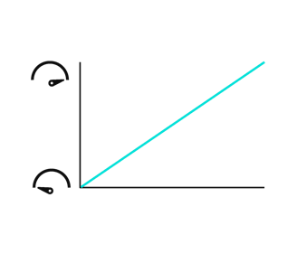
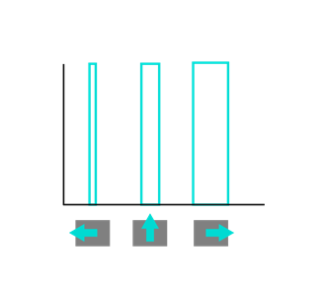
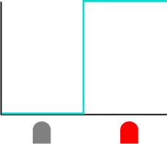
Control signal relationships
The three charts show how a signal from the microcontroller can change the state of a status LED, DC motor speed and servo motor position.
What kind of signal is being used in each case?
What does each axis represent in each chart?
What is the relationship between the signal and the state of each device?
LED off/on
DC motor speed
Servo motor position
10

Slide 11

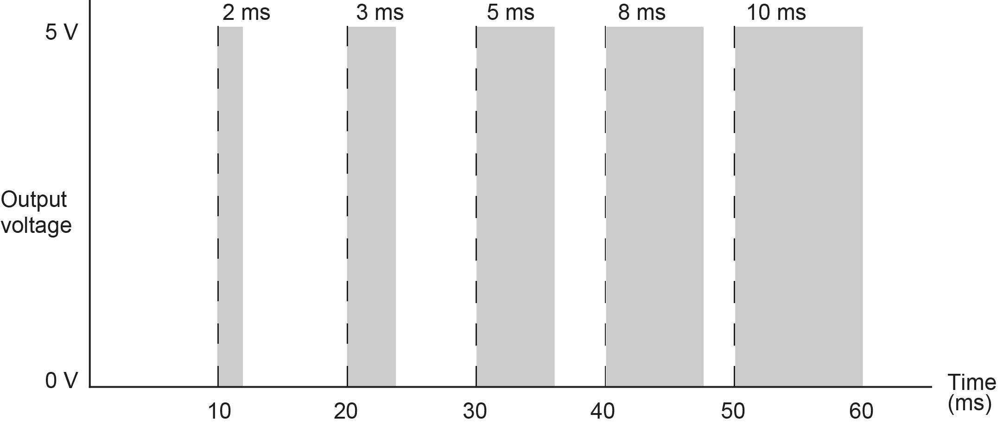
What is pulse width modulation?
What is the frequency
of this PWM signal?
Calculate the % duty cycle during each period, and the average voltage this produces each time.
What duty cycle would be needed to create the following average voltages? 1.2 V, 3.5 V, 4.8 V
This controller has 8-bit resolution (0 to 255). What is the resolution of the PWM output, in volts?
Pulse width modulation (PWM) is a form of digital to analogue conversion (DAC).
PWM varies the time for which the output voltage is set high (the duty cycle) in a set frequency.
Output devices like DC motors interpret this as the average voltage during each period.
The bars in the diagram below show how the pulse widths in this signal vary. Each pulse is 10 ms apart, for example, a 1 ms pulse below would be a 10% duty cycle (1 ms/10 ms).
11

Slide 12
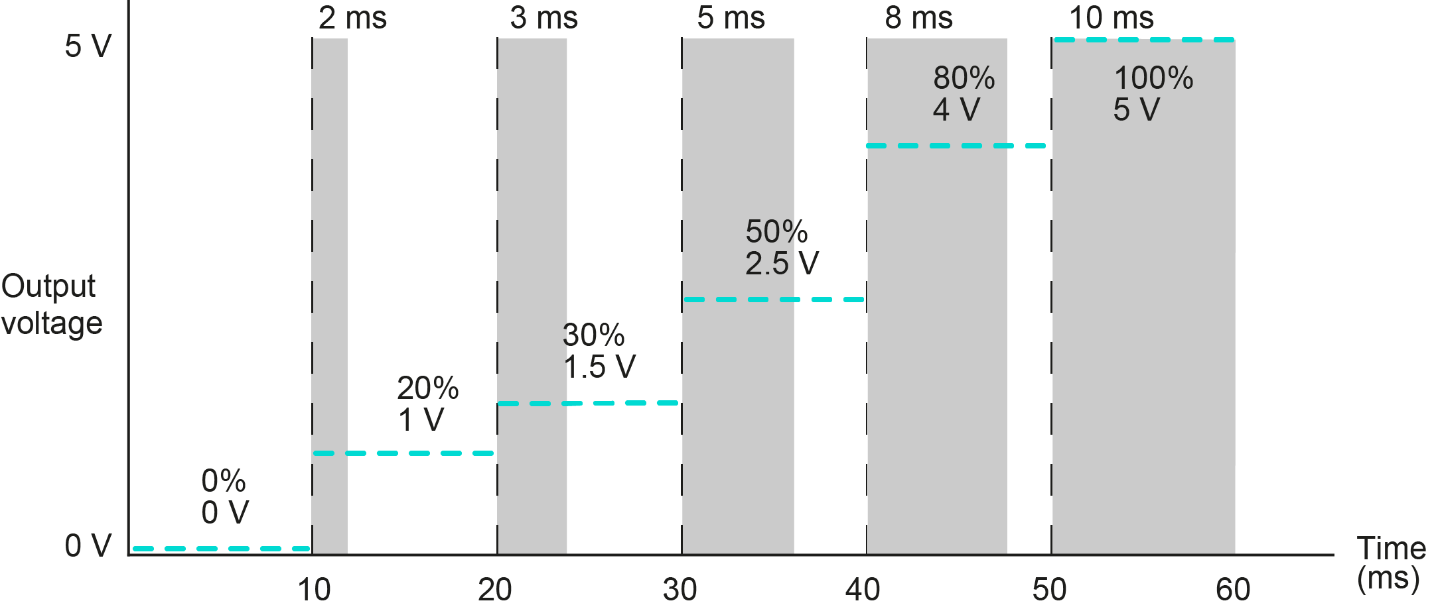
What is pulse width modulation?
What is happening if
the duty cycle is set to zero or 100%?
More generally, what is happening if the duty cycle stays the same?
How could PWM control the speed of a motor?
The frequency of the PWM signal is 100 Hz (1/10 ms = 100)
Duty cycles:
1.2 V: 24%, or 2.4 ms (1.2 V/5 V x 100% = 24%)
3.5 V: 70%, or 7 ms
4.8 V: 96%, or 9.6 ms
The resolution of the PWM output is 5 Volts / 256 steps = 0.02 V to 2 decimal places.
12

Slide 13

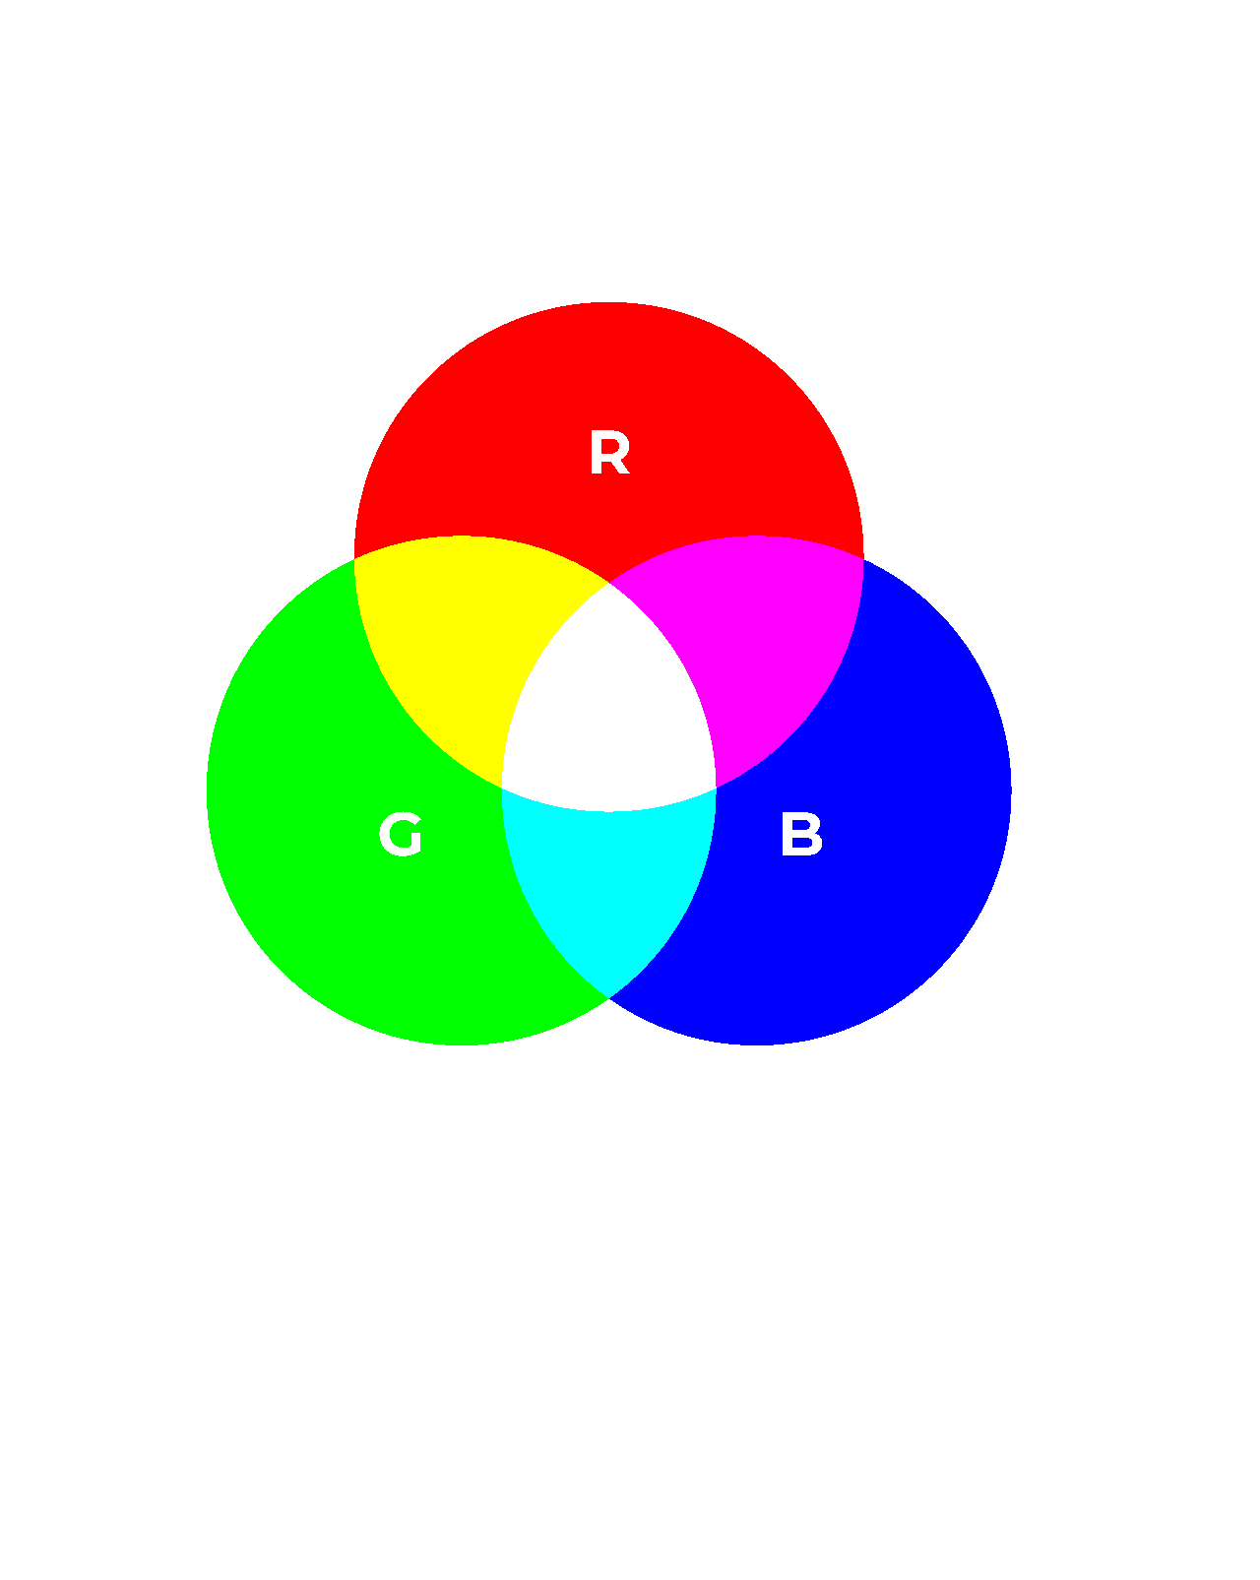

Applying pulse width modulation: RGB LEDs
4. Pulse width modulation
A CNC machine status light can be red, amber or green.
A microcontroller changes the status of the red, green or blue emitters in an RGB LED.
Each emitter can be on, dimmed (50% duty cycle) or off.
First, think about what PWM signal to each emitter will create a red, yellow or green light. Then, consider whether you need to send a 50% duty cycle signal to the red or green emitter, while leaving the other on 100%, to change yellow to amber. Sketch on the activity sheet what PWM signals would make the light cycle through red, amber and green statuses.
13

Slide 14

Applying pulse width modulation: DC motors
4. Pulse width modulation
The CNC tool head motor has an operating speed of
0 to 12,000 rpm.
The microcontroller will operate a higher power PWM circuit to control the motor speed.
This PWM circuit will operate at a frequency of 50 kHz.
Complete the table on the
activity sheet to show the duty cycles for a range of tool head motor speeds.
14

Slide 15

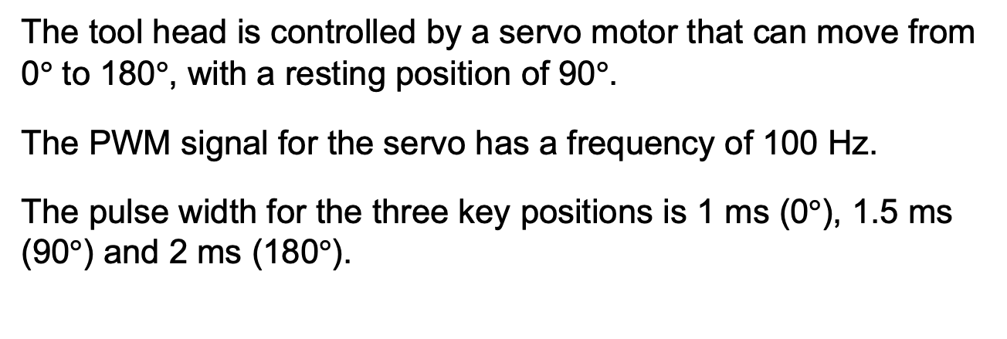
Applying pulse width modulation: servo motors
4. Pulse width modulation
The tool head is controlled by a servo motor that can move from 0$°$ to 180$°$, with a resting position of 90$°$.
The PWM signal for the servo has a frequency of 100 Hz.
The pulse width for the three key positions is 1 ms (0$°$), 1.5 ms (90$°$) and 2 ms (180$°$).
Calculate the pulse width for the
intermediate positions listed on the activity sheet.
If the microcontroller has an 8-bit (256 step) resolution, what is in principle the smallest increment by which the servo motor can rotate?
Image © This Is Engineering
15

Slide 16
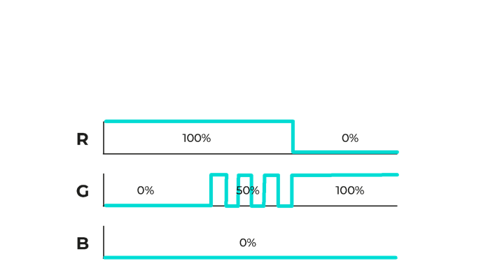
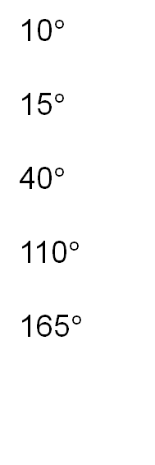
Answers
4. Pulse width modulation
9a. LEDs
9b. Tool head motor
rpm % (2dp) ms (4dp)
9c. Servo motor
Angle Pulse width
ms (4dp)
Speed Duty cycle Pulse width
10$°$
15$°$
40$°$
110$°$
165$°$
1.056
1000
2000
5000
8000
11000
8.33
16.66
41.67
66.67
91.67
0.0017
0.0033
0.0083
0.0133
0.0183
1.083
1.222
1.611
1.917
The maximum theoretical resolution is 90/128 = 0.7 degrees
Example:
(1000/12000) x 100% = 8.33% duty cycle.
(1/50000) x 8.33% = 0.0000017 s = 0.0017 ms
Example:
(10/180) x 1 = 0.056
0.056 + 1 = 1.056 ms
16

Slide 17
Pulse width modulation at work
4. Pulse width modulation
Power
engineer
PWM saves energy compared with using transformers to regulate voltage.
Buildings
engineer
PWM controls the brightness of my smart lighting system.
Automation
engineer
PWM is used in the signals from the Internet of Things (IoT) devices that monitor our
automated factory.
You’ve explored how PWM allows microcontrollers
to control a variety of output devices.
Where might you
come across PWM control in a work environment?
Robotics
engineer
PWM signals control the speed and angle of my 6-axis robot arms.
Maintenance engineer
PWM manages the cooling fans on our CNC machines.
Safety
engineer
PWM helps to control the drones I use to inspect our sites.
17

