Slide 1
Electrical machines
2. Investigating torque, speed and current

Slide 2
Practitioner guide
2. Investigating torque, speed and current
2

Slide 3
Introduction and overview
2. Investigating torque, speed and current | Practitioner guide
These resources help practitioners to deliver the electrical machines components of engineering and manufacturing-related qualifications at levels 2 and 3. They introduce the topic and stimulate learners to explore and reflect on key concepts, and are designed to complement and enhance practitioners’ own lesson materials and schemes of work.
Resources summary
Prerequisites – it is recommended that learners complete 1. Introducing electric motors before starting this resource.
Resource name | Level | PPT slides + notes - practitioner | PPT slides - learner | Activity sheets | Film | Interactive
2. Investigating torque, speed and current | 3 |  |  | 2
Delivery
Delivery suggestions for practitioners, and suggested answers where appropriate, are in the presenter’s notes for each slide. The core activities in each resource provide around 60 mins of learning time, though additional suggestions, including independent learning, can extend this time significantly.
Overarching theme/big questions
How do we choose the right motor for the work we need to do?
Overview
The Level 2 resource introduces some basic classifications of DC and AC motors before exploring in simple terms what differences lead to their various characteristics and applications.
Level 3 resources introduce characteristic curves for DC series, shunt and compound motors, including for torque, current, speed and power. They continue with an exploration of power output and efficiency, and how this affects real-world performance. The importance of electric motor efficiency is considered in the wider context of sustainability.
3

Slide 4
Learning outcomes and resource links
2. Investigating torque, speed and current | Practitioner guide
Level 3 resource 1
Investigating torque, speed and current
Describe how torque and speed vary with current in a series-wound and shunt-wound DC motor.
State the formula for calculating the output power of an electric motor.
Calculate the mechanical power of a motor based on its rotational speed and torque.
Full resource list available for the topic of Electrical machines:
1. Introducing electric motors (Level 2)
2. Investigating torque, speed and current (Level 3)
3. Efficiency and motor selection (Level 3)
Links to other supported topics
Renewable energy, Sustainability.
4

Slide 5
Subject coverage
2. Investigating torque, speed and current | Practitioner guide
Electrical machines/Electric motors
Characteristics of series, shunt and compound-wound electric motors
Measuring characteristics of electric motors
Power output
Maths
Making measurements
Working with formulas
Interpreting charts and tables
Including careers
Careers that use electric motor knowledge and understanding
5

Slide 6
Electrical machines
2. Investigating torque, speed and current
6

Slide 7
Learning outcomes
2. Investigating torque, speed and current
You will be able to:
Describe how torque and speed vary with current in a series-wound and shunt-wound DC motor.
State the formula for calculating the output power of an electric motor.
Calculate the mechanical power of a motor based on its rotational speed and torque.
Image © This Is Engineering
7

Slide 8
Torque, speed and current in DC motors
2. Investigating torque, speed and current
Torque and speed vary with current in different ways in series, shunt and compound DC motors:
In a series-wound motor:
Torque is proportional to the square of the current. Speed is inversely proportional to the square of current.
In a shunt-wound motor:
Torque is proportional to current. Speed is inversely proportional to current.
In the sketch graphs, identify which of motors A and B is series-wound and which is shunt-wound.
Motor C is compound-wound. Its torque and speed characteristics are a compromise between series and shunt. Describe how motor C’s characteristics might look on each graph.
B
Torque (Nm)
Speed (RPM)
A
B
A
Current (A)
Current (A)
8
Notes:
Practitioner delivery notes
This Level 3 resource explores the characteristics of series, shunt and compound DC motors in more detail before learners use the Electrical machines interactive tool to complete virtual investigations into the performance characteristics of a realistic simulated DC motor. Learners use their results to verify the type of motor before using the interactive tool to investigate more about torque, rotational speed and mechanical output power.
Learners will need internet access to use the Electrical machines interactive tool. Use this resource alongside practical investigations into how torque and speed vary with current in the different types of DC motor.
Film
Before starting this activity learners could watch the Electrical machines film.
Activity
Ask learners to remind you of some differences between series, shunt and compound motors.
Review the written information on the slide. You may wish to remind learners that a proportional relationship between two variables is linear, or leave this for them to remember on their own.
In pairs, learners discuss the descriptions and use them to identify which motor (A or B) is series and which is shunt-wound. (Note that the square and inverse square curves have been constrained to fit the area of the chart, as if a constant less than 1 has been applied – help learners to focus on the shapes of the curves/lines rather than their relative values for any value of current. This will also help learners to consider the curves for a compound-wound shunt motor in the next activity.) Share ideas.
Then, learners describe in words how the characteristic curves for torque and speed might look for a compound DC motor, motor C. Optionally, invite learners to sketch their ideas on copies of this slide or on your board. (Note that this refers to a cumulative compound motor, not differential.)
Example answers
Learners should recall that series motors have a few thick turns of field coils while shunt motors have many thin field coil turns. Compound motors are a combination of these approaches, combining many thin parallel field coils overlaid with a few thick series-wound field coils. These differences produce different operating characteristics.
Please also see the next slide.
Assessment
Recall of information about how series, shunt and compound-wound DC motor field windings are wound.
Discussion and verbal answers.
Optional sketching of compound motor torque and speed curves.

Slide 9
Torque, speed and current in DC motors
2. Investigating torque, speed and current
A compound-wound motor’s torque and speed characteristics are midway between those of series and shunt-wound motors.
These speed and torque characteristics can be combined to identify how speed varies with torque:
C Compound
B Series
B Series
A Shunt
Torque (Nm)
A Shunt
A Shunt
Speed (RPM)
Speed (RPM)
B Series
C Compound
C Compound
Current (A)
Current (A)
Torque (Nm)
The current draw through a motor is dependent on the load.
Use the speed v current graph to explain why it might be dangerous to start a series-wound motor with no load.
Use this graph to explain why a series-wound motor is a better choice for when a heavy load must be moved from rest.
9
Notes:
Practitioner delivery notes
Activity
Review the answers on the first two graphs on the slide. They show that the compound-wound motor’s characteristics will lie somewhere between those of motor B (the series-wound motor) and motor A (the shunt-wound motor).
Learners discuss why it might be dangerous to start a series-wound motor with no load.
Review the graph on the right of the slide, which shows how speed varies with torque for each type of motor. Introduce the concept of ‘stall torque’, where the motor speed drops to zero as torque increases. Can learners suggest what causes this?
Discuss with learners why this graph suggests that a series-wound motor might be best when a heavy load must be moved from rest.
Example answers
Under no load, a series-wound motor might operate at a speed that causes overheating and mechanical damage.
Stall torque occurs when the load is more than the mechanical force the motor is able to provide and the rotational speed therefore drops to zero.
A series-wound motor is best when a heavy load must be moved from rest because it can provide high torque at very low speeds. Other types of motor might not be able to provide sufficient torque to start the load moving.
Assessment
Discussion and verbal answers.
Ability to interpret graphs and use them to suggest answers.
Extension
Learners can research applications for series, shunt and compound-wound motors.

Slide 10
Investigating torque and current
2. Investigating torque, speed and current
The Electrical machines interactive tool supports a range of investigations into the relationships between load, torque, speed, power and efficiency.
1. Use the sliders to set the radius and mass
2. Click on the switch to run the motor every time you set the radius and mass.
3. Observe how the values change.
Set r = 0.1 m and, for the range of values for mass, plot a chart of torque (y axis) against current draw (x axis).
Use your chart to identify whether this is a series or shunt-wound motor.
10
Notes:
Practitioner delivery notes
Learners will need internet access to use the Electrical machines interactive tool. Learners could optionally record their results in a spreadsheet and generate graphs.
Activity
Review how to use the Electrical machines interactive tool and the different data that it displays. Note how learners can set the pulley radius and mass before starting the motor, and that the motor has a stall torque of 1.0 Nm (when the lift speed will drop to zero). This limits some extreme settings in the interactive tool.
Ask learners to set the value of r to 0.1 m. Learners set the mass to 0.1 kg and set the motor running. Check how to read the current and torque from the interactive.
Learners change the value of m to each value on the table on the activity sheet and record the current and torque when the motor is running, then transfer their results to the graph on the activity sheet.
Using their recall of the graphs from the first slide, learners identify whether the motor in the interactive is a series or shunt-wound motor.
Activity sheet
Learners use the interactive tool to complete the table and graph on Electrical machines - Activity sheet: section 3a and then identify the type of motor.
Example answers
Please see the next slide.
Assessment
Ability to use the interactive tool.
Written answers and interpretation of graph.
Extension
Learner can make practical measurements of torque.

Slide 11
Investigating torque and current – answer
2. Investigating torque, speed and current
The motor demonstrates a linear relationship between torque and current.
This is a shunt-wound DC motor.
Torque (Nm) v Current (A)
0.5
0.4
0.3
Torque (Nm)
0.2
0.1
0.0
0.0
0.2
0.3
0.4
0.5
0.6
Current (A)
11
Notes:
Practitioner delivery notes
Activity
Review the answer graph. The linear relationship shows that this is a shunt-wound motor.

Slide 12
Investigating lift speed
2. Investigating torque, speed and current
The motor is used to power a hoist. The operator wants to know how to lift different masses most efficiently. They can vary the radius of the pulley connected to the axle.
20 m
19 m
18 m
17 m
16 m
15 m
Discuss whether this is an appropriate application for a shunt-wound DC motor.
Use the interactive tool to find what pulley radius hoists the mass at the fastest speed.
What do you predict about how lift speed will vary with radius?
Start with r = 0.1 m and m = 0.2 kg. Time the hoist. Change the radius and repeat your measurement to find r for the fastest lift speed at m = 0.2 kg.
14 m
13 m
12 m
1
1 m
10 m
12 V
9 m
8 m
7 m
6 m
5 m
4 m
3 m
On/Off
2 m
1 m
Lift time: 00.00 s
12
Notes:
Practitioner delivery notes
Learners will need internet access to use the Electrical machines interactive tool.
Activity
Introduce the scenario: this motor will be used to power a hoist (the centre of the interactive tool shows this, along with the time taken to hoist the load to 20 m).
Discuss whether this is the best use of a shunt-wound motor (learners should recall their learning from the Level 2 resource 1. Introducing electric motors).
Ask learners to predict how they think the lift speed will vary as the radius increases. Share ideas.
Learners follow the instructions on the slide and activity sheet to complete the table and graph on the activity sheet.
Activity sheet
Learners use the interactive tool to complete the table and graph on Electrical machines - Activity sheet: section 3b.
Example answers
While the shunt-wound motor clearly works, it is not optimal when starting to lift a heavy load. A series-wound motor would provide higher starting torque and allow heavier loads to be lifted.
Please also see the next slide.
Assessment
Discussion and predictions.
Recall of Level 2 resource learning.
Written work, graphs and interpretation.

Slide 13
Investigating lift speed – answers
2. Investigating torque, speed and current
The motor must do work to raise the load. As the load gains height, it gains potential energy.
The faster the load rises, the faster the energy used in the motor is converted into this potential energy.
Torque (Nm) v Current (A)
What characteristic of the motor do you think is at its maximum when the lifting speed is at its maximum value?
2.0
1.5
Lift Speed (m/f)
1.0
0.5
0.0
0.1
0.2
0.3
0.4
0.5
Radius (m)
The lifting speed increases with radius to a maximum before decreasing.
13
Notes:
Practitioner delivery notes
Activity
Review the answer graph on the slide. Discuss whether learners are surprised by this result.
Discuss how the motor does work (it must move the mass upwards against the downwards force of gravity) and as the mass gains height it gains gravitational potential energy.
Discuss learners’ recall of energy and power and how this relates to the shape of the curve.
Example answers
Power is the rate at which energy is transferred or converted, so the power output of the motor peaks at the radius where lift speed is greatest, but then decreases again.
Assessment
Discussion.
Recall of Level 2 science learning about energy and power.

Slide 14
Angular velocity, torque and power output
2. Investigating torque, speed and current
This force F moves a distance d at velocity v, in time t:
d
F
F
When a force F moves, work is done where W = Fd
Power is the amount of work done per second: P = W so we can write that P = Fd
Since d is velocity v, we can say that P = Fv
The power is equal to the force multiplied by the velocity at which it is moving.
Can you suggest the equivalent of P = Fv for a force that rotates around a point?
t t
t
14
Notes:
Practitioner delivery notes
This and the next slide provide an optional derivation of the formula for mechanical power output from a motor, which learners will then use the online interactive tool to verify and investigate. It’s helpful to work through the derivation together so learners begin to understand why power is proportional to both the torque and rotational speed.
Activity
Review the derivation of P = Fv (power = force x velocity) when a force moves in a straight line.
Example answer
Please see the next slide.
Assessment
Understanding of derivation.

Slide 15
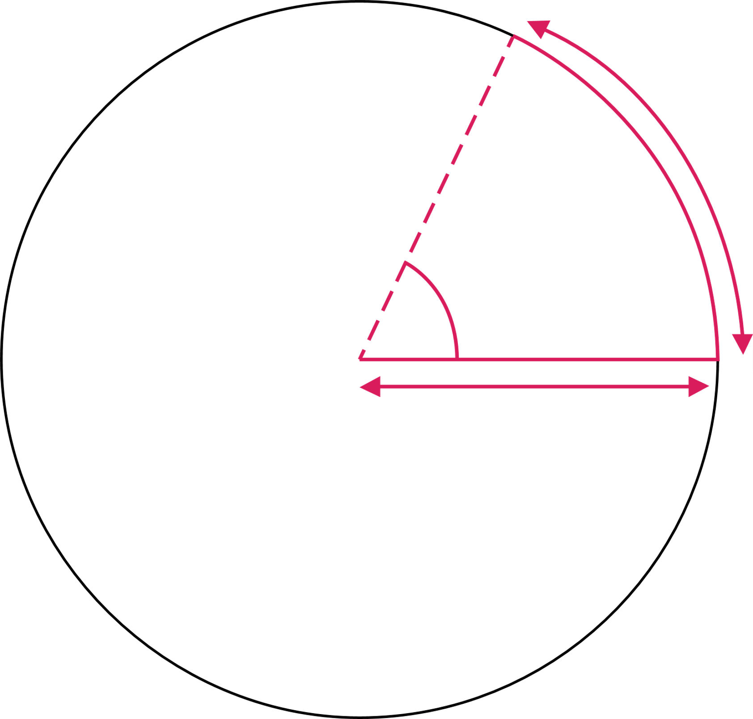
Angular velocity, torque and power out
2. Investigating torque, speed and current
If a force F rotates it becomes a torque 𝞽.
We measure angular velocity ω in radians per second:
There are 2π radians in one complete revolution.
𝞽
.
ω
P = 𝞽ω
radius r
𝞽
1 radian
For angular motion P = Fv becomes P = 𝞽ω
ω = speed N in RPM x 2π radians per second
60
(dividing by 60 converts ‘per minute’ to ‘per second’)
and so by substituting, we can write
P = 𝞽2πN
60
radius r
15
Notes:
Practitioner delivery notes
Activity
Introduce torque and angular velocity.
Optionally relate this back to learners’ Level 2 science learning about turning moments: a turning moment is a static force that acts at a distance from a pivot. If this force is able to rotate, it becomes a torque.
Introduce radians as an alternative way to describe an angle. Note that radians do not have a unit.
Highlight that for angular motion, P = 𝞽ω is the equivalent of P = Fv for motion in a straight line. The power equals the torque multiplied by its rotational speed in radians.
Review the derivation of the mechanical power output formula.
Highlight how we need to convert from RPM to radians by multiplying by 2π and dividing by 60 to go from per minute to per second.
Ask learners to identify the constants and the variables in the formula.
The constants are 2, π and 60, leaving only the torque 𝞽 and speed N in RPM as the variables that affect the mechanical power output.
Assessment
Understanding of derivation.

Slide 16
Understanding power, torque and current
2. Investigating torque, speed and current
This knowledge helps to explain why, in a shunt-wound DC motor, torque is proportional to current, as you previously found:
Remember that in a shunt-wound motor
V = E + I_{a}R_{a}
Since P = VI the mechanical power P = EI_{a}
We also know that P = 𝞽ω
Hence 𝞽ω = EI_{a} and so 𝞽 = I_{a} x E
ω
Torque is proportional to current.
Torque (Nm) v Current (A)
0.5
0.4
0.3
Torque (Nm)
0.2
0.1
0.0
0.0
0.2
0.3
0.4
0.5
0.6
Current (A)
16
Notes:
Practitioner delivery notes
This brief discussion builds on the introduction to back emf, current and resistance in Level 2 resource 1. Introducing electric motors to provide a mathematical explanation for learners’ earlier result that torque is proportional to current, and therefore the motor being modelled in the online interactive tool is series-wound. Learners may need to be reminded that P = VI from their level 2 science learning.
Activity
Remind learners of their earlier result: the torque in the online interactive tool is proportional to the current and so drawing on the initial slides, this suggests that the interactive models a shunt-wound DC motor.
Then, remind learners that in the first electrical machines resource they will have been introduced to the basic formulas for describing input voltage, back emf, resistance and current.
Work through the derivation on the left-hand side of the slide, which combines the electrical and mechanical formulas for mechanical power out. Learners may identify that power losses occur via I_{a}R_{a}, which the final resource explores in more detail.
Note that the back emf E is proportional to speed (and therefore ω) so E/ω is a constant.
Assessment
Recall that torque is proportional to current in a shunt-wound DC motor.
Recall of P = 𝞽ω from the previous slide. Recall of V = E + I_{a}R_{a} from the previous resource.

Slide 17
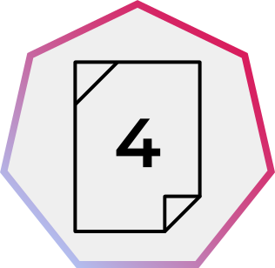
Investigating mechanical power
2. Investigating torque, speed and current
Radius (m) | Torque (Nm) | Rotation (RPM) | Power (W)
0.1 | 0.2 | 115.2 | 2.413
0.15 | 0.3 | 100.8 | 3.167
0.2 | 0.4 | 86.4 | 3.619
0.25 | 0.5 | 72 | 3.77
0.3 | 0.6 | 57.6 | 3.619
0.35 | 0.7 | 43.2 | 3.167
0.4 | 0.8 | 28.8 | 2.413
0.45 | 0.9 | 14.4 | 1.357
0.5 | 1 | 0 | 0
In the Electrical machines interactive tool, verify that P_{out} = 𝞽2πN
Choose two combinations of radius and mass. Use the values for torque, rotational speed and mechanical power to verify the relationship. Use π = 3.14159.
The table on the left shows how torque, rotation speed and power change as the radius increases when lifting a mass of 0.2 kg. (Remember that 1 W = 1 Nm/s). Use the power formula above to help you interpret the table and suggest why power increases to a maximum, but then decreases.
60
17
Notes:
Practitioner delivery notes
Activity
Explain that learners are first going to use the Electrical machines interactive tool to verify that the mechanical power output of the interactive tool matches what the formula predicts.
Learners first choose two radii and masses and apply the formulas. (Two example calculations are below.)
To investigate how power varies with output (and verify their interpretation of the previous graph) learners should look carefully at how torque and rotation vary with radius, before then looking at how power varies with radius and sketch/write their interpretation on the activity sheet.
Ask learners to consider why varying the radius while keeping the mass constant is one way to vary the power requirement on the motor.
Activity sheet
Learners complete their verifications and interpret the table of results on Electrical machines - Activity sheet 4.
Example answers
For r = 0.25 m and m = 0.35 kg the mechanical output power is (0.875 x 2 x 3.14159 x 18)/60 = 1.649 Nm
For r = 0.40 m and m = 0.20 kg the mechanical output power is (0.800 x 2 x 3.14159 x 28.8)/60 = 2.413 Nm
Please also see the next slide.
Assessment
Verification of formula.
Interpretation of results table.

Slide 18
Investigating mechanical power – answers
2. Investigating torque, speed and current
The mechanical power output is proportional to rotational speed x torque.
For a fixed mass, increasing the radius increases the load on the motor. Hence the power of the motor first increases with load before decreasing after maximum power is reached.
How else could you verify this using the Electrical machines interactive tool?
What practical considerations do you think this power output curve raises for an engineer?
Rotational speed is inversely proportional to the radius:
… while torque is proportional to the radius:
125
1.00
100
0.75
75
Torque (Nm)
Rotation (RPM)
0.50
50
25
0.25
0.0
0.1
0.2
0.3
0.4
0.5
0.0
0.1
0.2
0.3
0.4
0.5
Radius (m)
Radius (m)
4
… and when torque and rotational speed are multiplied within the power formula, this has the result of creating a curve for power output against radius:
3
Power (W)
Fastest lift speed is at maximum power output
2
1
0.0
0.1
0.2
0.3
0.4
0.5
Radius (m)
18
Notes:
Practitioner delivery notes
Activity
Review how the three graphs on the slide interpret the columns in the table and explain the curve in the mechanical power output.
Rotational speed in RPM has an inversely proportional relationship to the radius.
Torque has a proportional relationship to radius.
When each pair of values (ie for a given radius) is multiplied within the formula for mechanical power output, their product increases to a maximum value before decreasing again.
The reason why varying the radius creates these results is that increasing the radius increases the load on the motor because it moves the downwards force of the weight of the load further from the pivot point at the centre of the axle.
Discuss the questions at the bottom of the slide.
Example answers
A more direct way to investigate this would be to keep the radius constant and increase the mass.
An engineer selecting a motor would need to know the maximum load it must work under in order to select a motor with sufficient power to move this load at the desired speed.
Assessment
Discussion of answer graphs and interpretation.
Verbal answers.

Slide 19
Learning outcomes
2. Investigating torque, speed and current
You will be able to:
Describe how torque and speed vary with current in a series-wound and shunt-wound DC motor.
State the formula for calculating the output power of an electric motor.
Calculate the mechanical power of a motor based on its rotational speed and torque.
Image © This Is Engineering
19

