Slide 1
Microcontroller systems
2. Sensors and signals

Slide 2

2. Sensors and signals
2

Slide 3

Learning outcomes
You will be able to:
Understand the role of signal conditioning and analogue to digital conversion.
Perform calculations to find output voltage and digital outputs.
Select a sensor component to match a functional specification.
Image © Ocado Technology
3

Slide 4



Control systems recap
What is the
role of each part of this control system?
What do the arrows represent?
What is the importance of feedback in a control system?
How many examples of input devices or sensors can you name?
Input
device
Input
Electronic controller
Output
Output
device
Feedback
Sensor
4

Slide 5
Sensors and output signals
Input devices and sensors can create a variety of output signals.
On the activity sheet, list some sensors that produce each type of output.
Discuss how you would describe how each output signal changes and what values the signal can have.
On
Max
255
Off
Min
0
Push switch
Variable resistor
Linear encoder
5

Slide 6
Sensors and output signals - answers
Push switch
Variable resistor
Linear encoder
On
Max
255
Off
Min
0
Sensors
Sensors
Sensors
Microswitch
Tilt switch
Reed switch
Magnetic switch
Push button switch
Thermistor
Variable resistor
Light-dependent resistor
Flow meter
Rotary encoder
Linear encoder
Accelerometer
Digital temperature
sensor
6

Slide 7
Analogue signal conditioning
Signal conditioning converts analogue output signals to a common range.
This allows microcontrollers and PLCs to use a standard input circuit.
One common standard is for sensors to produce a current from 4 mA (min) to 20 mA (max).
This can be converted into 1 - 5 V by passing the current through a 250 Ω resistor.
Complete the table on your activity sheet to show:
What output these three sensors will produce across a 250 Ω resistor.
What reading each output current represents.
What digital resolution is possible with 256 steps.
What digital output the ADC would give for each reading.
Identify why a minimum current of 4 mA may be helpful.
Unit | Range | Output current
ºC | 0 to 100 ºC | 12 mA
mm | 0 to 200 mm | 16 mA
Bar | 0 to 1 Bar | 6 mA
E.g. a sensor produces an 8 mA current. 0.008 x 250 = 2 V.
7

Slide 8
Analogue to digital converters (ADCs)
After signal conditioning, a sensor’s analogue output voltage may be
converted into a digital signal.
The resolution (number of possible digital values) depends on the number
of ‘bits’ the ADC uses.
What resolution is possible
for the sensors in the table below?
What digital output would the ADC give for each reading?
Discuss why the resolution may not be the same as the sensor’s sensitivity.
Unit | Range | Output voltage
ºC | 0 to 100 ºC | 3 V
mm | 0 to 200 mm | 4 V
Bar | 0 to 1 Bar | 1.5 V
An 8-bit ADC represents
4 to 20 mA or 1 to 5 V as digital values
from 0 to 255.
This ADCs digital output
for a sensor output aV is
256 x (a-1)
4
8

Slide 9
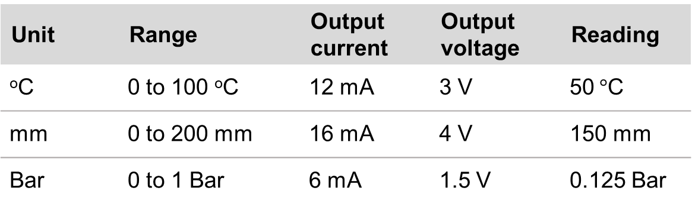

Answers
Analogue signal conditioning
4 mA helps to identify faults, which may produce zero current.
4 mA can also provide power for active sensors.
Analogue to digital conversion
The sensor may only be accurate to less than the ADCs resolution, for example, to the nearest 1$°$C rather than 0.4 $°$C.
Unit | Range | Output current | Output voltage | Reading
ºC | 0 to 100 ºC | 12 mA | 3 V | 50$°$C
mm | 0 to 200 mm | 16 mA | 4 V | 150 mm
Bar | 0 to 1 Bar | 6 mA | 1.5 V | 0.125 Bar
Unit | Range | Output | Resolution | Digital output
ºC | 0 to 100 ºC | 3 V | 0.4 ºC | 128
mm | 0 to 200 mm | 4 V | 0.8 mm | 192
Bar | 0 to 1 Bar | 1.5 V | 0.004 Bar | 32
9

Slide 10
Sensor specifications table
Component | Specification | Output signal
Rotary encoder 1 | 0 to 360º, free rotation, 24 steps per revolution, absolute | Digital, 8-bit
Tachogenerator 1 | 9 mV/RPM, 10 mm shaft, +/-3% | 0 to 250 V, analogue
Thermistor 1 | 0 to 100 ºC, 0.5º resolution, steep slope | 1 to 5 V, analogue
IR sensor 1 | 2 uM, 0 to 1000 ºC, 1º resolution | 4 to 20 mA via USB or analogue
Rotary encoder 2 | 0 to 360º, free rotation, 360 steps per revolution, incremental | Digital, 12 bit
Thermistor 2 | 0 to 250 ºC, 0.5º resolution, weak slope | 1 to 5 V, analogue
Tachogenerator 2 | 10 mV/RPM, 10 mm shaft, +/-5% | 0 to 250 V, analogue
IR sensor 2 | 5 uM, 0 to 500 ºC, 0.1º resolution | 4 to 20 mA via USB
Thermistor 3 | 0 to 100 ºC, 0.1º resolution, steep slope | 1 to 5 V, analogue
IR sensor 3 | 5 uM, 0 to 1000 ºC, 0.5º resolution | 4 to 20 mA, analogue
Rotary encoder 3 | 0 to 360º, free rotation, 360 steps per revolution, absolute | Digital, 12 bit
Tachogenerator 3 | 10 mV/RPM, 10 mm hollow shaft, +/-5% | 0 to 250 V, analogue
10

Slide 11




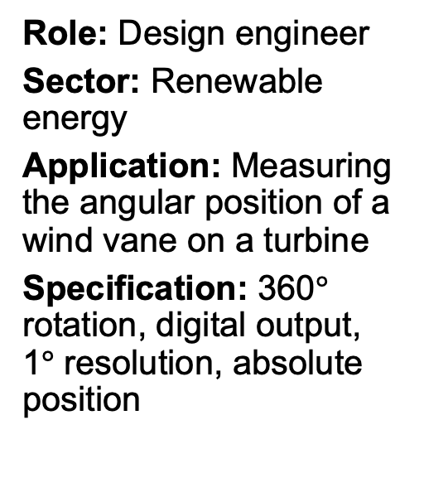
Select the right sensor
Role: Process improvement engineer
Sector: Food production
Application: Detecting whether jars of baby food have reached sterilisation temperature
Specification: Non-contact, 5 µM wavelength, 70 to 120 $°$C, 0.1 $°$C resolution
Role: Design engineer
Sector: Renewable energy
Application: Measuring the angular position of a wind vane on a turbine
Specification: 360$°$ rotation, digital output, 1$°$ resolution, absolute position
Role: CNC maintenance engineer
Sector: Manufacturing
Application: Measuring rotational speed of CNC router spindle
Specification:
10 V/ 1000 RPM,
10 mm hollow shaft, +/- 5% accuracy
Role: HVAC engineer
Sector: Commercial greenhouses
Application: Measuring air temperature so tomatoes can be kept at 21 to 24$°$C
Specification: 0 to 50 $°$C, 0.1 $°$C resolution, steep slope (fast resistance change with temperature)
11

Slide 12
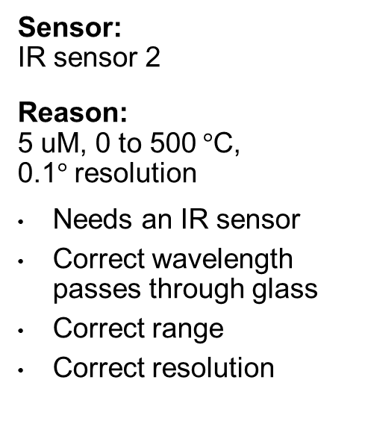
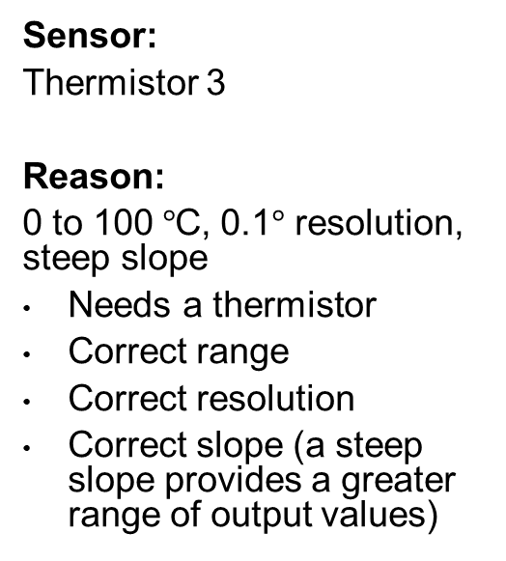
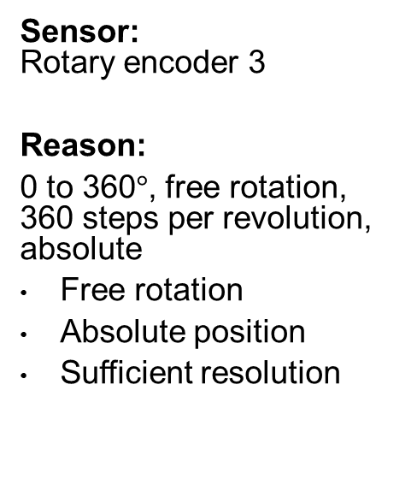
Select the right sensor
Process improvement engineer
Design engineer
CNC maintenance engineer
HVAC engineer
Sensor:
IR sensor 2
Reason:
5 uM, 0 to 500$°$C, 0.1$°$ resolution
Needs an IR sensor
Correct wavelength passes through glass
Correct range
Correct resolution
Sensor:
Rotary encoder 3
Reason:
0 to 360$°$, free rotation, 360 steps per revolution, absolute
Free rotation
Absolute position
Sufficient resolution
Sensor:
Tachogenerator 2
Reason:
10 mV/RPM, 10 mm shaft, +/-5%
Correct shaft diameter
Sufficient accuracy
Correct output
Sensor:
Thermistor 3
Reason:
0 to 100$°$C, 0.1$°$ resolution,
steep slope
Needs a thermistor
Correct range
Correct resolution
Correct slope (a steep slope provides a greater range of output values)
12

Slide 13

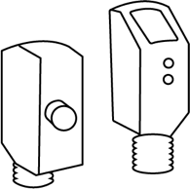
Classifying sensors
Analogue output
Digital output
Passive sensor
(responds
to its environment, so does not require a power source)
Light-dependent resistor (LDR)
Reed switch
Active sensor (requires a power source to emit a signal that is scattered back to the sensor)
3-axis accelerometer chip
Laser distance
13

