Slide 1
CNC machinery
1. Understanding CNC machines

Slide 2
CNC machinery
1. Understanding CNC machines
2

Slide 3
Learning outcomes
1. Understanding CNC machines
You will be able to:
Know what CAD, CAM and CNC stand for and be able to define each.
Identify and describe common forms of CNC machining.
Identify some advantages and disadvantages of using CNC.
Image © This Is Engineering
3

Slide 4
What does CNC mean?
1. Understanding CNC machines
CNC machines are used in a wide range of engineering and manufacturing environments.
Discuss the two images on the left. What is the key difference that helps to explain what CNC means?
Can you expand and define the following terms: CAD, CAM and CNC?
Image © This Is Engineering
4

Slide 5
What does CNC mean? Answers
1. Understanding CNC machines
Design code
Tool path code
CAD: computer-aided design
CAD uses computer software to create digital designs for objects or components.
CAM: computer-aided manufacturing
CAM uses computer software to generate tool paths and instructions to create these designs. (Also known as computer-aided modelling.)
CNC: computer numerical control
CNC codes drive toolhead and machine movements to machine materials and form these designs.
CNC is a form of automation and therefore requires a control system with inputs, processing, outputs and feedback.
Describe what the input, control, output and feedback elements a CNC machine might be (their type) or do (their function).
Image © This Is Engineering & rawpixel.com on Freepik
5

Slide 6
The CNC control process
1. Understanding CNC machines
CNC is an example of automation and so it is helpful to think of a CNC machine as a control system:
Input
Output
Finished workpiece
Input device
Machine control unit
Machine drive system
A display monitor shows the program and other control or operating data​.
Computer or microprocessor follows input instructions, adjusts in response to feedback.
Amplifier circuits drive motors and ball lead screws that control the tool head.
This control system is common to all types of CNC machines.
Can you name or describe some different types of CNC machine?
Feedback
Sensors
Position and speed transducers continuously monitor the tool head.
6

Slide 7
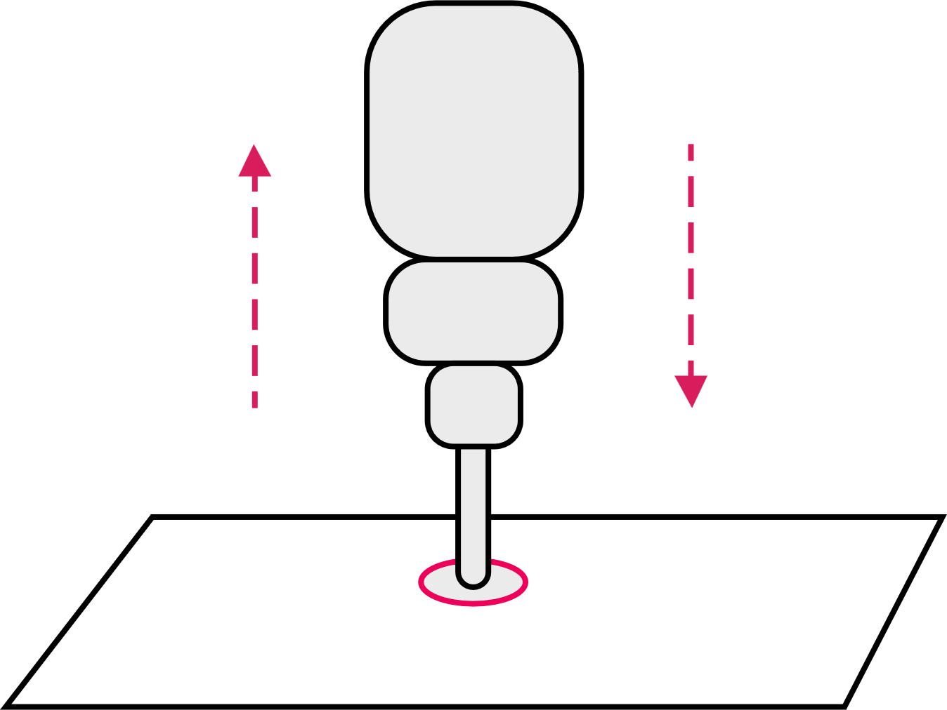
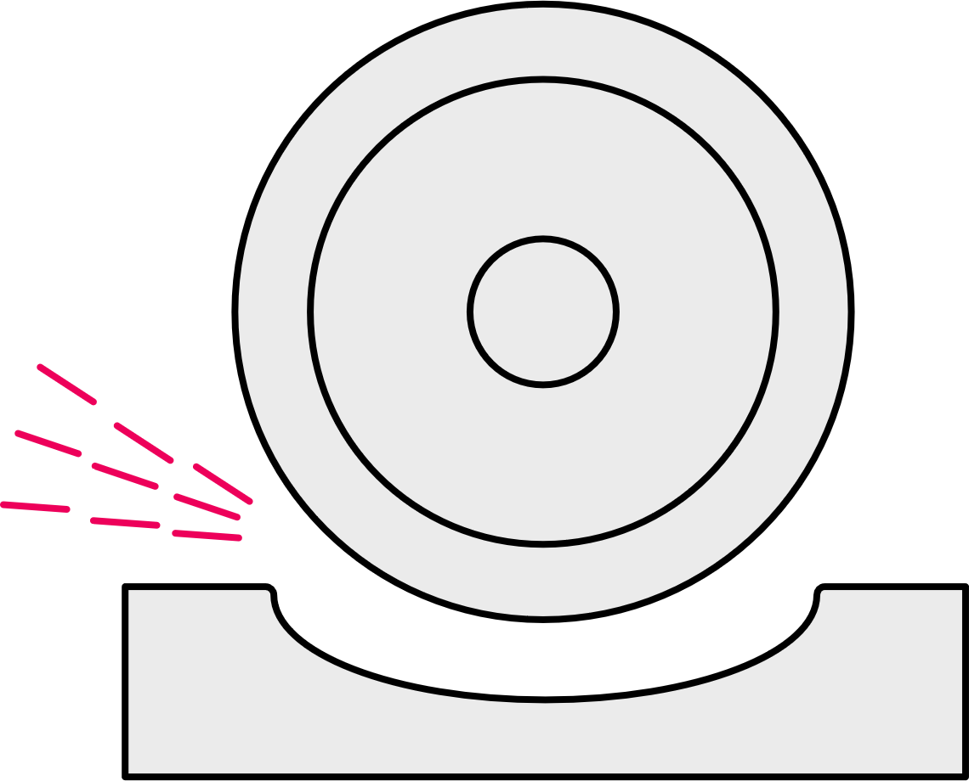
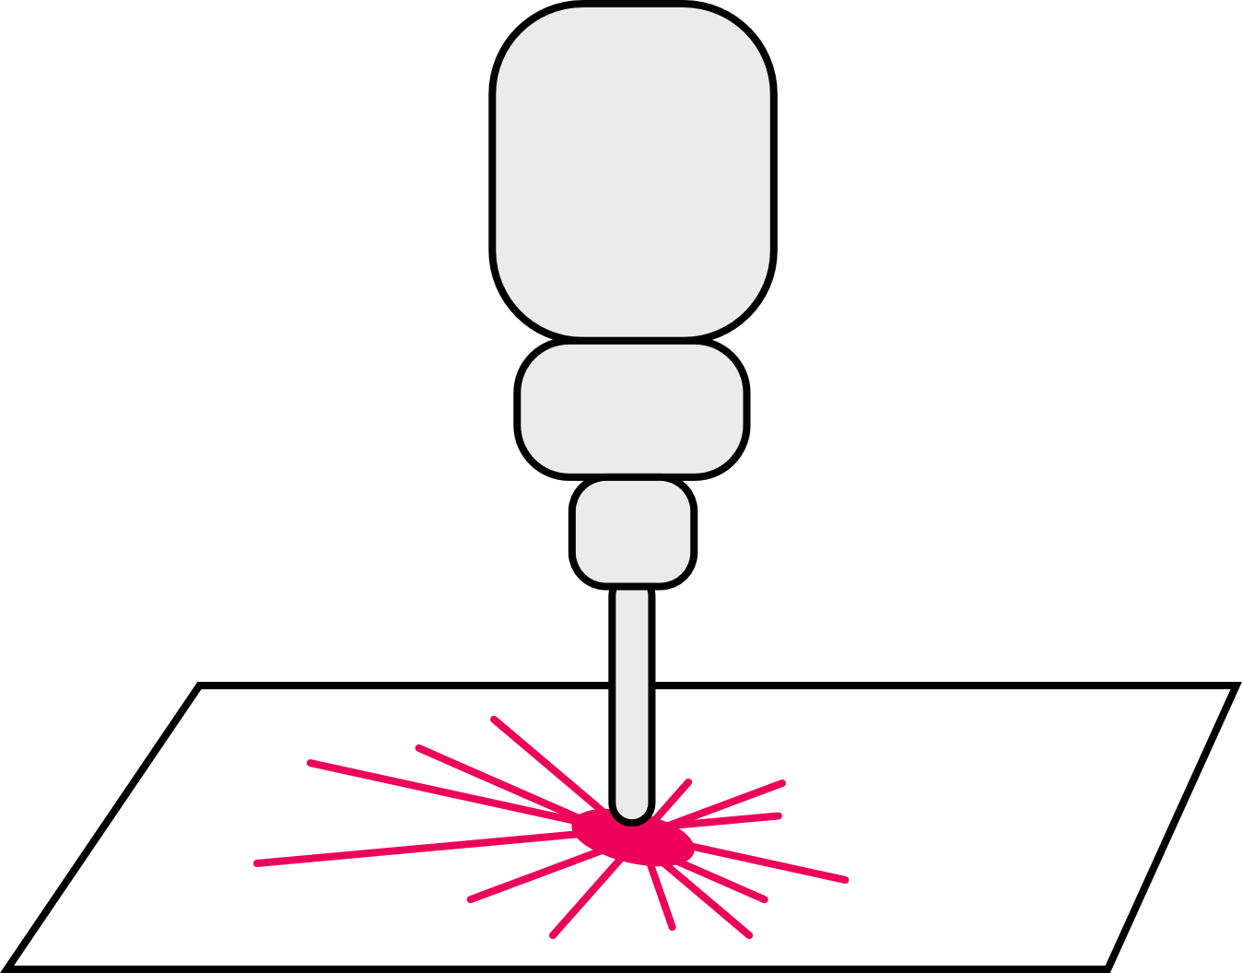
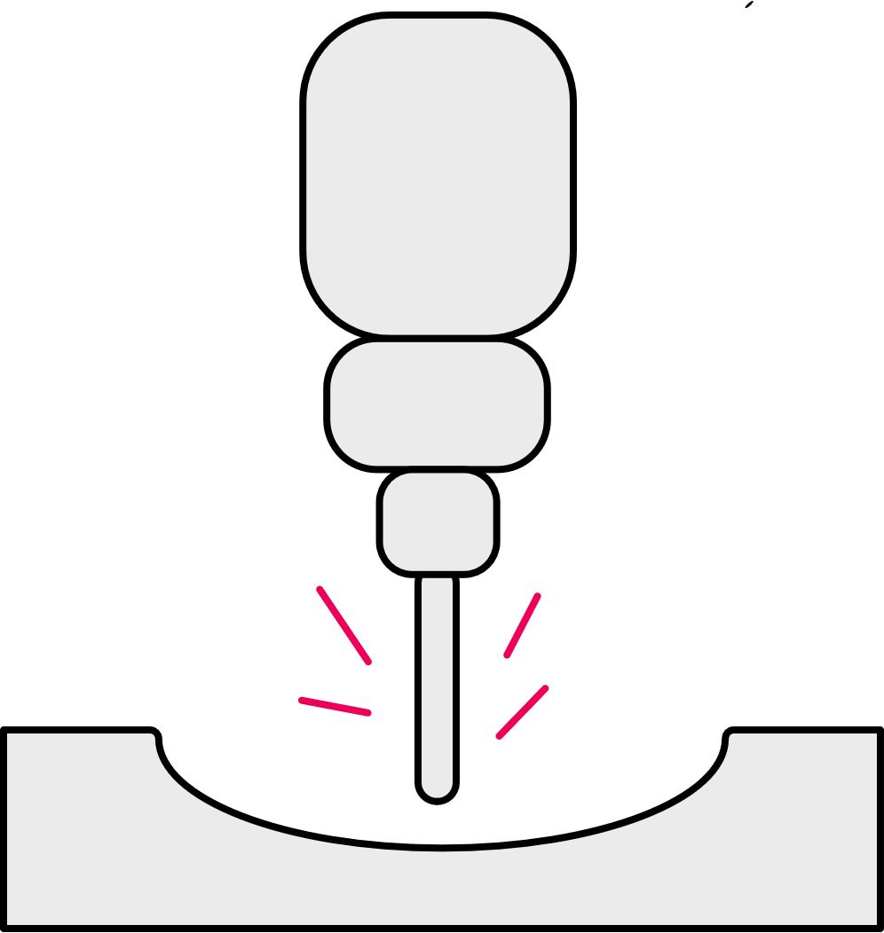
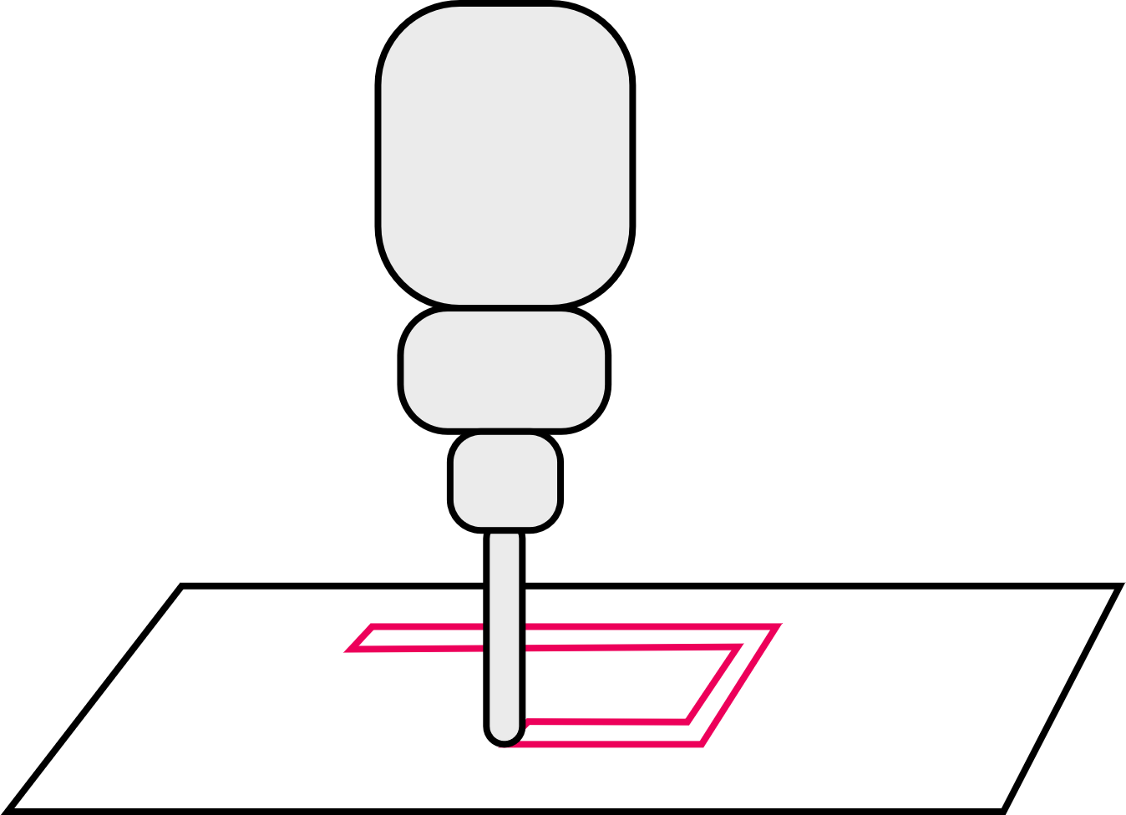
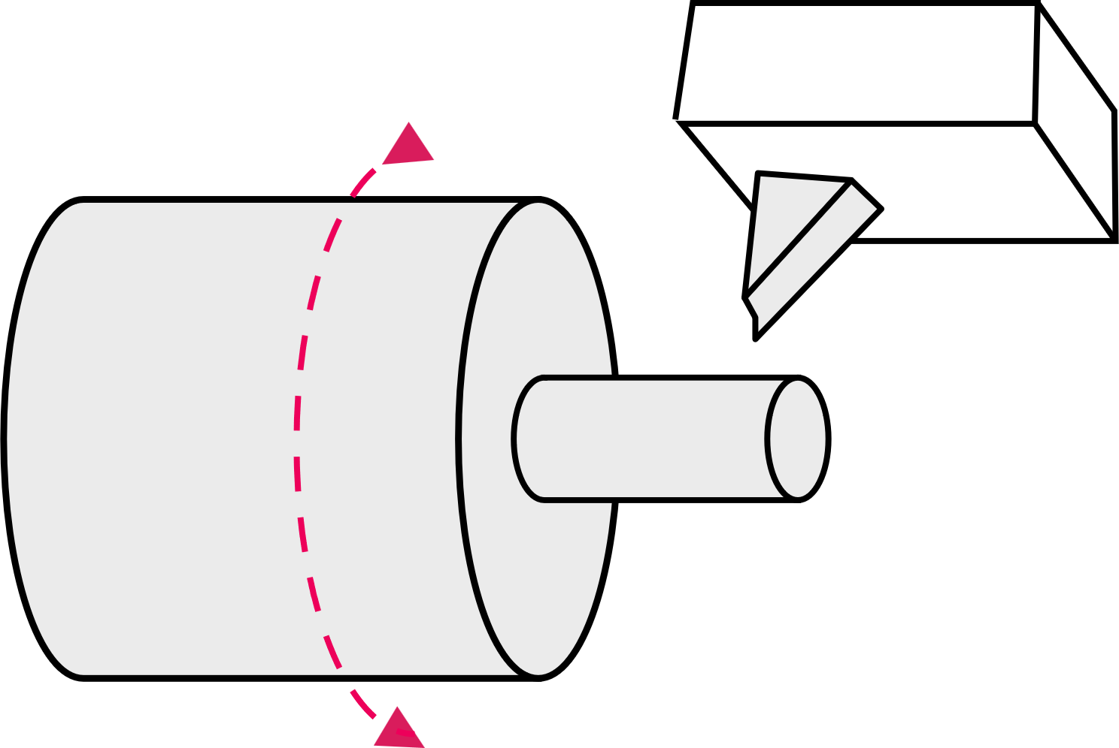
Common CNC machines
1. Understanding CNC machines
Laser or plasma cutting
Drilling
Grinding
Lathe
Milling
Router
Drilling, reaming or tapping holes of different depths and diameters.
An abrasive wheel or cylinder produces a fine, accurate finish.
Cutting that uses a laser or plasma to create a cut line and edge in sheet material.
Cutting a cylinder of material as it spins on an axis.
Detailed, precise cutting of hard materials in 3D.
Simple cutting of softer materials, usually sheet material.
Discuss each type of machine:
What type of components can be produced?
What type of materials can be used?
7

Slide 8
Common CNC machines
1. Understanding CNC machines
Laser or plasma cutting
Drilling
Grinding
Latahe
Milling
Router
Adding holes and screw threads to parts in almost any material, shaped using other CNC machines.
Creating a fine finish on parts shaped using other CNC machines.
Cutting shaped parts from sheet metal such as flat components, lattice or grid parts, or certain small gears.
Cylindrical parts in metals or wood including furniture parts, axles, bolts, camshafts.
Any 3D metal part such as engine blocks, structural parts, bevel, screw or worm gears, impellers.
Cutting shaped parts from wood, plywood, MDF or laminated composites such as flat components, furniture parts.
These are all examples of subtractive manufacturing, where material is removed to create the finished part.
8

Slide 9
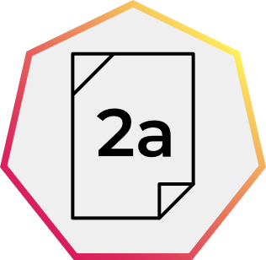
Why is CNC used?
1. Understanding CNC machines
CNC machines, along with CAD/CAM packages, can represent a significant investment cost to buy and overhead cost to maintain. However, this can be offset by the reduced cost of hiring and training skilled labour to manually produce parts.
What broader advantages might motivate a company to invest in CNC?​
Are there any other disadvantages to investing in CNC that the company might need to consider?
Image © This Is Engineering
9

Slide 10
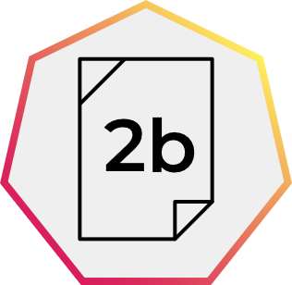
Why is CNC used? Answers
1. Understanding CNC machines
Advantages | Disadvantages
Safer – operators are not exposed to material or cutting tools. Can run 24 hours a day, for higher productivity and large production volumes. Higher degree of control, for higher quality and consistency. Range of processes (drill, cutting, mill, threading, tapping etc.) creates flexibility. Reduces wastage – helps with overall production costs. More complex multi-axis machines can produce complex forms. Feedback systems indicate wear for planned maintenance and less unplanned downtime. | Operators need training, including in simple computer operation. May lead to workforce redundancies. Faults require highly skilled maintenance, usually contracted in. Faults may halt entire production line.
Use your answers to consider what advice you would give to a small local company that produces a range of bespoke designs. Are there reasons to use manual machining, or should they also invest in CNC?
10

Slide 11
CNC in small-run settings
1. Understanding CNC machines
Manual machining still has many advantages for a small-run or bespoke engineering company:
Lower set up costs and overheads​.
Responsive: easier to make changes and experiment with ideas.​
Shorter turnaround time to set up machines.
Skilled operators understand machine limitations.
Ideal for simple components, low volume​.
However, even if producing small numbers of parts, these may need to be machined to exacting specifications, in which case customers may be willing to pay the increased cost for precision parts made using CNC.
These customers may include:
aerospace
research and development
scientific research
space exploration
other precision engineering companies who outsource work.
Image © This Is Engineering
11

Slide 12
CNC in your engineering career
1. Understanding CNC machines
What parts or products are produced in the engineering or manufacturing sectors of interest to you?
What types of CNC machine will produce these?
A CNC operator is seen as a highly skilled job. What knowledge and skills do you think a CNC operator needs?
Image © This Is Engineering
12

Slide 13
CNC in your engineering career – example
1. Understanding CNC machines
Sector | Part or product | CNC machines used | Knowledge and skills needed
Motorbike engineering | Brake levers | Mill – to shape Drill – create and tap holes Grinder – finish surface | Machine safety Personal safety and protection Machine operation Machine control (eg program loading) Material properties Required tolerances and quality level
13

Slide 14
Learning outcomes
1. Understanding CNC machines
You will be able to:
Know what CAD, CAM and CNC stand for and be able to define each.
Identify and describe common forms of CNC machining.
Identify some advantages and disadvantages of using CNC.
Image © This Is Engineering
14

